Slide 1
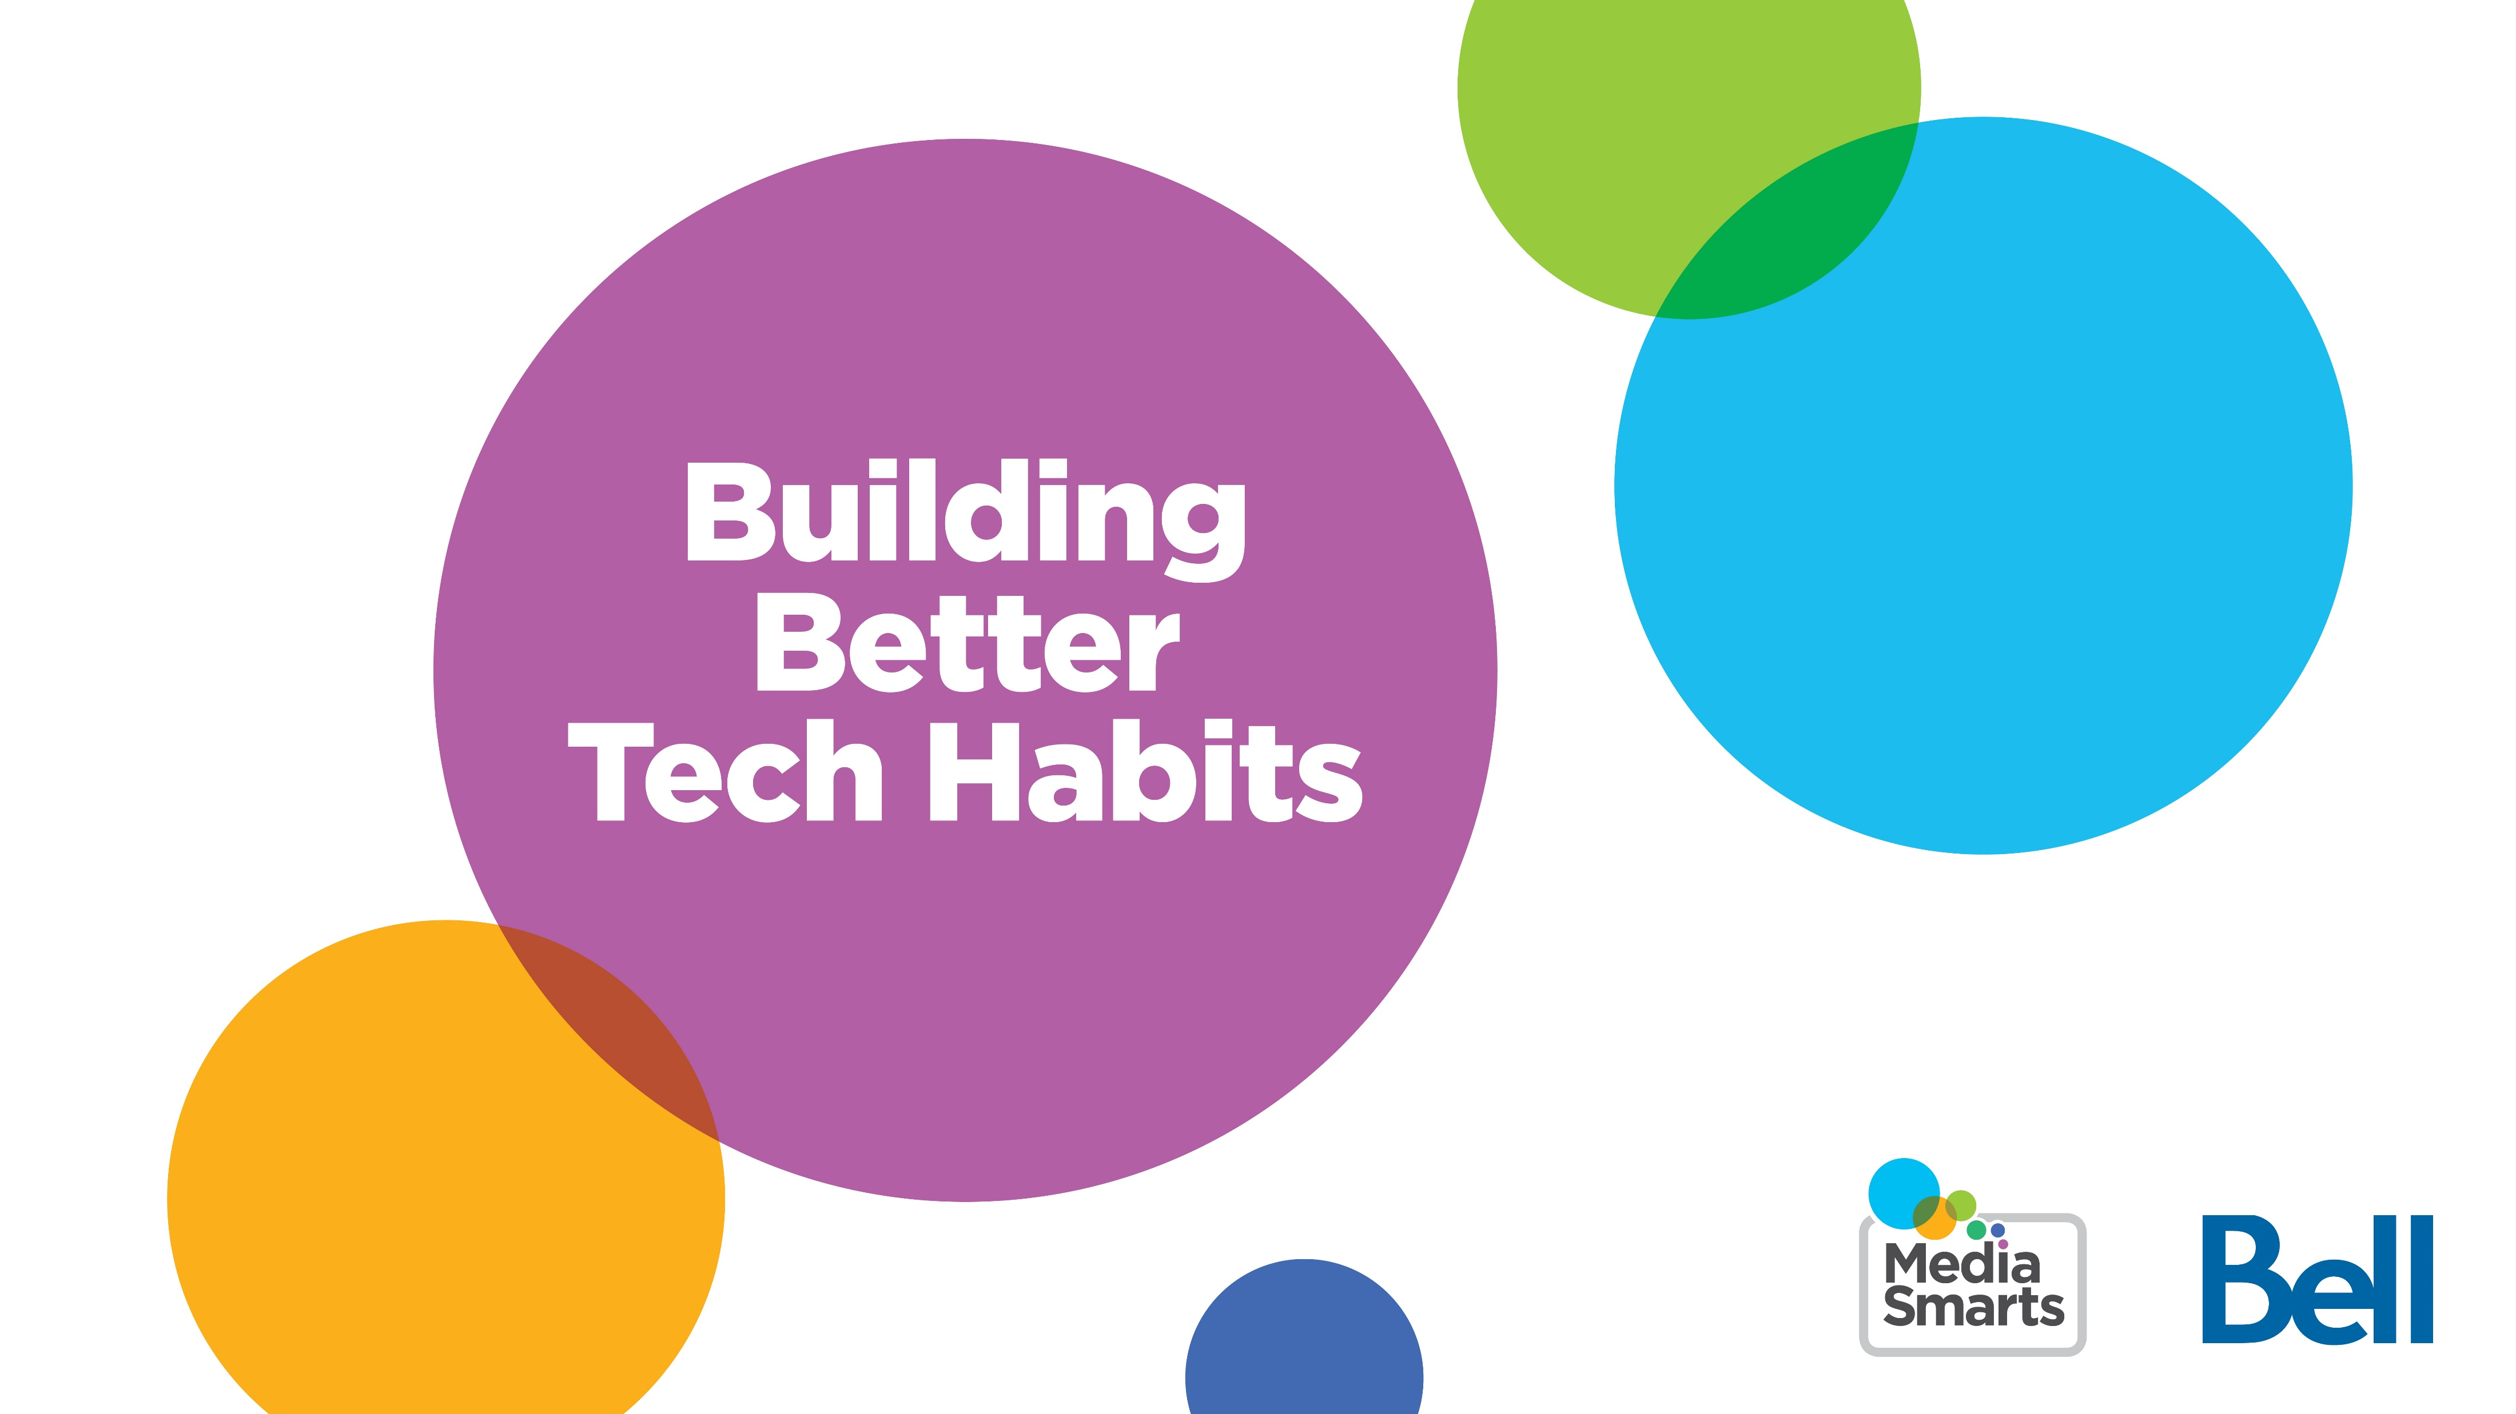
Building Better Tech Habits
Notes:
Welcome to our workshop on building better tech habits.
Screen time is one of parents’ top tech-related concerns, according to MediaSmarts’ research, and it’s the most common source of tech-related conflict between parents and young people in Canada. Kids are worried about their screen use too: almost half say they spend too much time on their phones. So what is the best way to address what’s become one of our top concerns relating to media and technology?

Slide 2
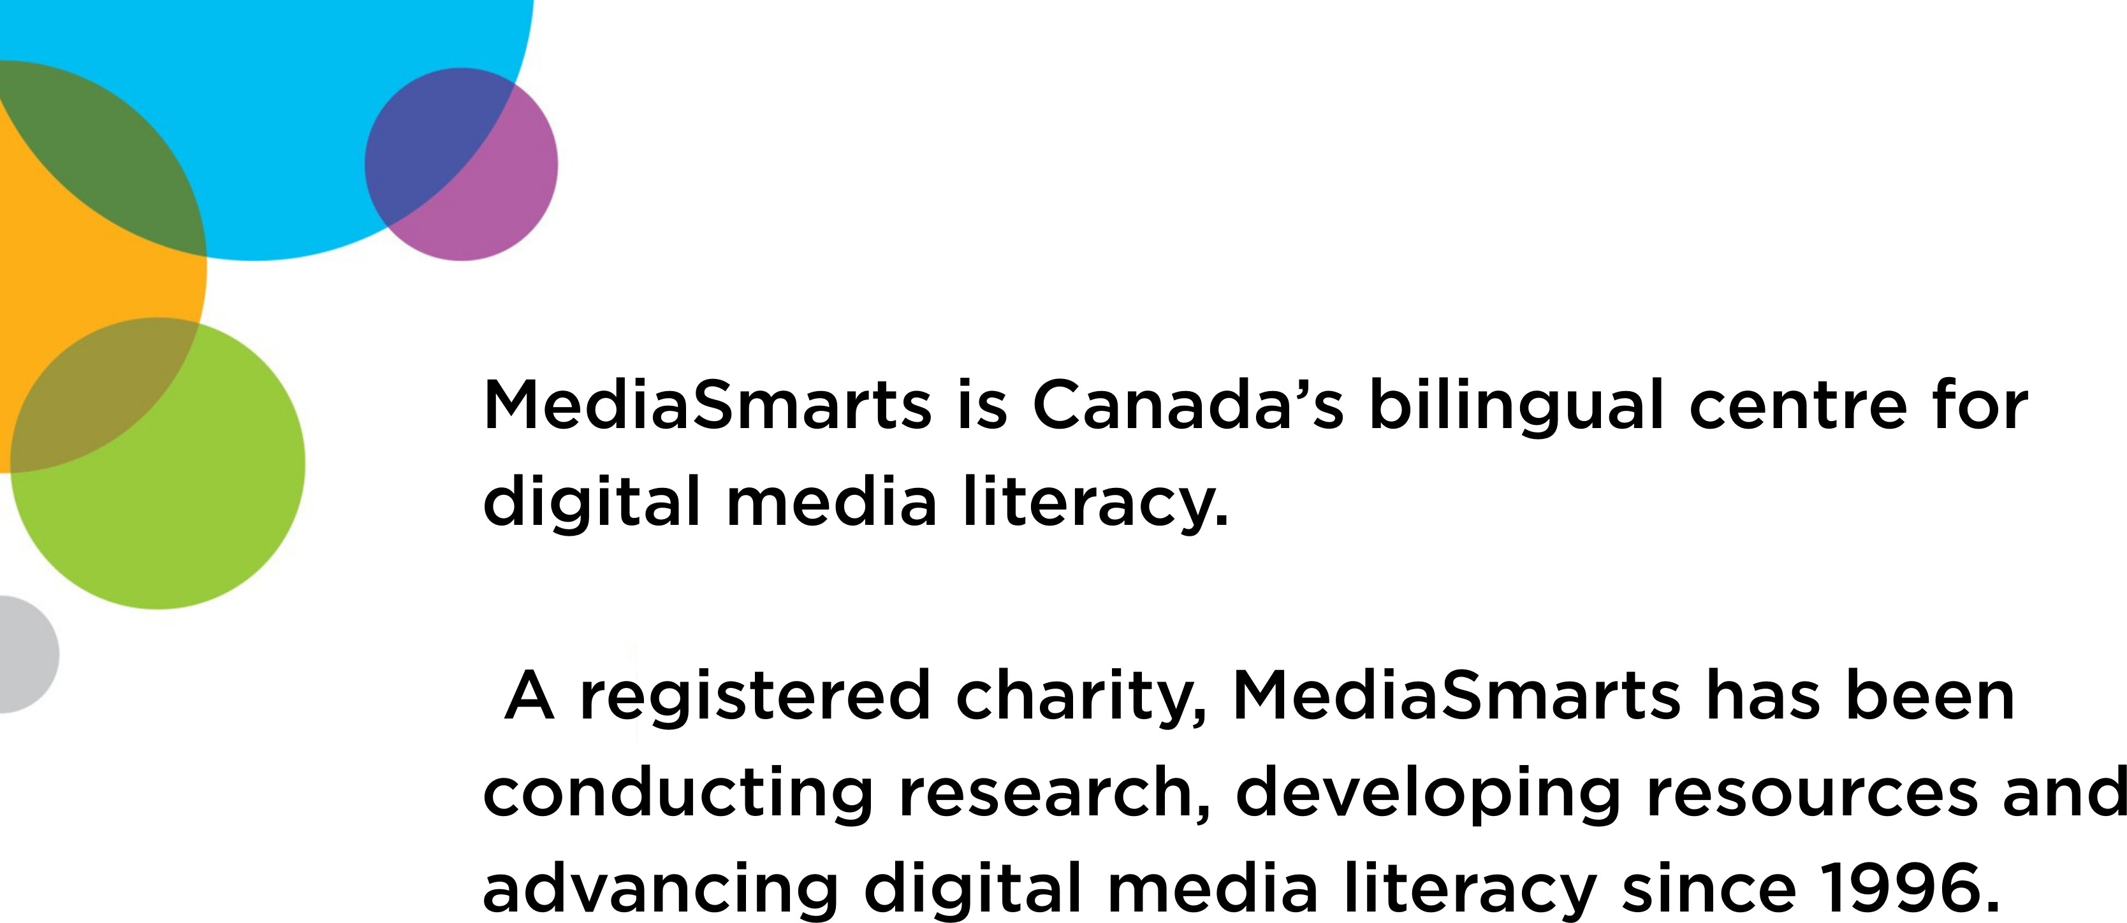
MediaSmarts is Canada’s bilingual centre for digital media literacy.
A registered charity, MediaSmarts has been conducting research, developing resources and advancing digital media literacy since 1996.
Notes:
First I'd like to tell you about our organization. MediaSmarts Canada’s bilingual centre for digital media literacy. We’re a registered charity and we’ve been conducting research, developing resources and advancing digital media literacy since 1996.
All of our resources and workshops are grounded in the best available evidence and research, including the original research that we conduct. We’ve been researching the digital lives of young Canadians since 2000 in an ongoing study called Young Canadians in a Wireless World. This internationally renowned study is foundational to all the work that MediaSmarts does and will continue to inform policy and set benchmarks for research on children’s digital lives.

Slide 3
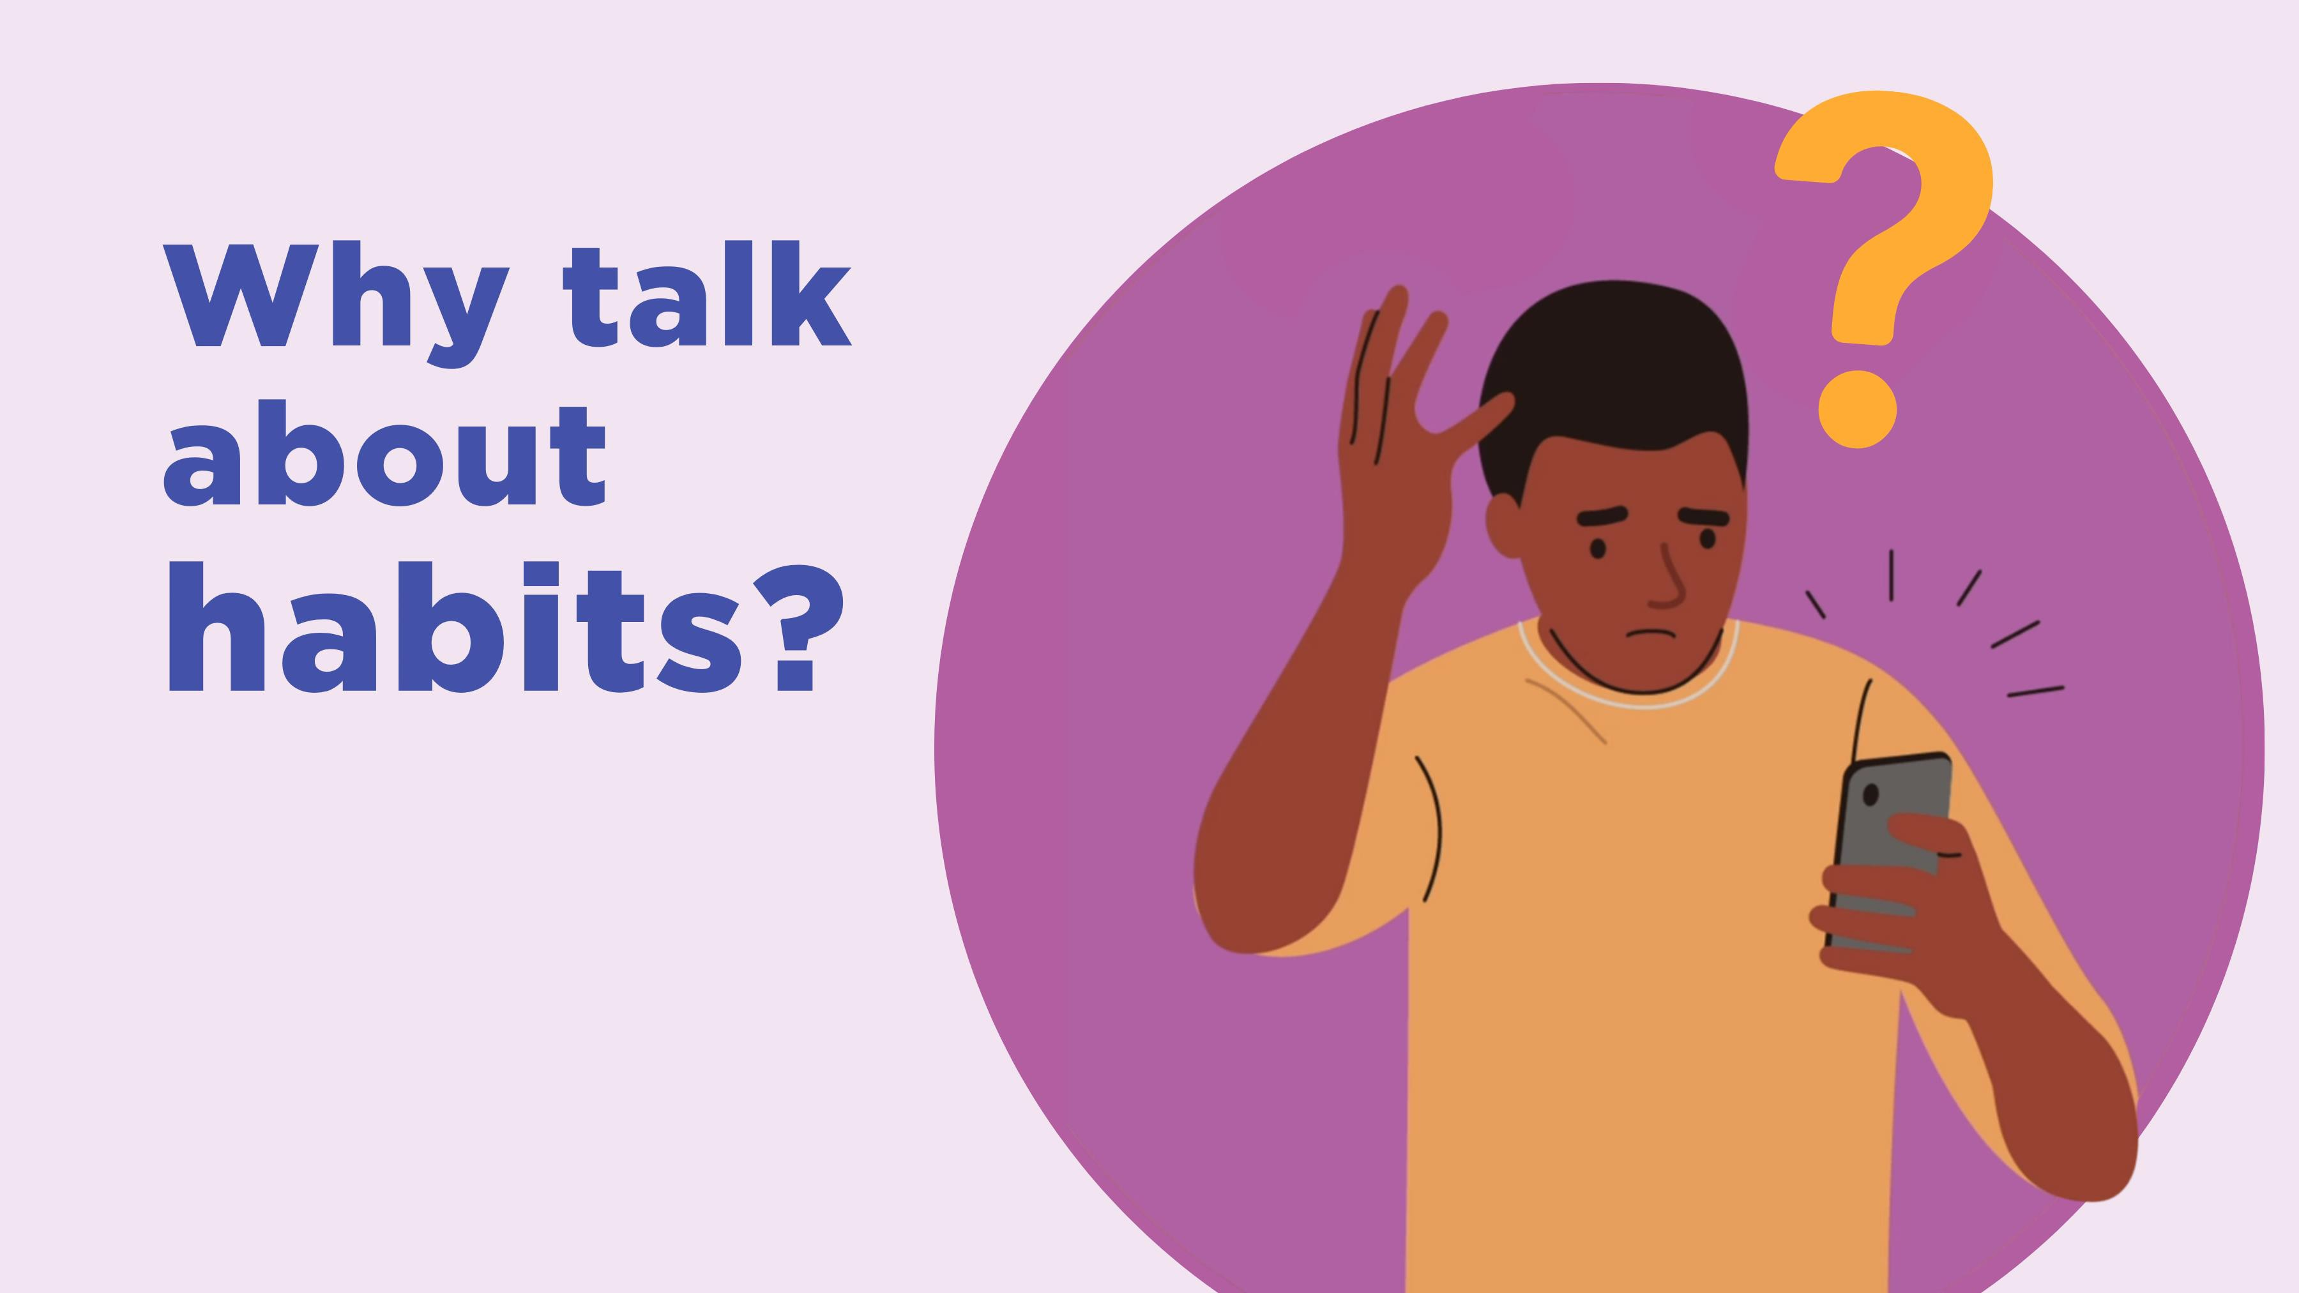
Why talk about habits?
Notes:
So why do we talk about tech “habits” instead of “addiction”?
First, there’s very little evidence that any of the devices or apps we use are addictive in the way that substances like tobacco or even activities like gambling are.
Talking about addiction can also backfire, giving us an excuse to not do anything to change the role that screens play in our lives. Teens will often readily admit to being “addicted” to their phones or to social media, but our research found that kids who were worried about screen time didn’t spend any less time online.

Slide 4
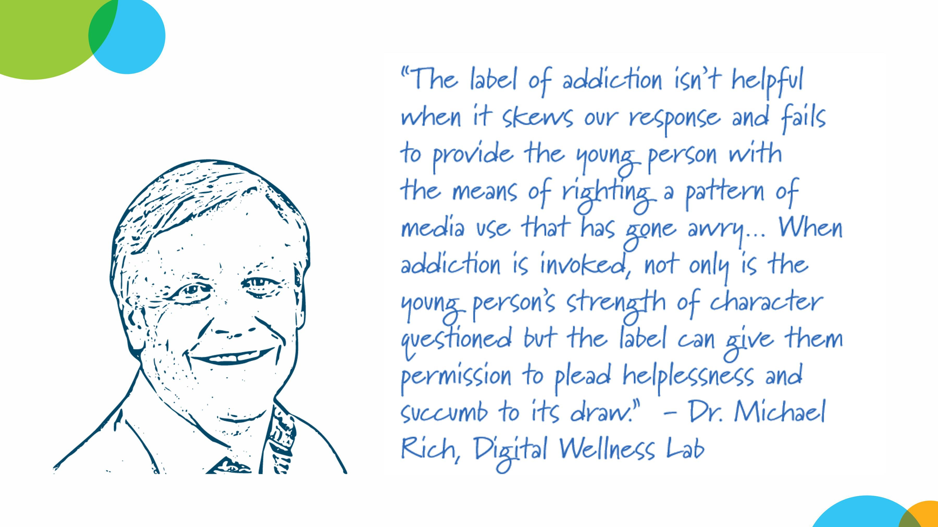
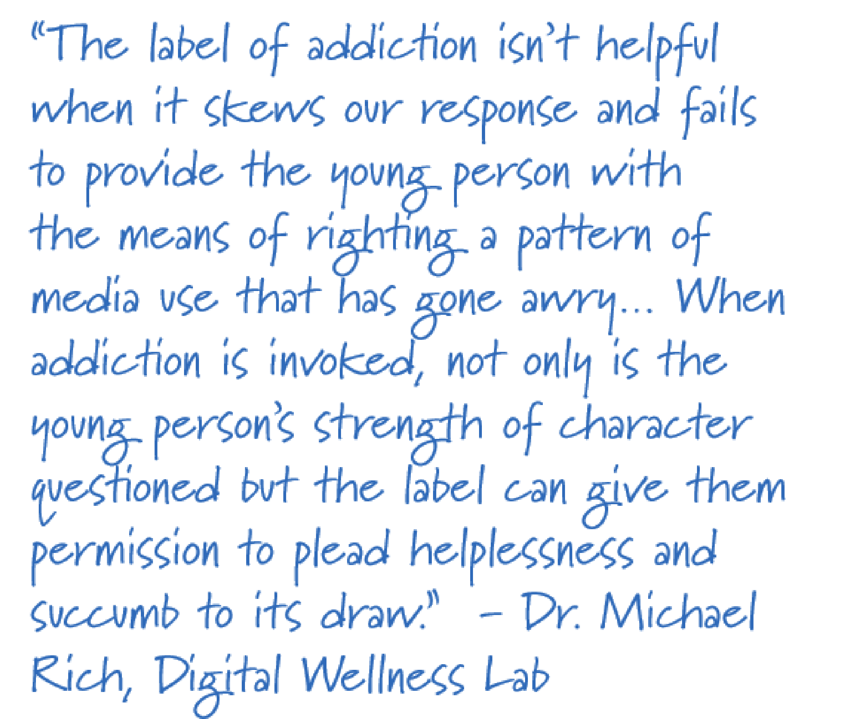
Why talk about habits?-1
Notes:
As Dr. Michael Rich, founder of the Digital Wellness Lab and a pioneer in treating problematic media use, puts it, “The label of addiction isn’t helpful when it skews our response and fails to provide the young person with the means of righting a pattern of media use that has gone awry… When addiction is invoked, not only is the young person’s strength of character questioned but the label can give them permission to plead helplessness and succumb to its draw.”

Slide 5
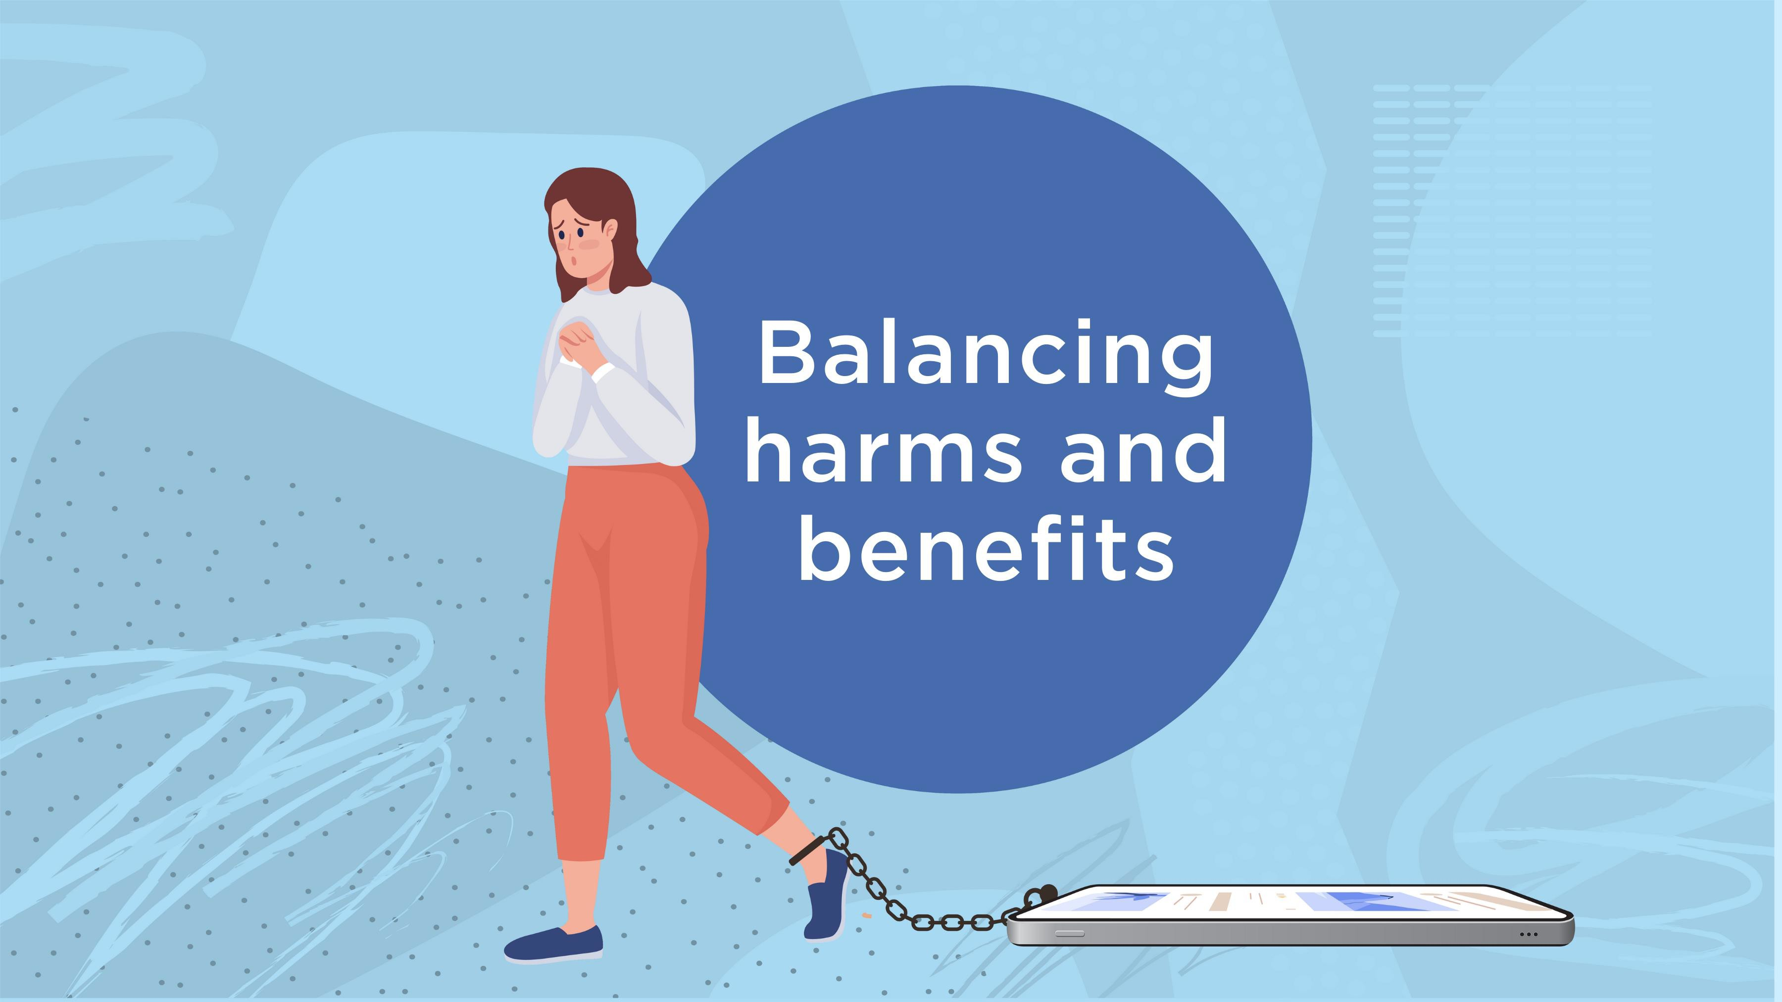
Balancing harms and benefit
Notes:
Thinking in terms of addiction also suggests that the only solution is abstinence – which is unrealistic when we consider that students need to go online for schoolwork, and most will eventually use devices at work. Not only that, but as parents, we probably don’t want to take their phones away: in fact, two-thirds of kids say they were given their first phone not because they asked for it, but because their parents wanted to be able to keep in touch with them.
As well, unlike genuinely addictive substances, phones and social media also provide kids with lots of benefits, from social connection to education to self-expression – and research suggests that those youth who are most vulnerable to the harms also get the most benefit.
With the exception of the very youngest kids, therefore, our goal is not to reduce screen time as much as possible but to help them develop habits that will let them balance the harms and benefits.

Slide 6
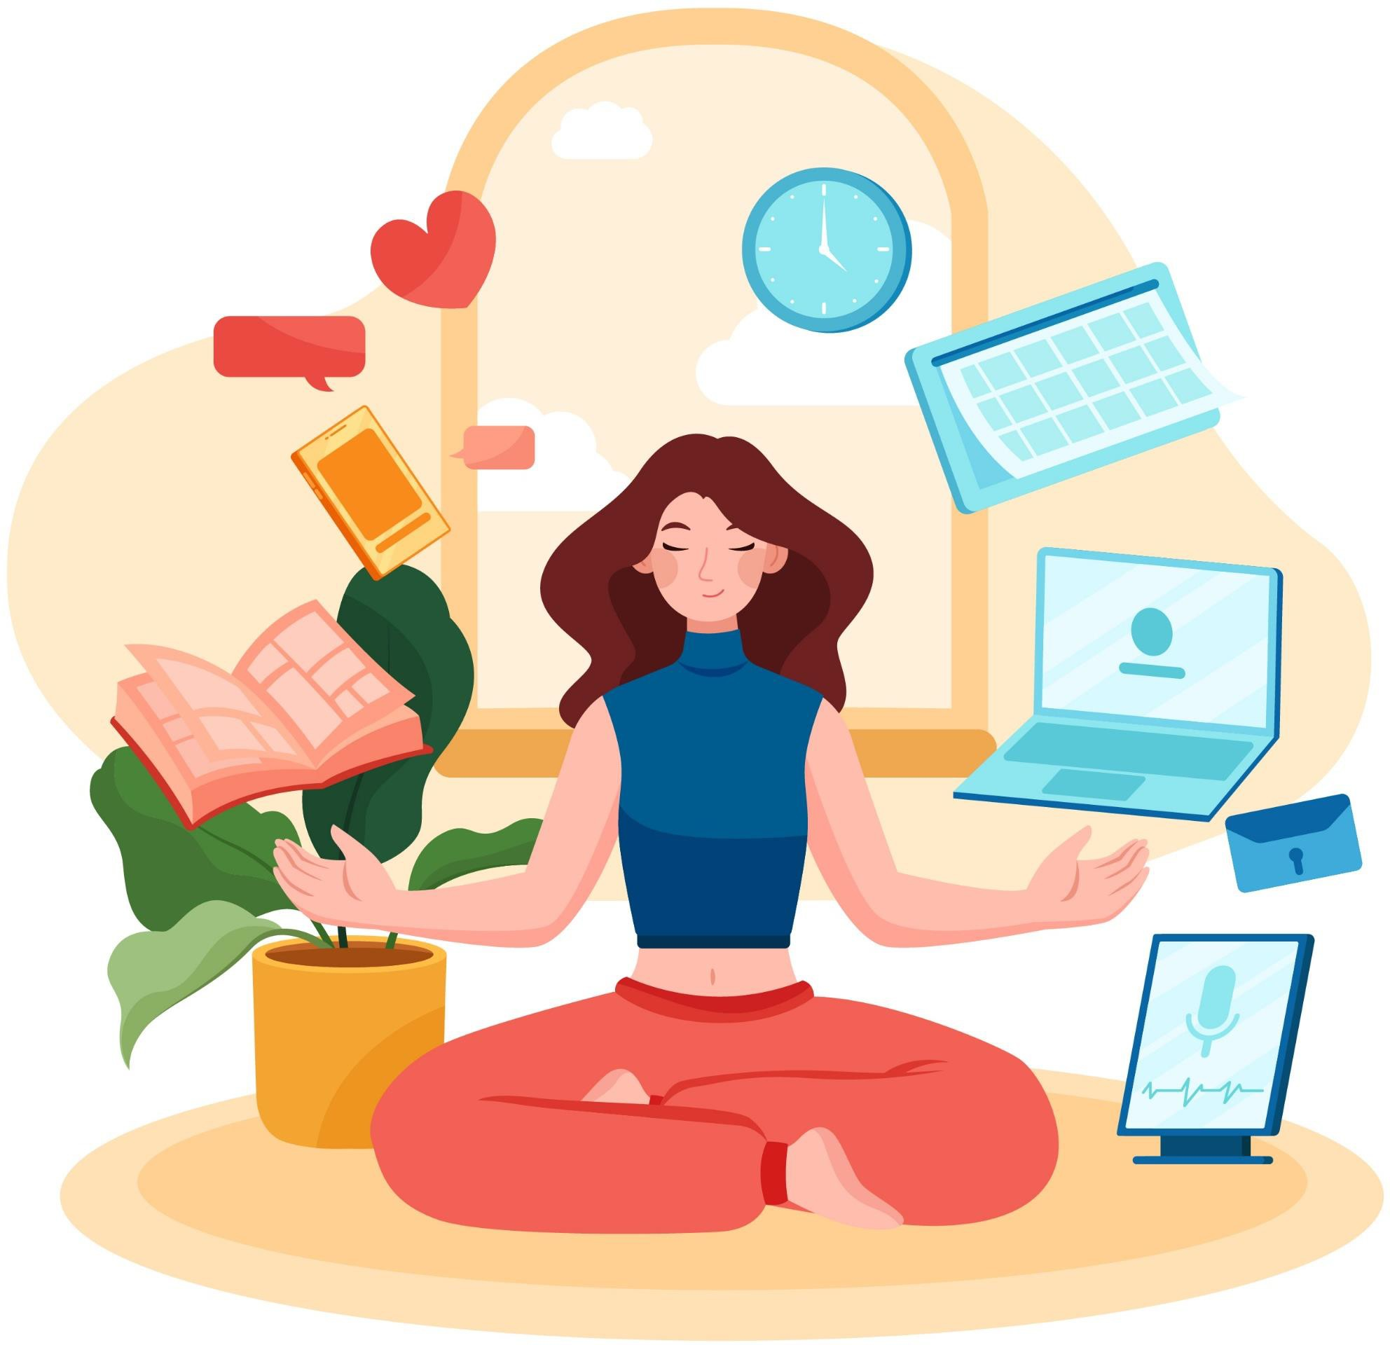
Balanced device use is…
Manageable
Meaningful
Mindful
Notes:
What do we mean by “balance?“ Here are three key elements:
First, balanced device use is manageable: You feel in control of your device use, and it doesn’t get in the way of other things that you need or enjoy.
Second, it’s meaningful: The time you spent feels worthwhile to you. That could be things like learning, creating, connecting with friends and family, but it could also be playing a game or watching a video that’s really engaging and satisfying.
And finally, balanced device use is mindful: You make an intentional choice to do it, and when you’re doing it, you’re present, not distracted or on “autopilot.”

Slide 7
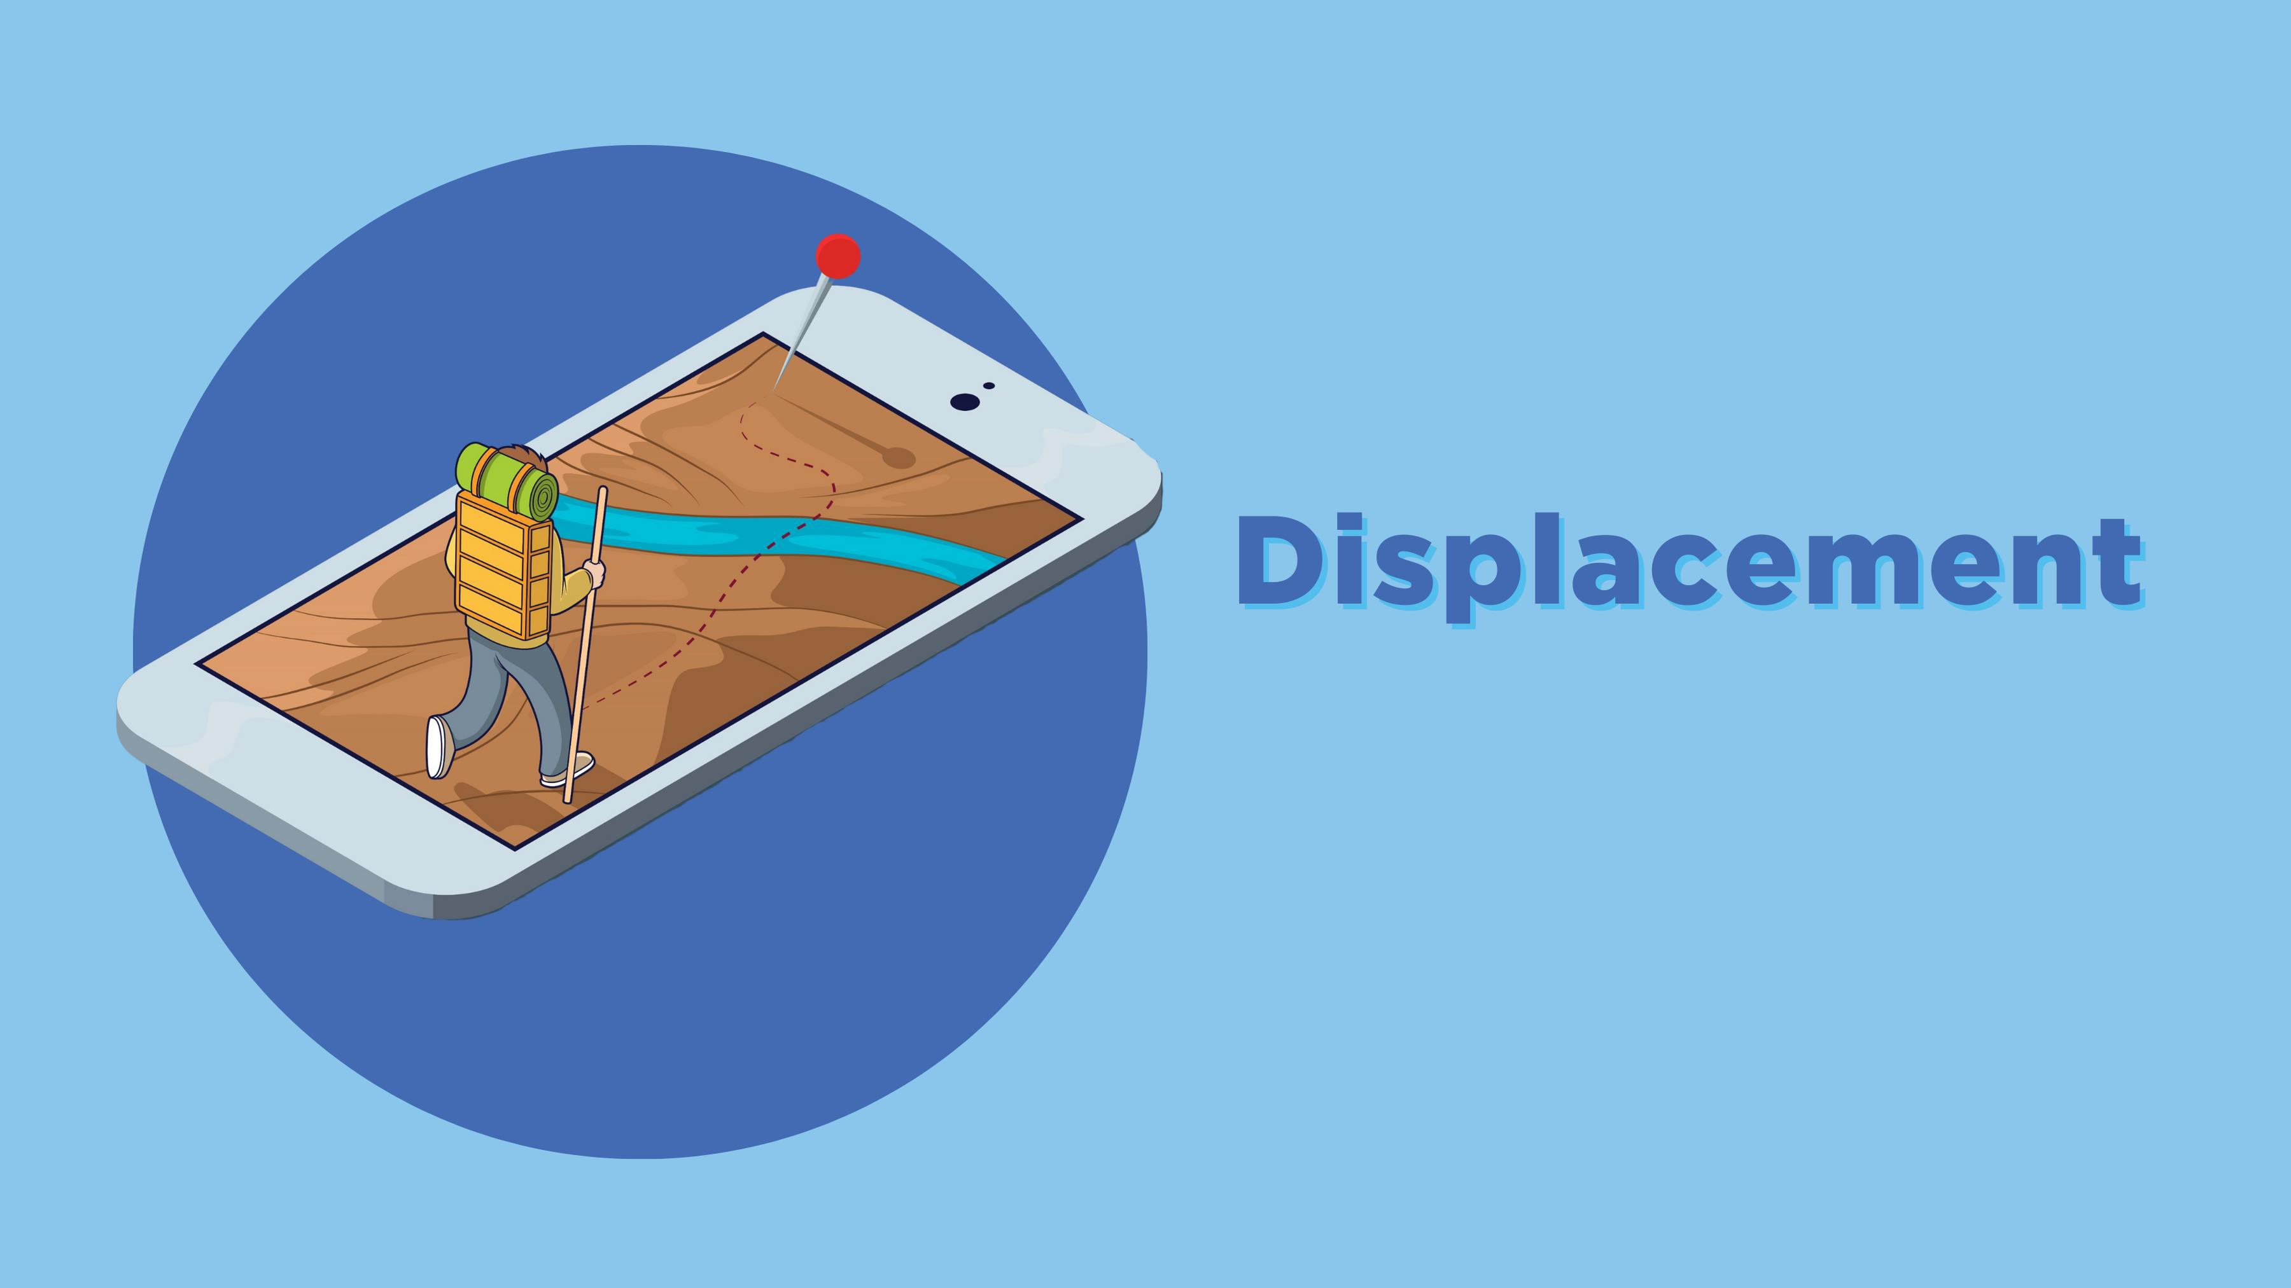
Displacement
Notes:
Just as we defined balanced use as being manageable, meaningful, and mindful, there are three phenomena that contribute to unbalanced use.
First, displacement when it takes time away that would otherwise be spent with friends or family or doing important things like exercising or getting enough sleep. This makes it feel less manageable;
This is why it is important to keep screen time as close to zero as possible for kids under two, because they need as much of all of those things as possible.
For older kids, think about whether or not a screen activity is providing something that you don’t want displaced:
Is it helping them get exercise, like a dance game or Pokémon Go?
Is it helping them learn something, whether that’s school-related, one of your child’s interests like history or dinosaurs, or something practical like cooking or playing guitar?
Are they making or creating something, like writing a story or making a video game?
And are they socializing in a meaningful way with friends or family members? Research has found that kids who mostly play video games alone are likely to become lonelier over time, while those who play with others become less so.

Slide 8
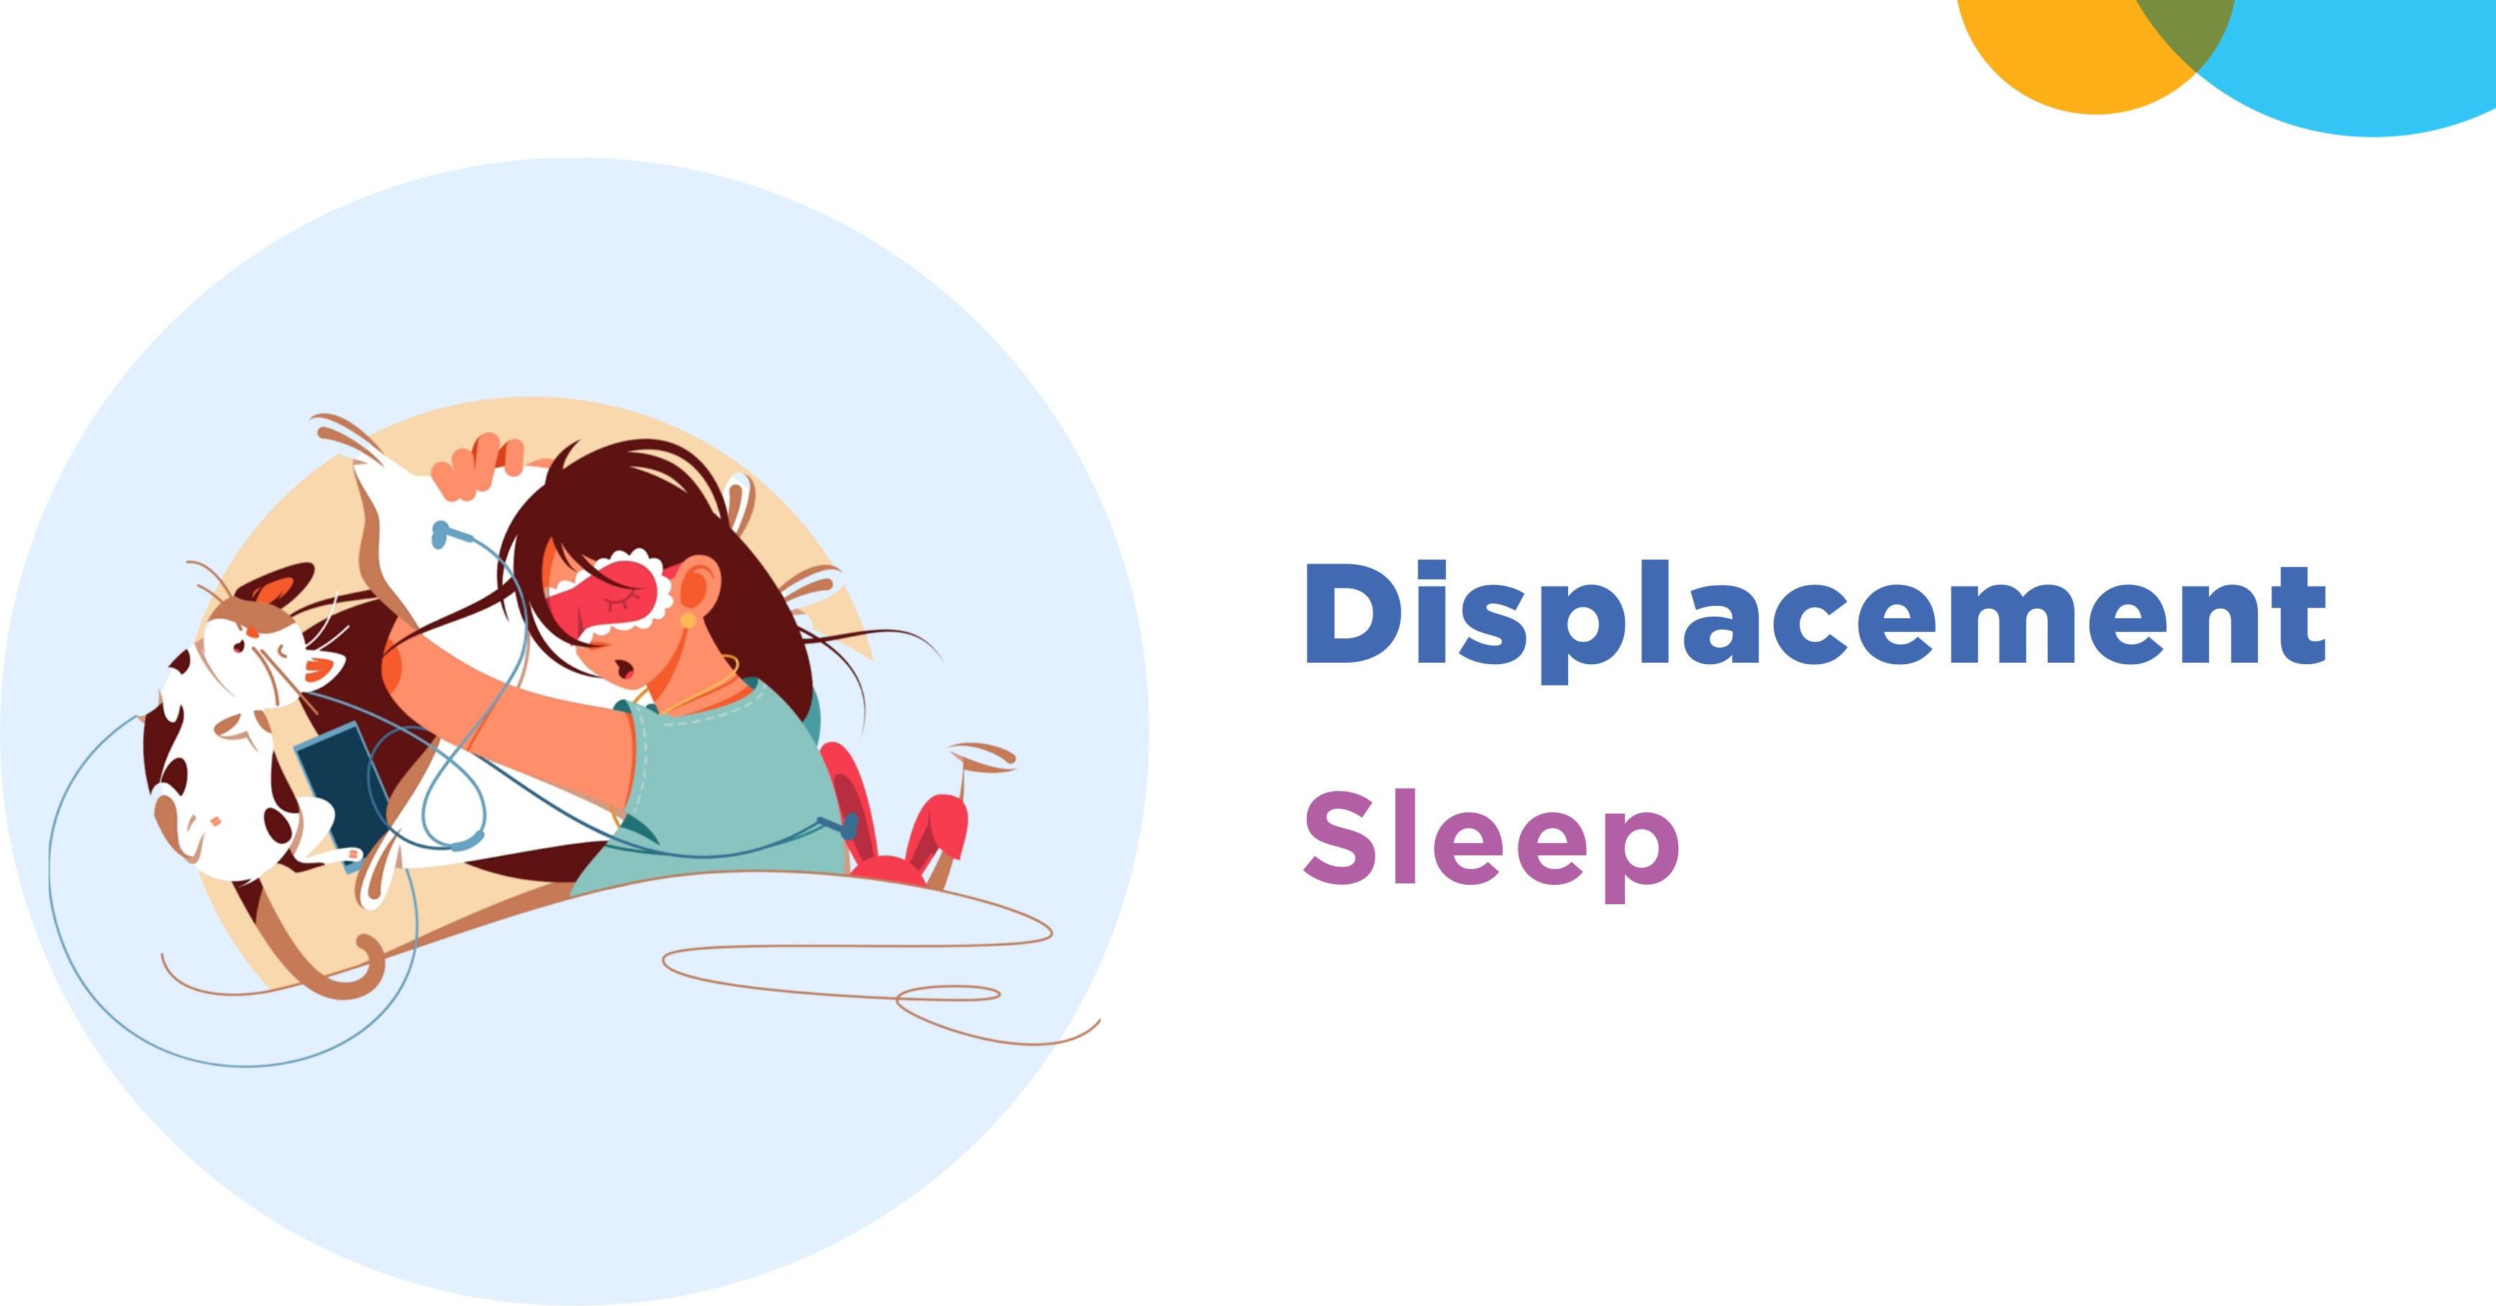
Displacement Sleep
Notes:
One of the things that media use is most likely to displace is sleep. A significant number of teens use digital devices in their rooms after they’ve gone to bed and are often awakened by texts and notifications. This means both less sleep and worse sleep, both of which can have negative consequences on general mental wellness and brain development.
Unfortunately, almost half of Canadian children frequently use a screen device after they’ve gone to bed most nights; along with its impact on sleep, keeping a phone in the bedroom is associated with a higher likelihood of experiencing, witnessing and engaging in online meanness and cruelty and of seeing racist or sexist content online.
Going to sleep isn’t a single step: we start out awake, begin our bedtime routine, lie down and close our eyes, and finally fall asleep. As we pass through each of these, if we have screen devices with us each step is a chance to fall into the enticing “rabbit hole” and delay sleep.

Slide 9
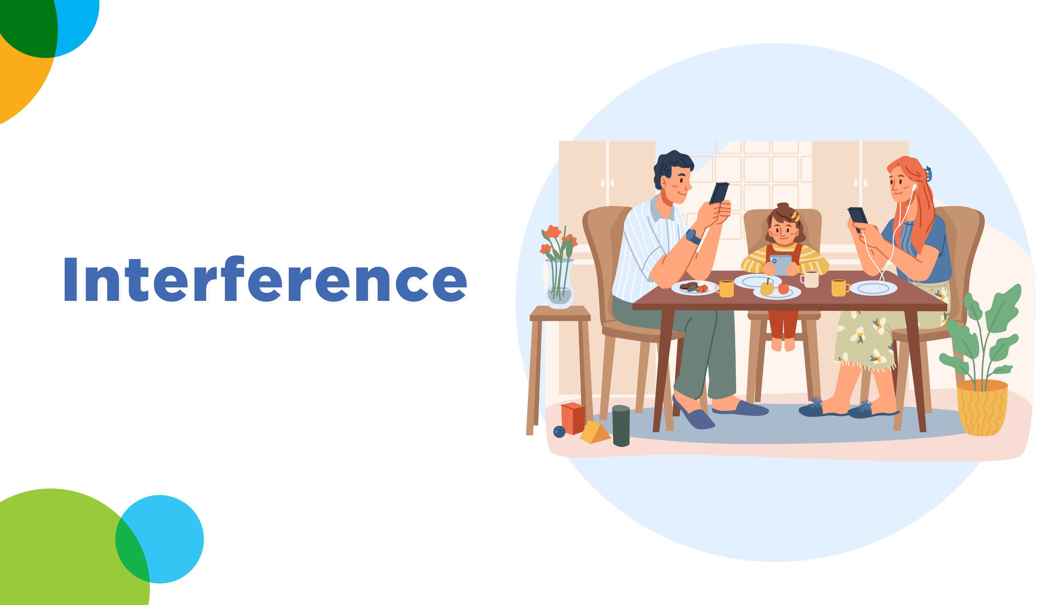
Interference
Notes:
The second risk of unbalanced use is interference. That’s when our tech use makes us less present for other activities, which makes it less meaningful. For e example, If you are invited to watch a movie with your friends, but scroll on your phone and lose track of what is happening in the movie, you won’t get much enjoyment from the movie and can't discuss it with your friends later.

Slide 10
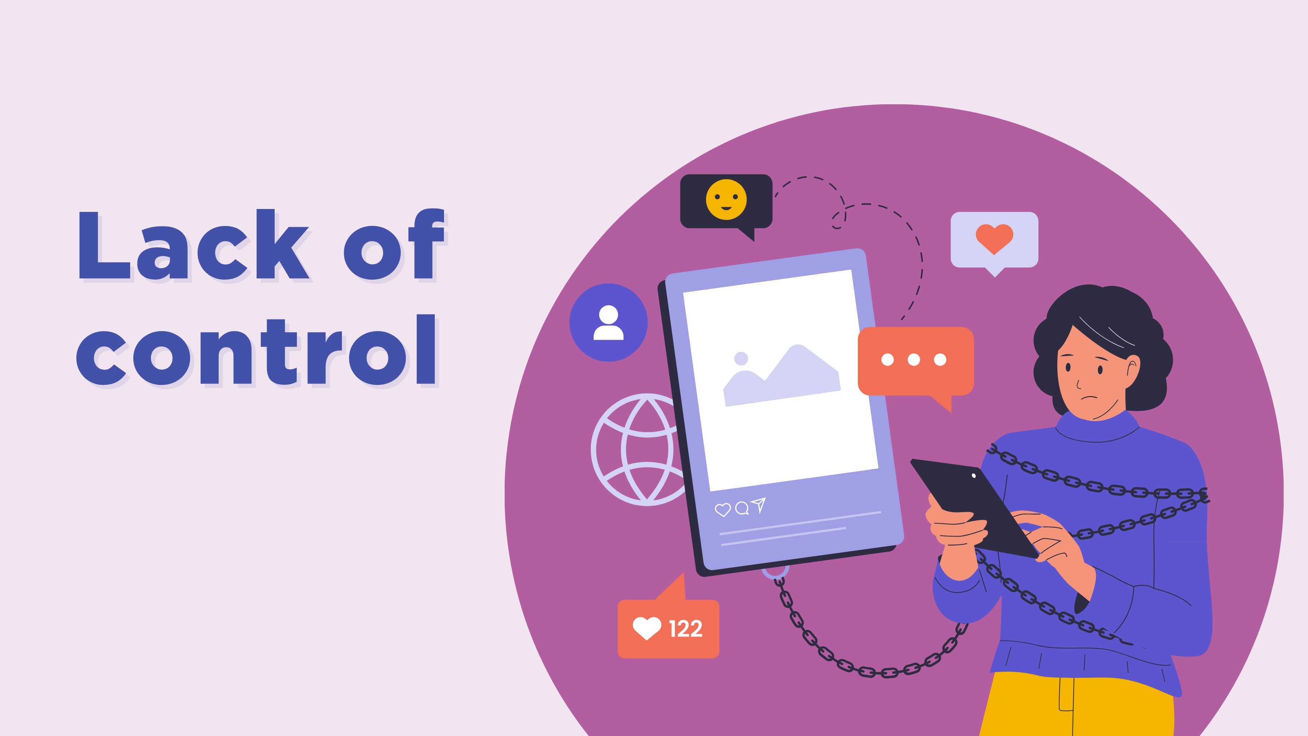
Lack of control
Notes:
Finally, a sense that our device use is out of our control makes it less mindful. This is true even if we only feel that way, without any clear negative impacts.
Feeling like we’re in control of our lives – what’s called a sense of autonomy – is just as important as the things we do with devices and the time we spend on them. Even if everything else is the same, if we feel in control of something we’ll feel better about it; if we feel like it’s out of our control, we’re likely to feel stressed.

Slide 11
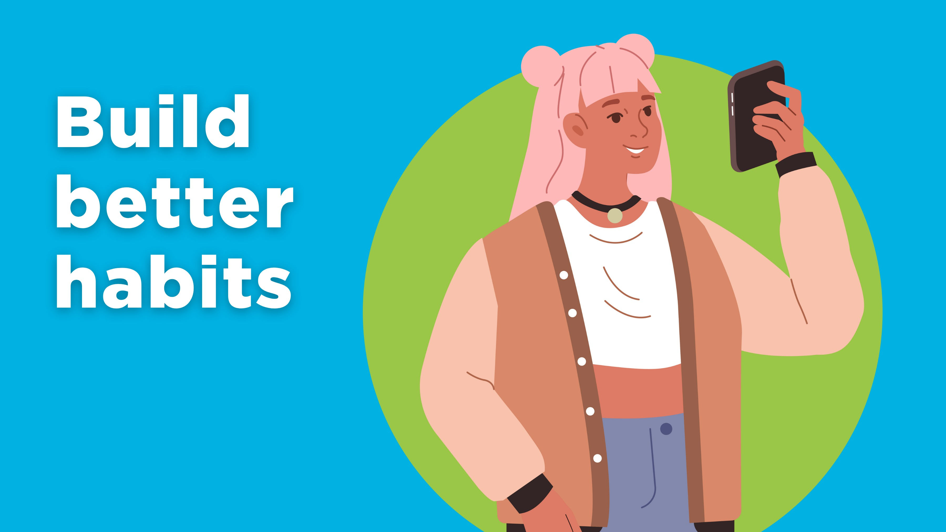
Build better habits
Notes:
Both balanced and unbalanced use are usually a result of our habits – so making our device use more balanced means changing our habits.
A habit is something you do without thinking (much) about it. Habits can be positive: if you’re in the habit of brushing your teeth every morning and every night, you’re a lot less likely to ever skip it because you do it automatically.
Here are some more specific tips for building better tech habits.
Remember that what we do sends as strong a message as what we say, so you can think about how these might help you manage your phone use, too.

Slide 12
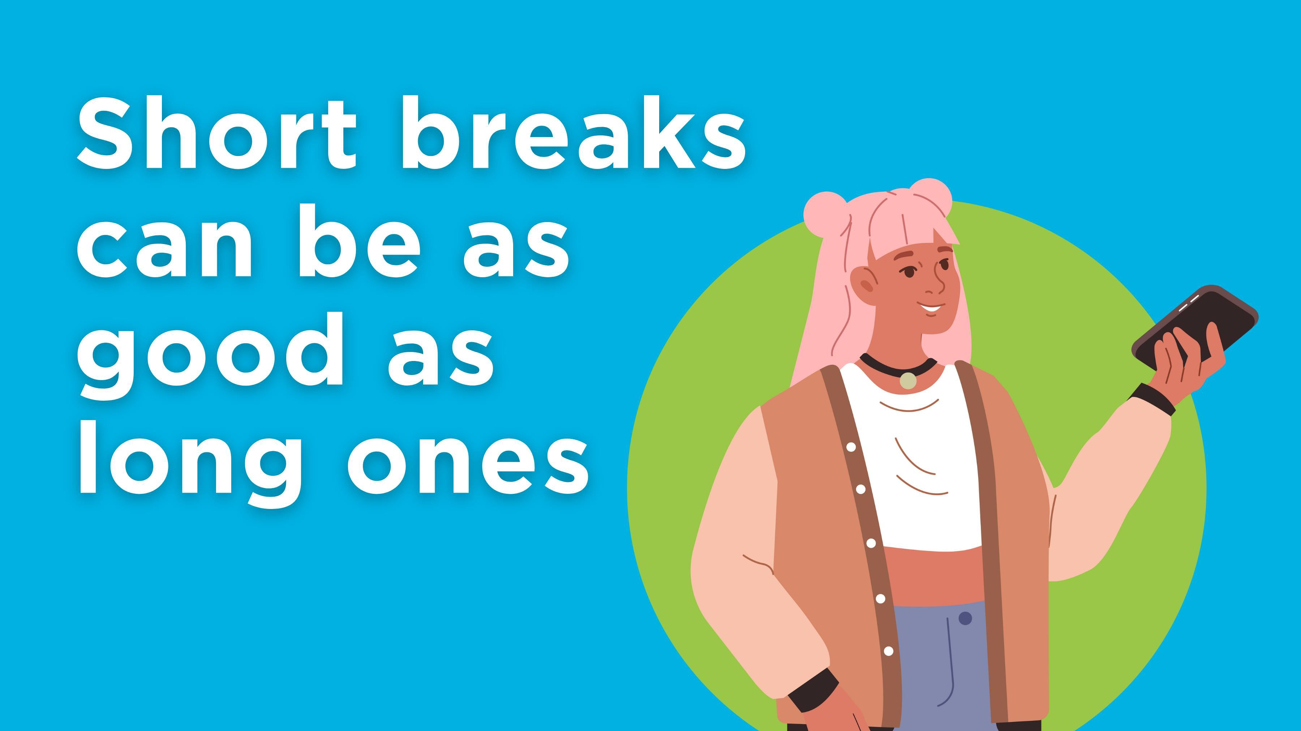
Short breaks can be as good as long ones
Notes:
It’s useful to take breaks from using devices, but a short break can be just as valuable as a longer “digital detox.” One study found that reducing time spent with devices had the same positive effect on depression and anxiety symptoms, life satisfaction and physical activity as not using devices at all, and the group who had reduced their time were more likely to show positive effects four weeks later than those who had abstained totally.

Slide 13
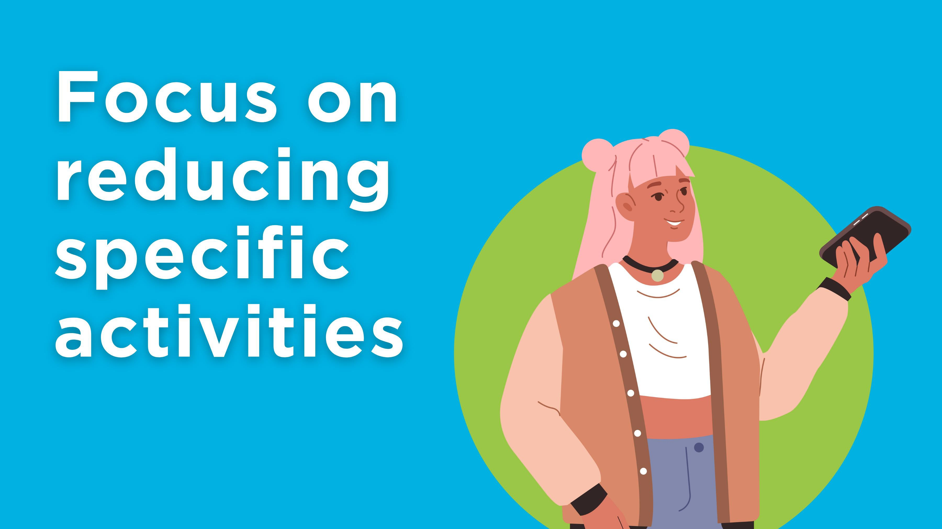
Focus on reducing specific activities
Notes:
Another found that the most effective approach was to try to reduce time spent on specific online activities at particular times – like not viewing videos from the “Up Next” bar on YouTube, or not using Instagram while in the library. The same study found that youth actually felt better if they planned to spend more time doing things they enjoyed online. ‘
Instead of trying to reduce overall “screen time,” it may be more effective to develop better tech habits by planning tech-free times for ourselves and our kids and having tech-free parts of our homes. (See MediaSmarts’ tip sheet Co-Viewing With Your Kids for tips on how to do this.)

Slide 14
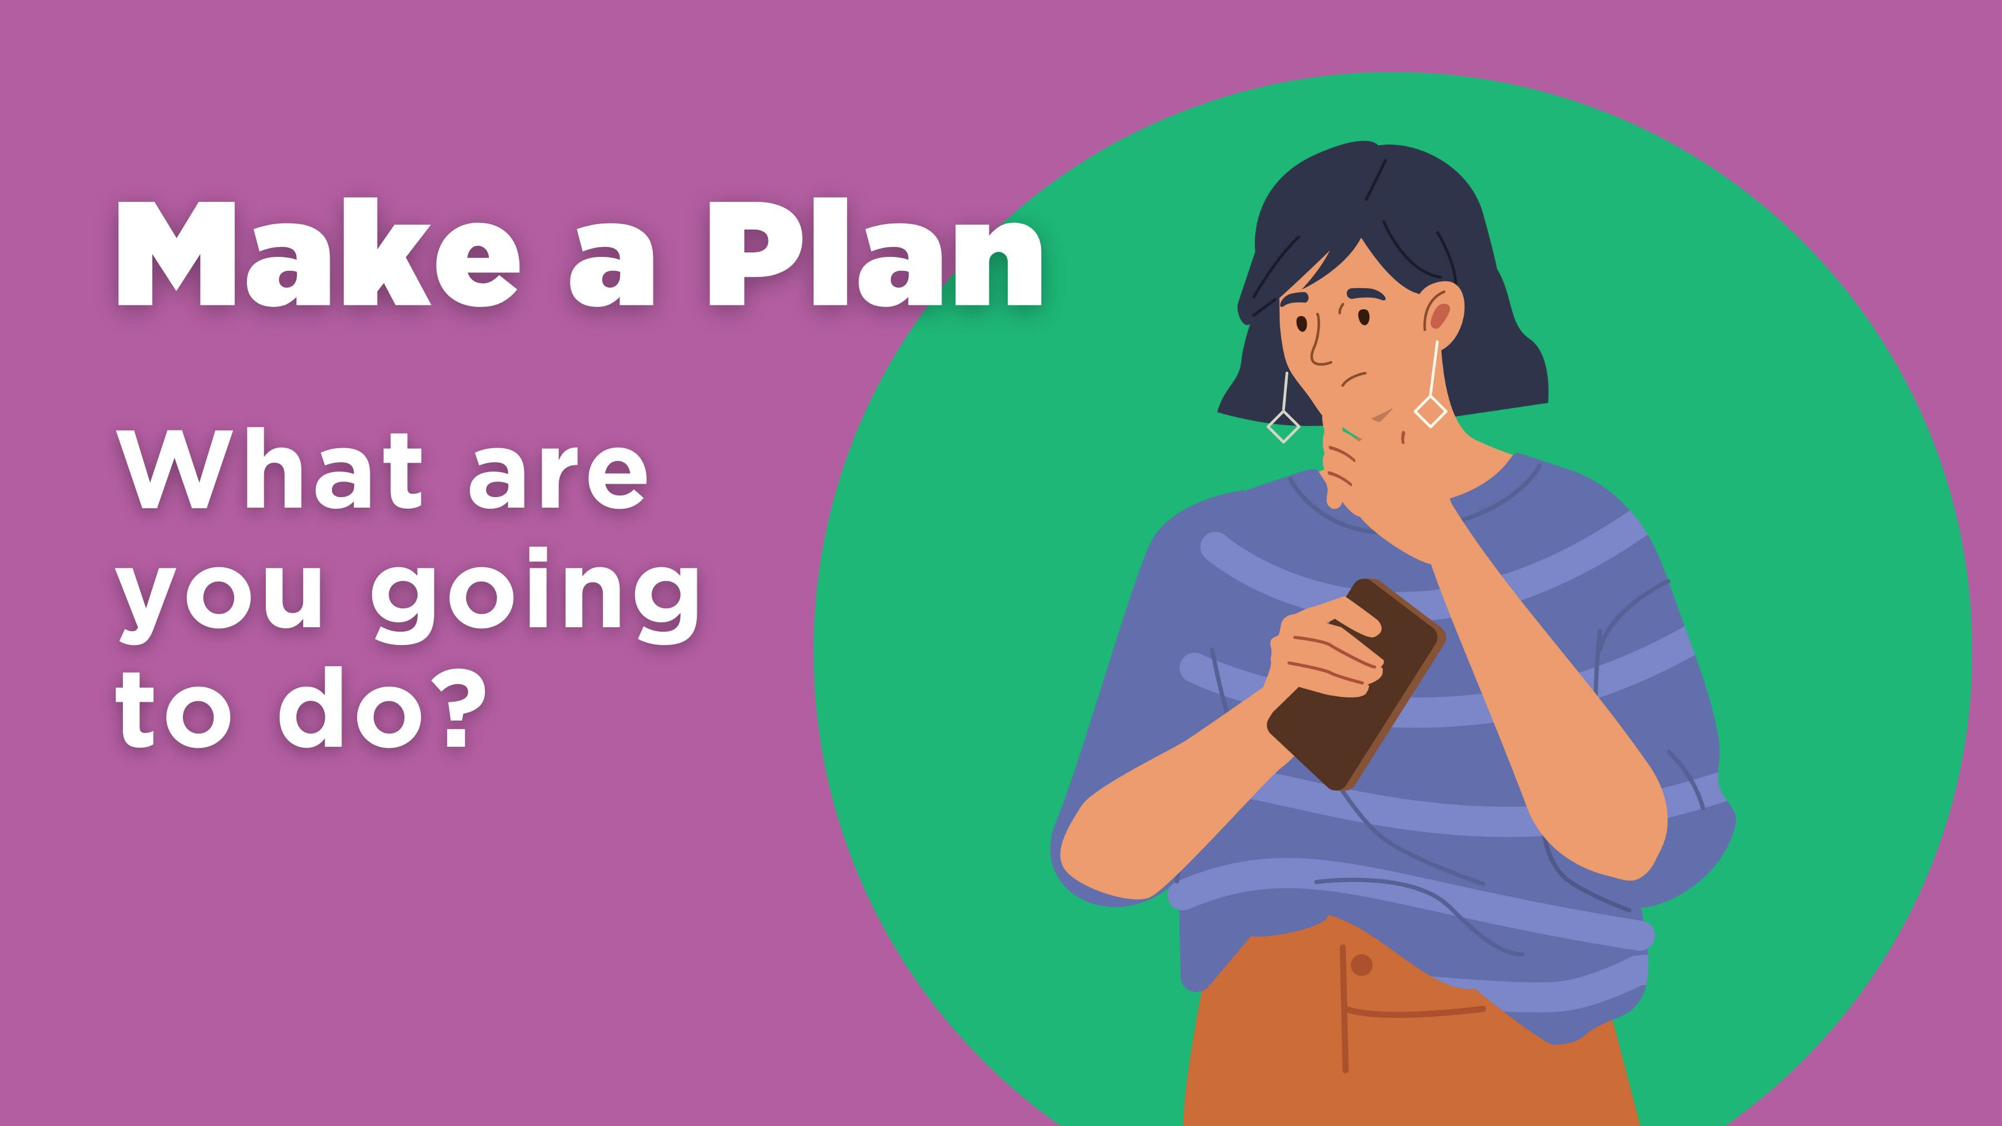
Make a Plan
What are you going to do?
Notes:
Have you ever gotten caught in the “phone loop” – opened your phone to do one thing, then done half a dozen things before you realized what was happening?
You can avoid that by being more intentional about your phone use. Before you open it, say what you’re going to do – “Check the weather” for example.
(You can say it out loud at first, then just think it later.)

Slide 15
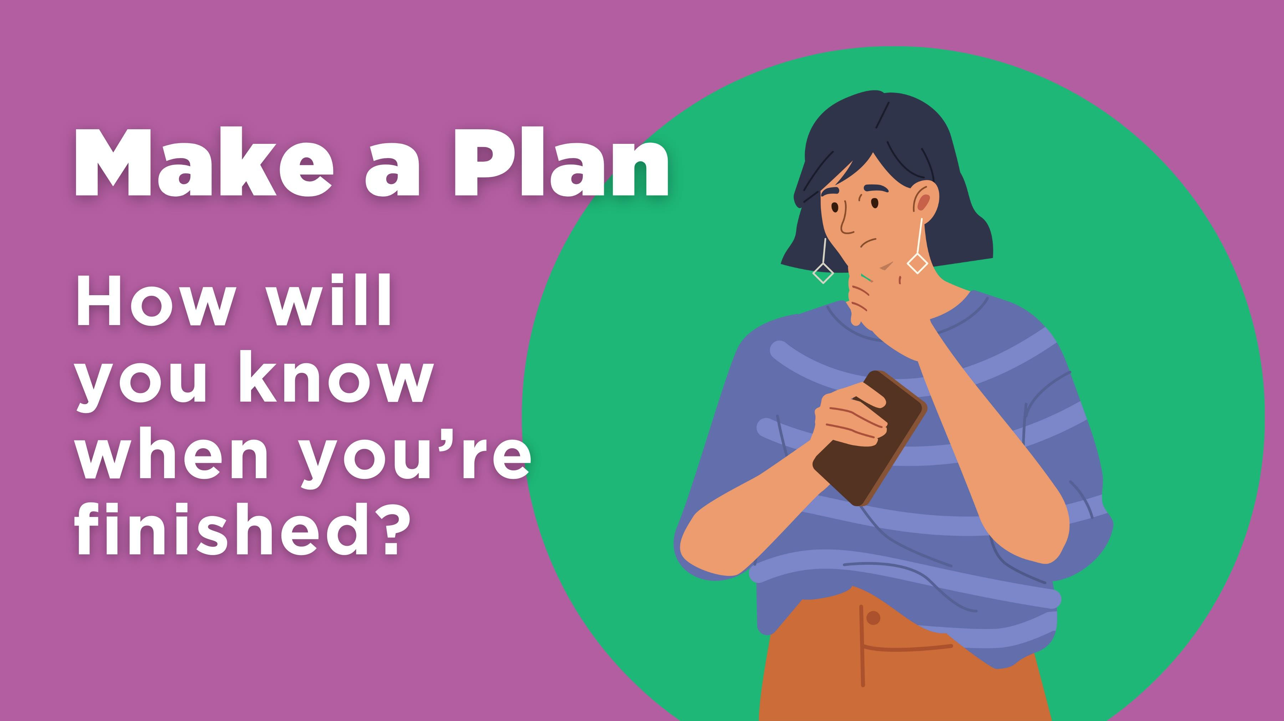
Make a Plan-1
How will you know when you’re finished?
Notes:
Set ahead of time how you’ll know you’re finished – “When I know whether or not it’s likely to rain,” for instance.

Slide 16
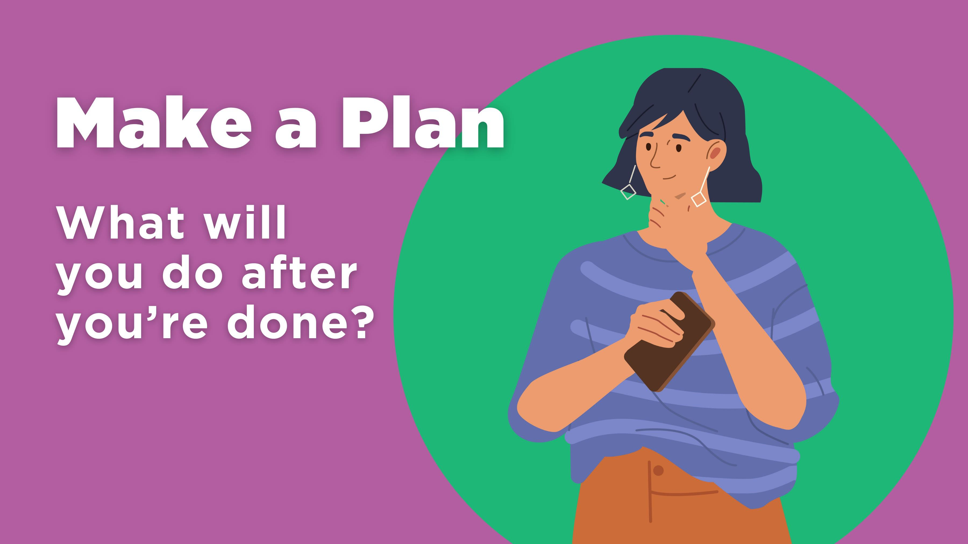
Make a Plan-2
What will you do after you’re done?
Notes:
Then say what you’ll do right after you’ve finished, like “Either get an umbrella or the sunscreen,”
This helps you avoid that in-between moment when your thumb might tap another app without you thinking about it.

Slide 17
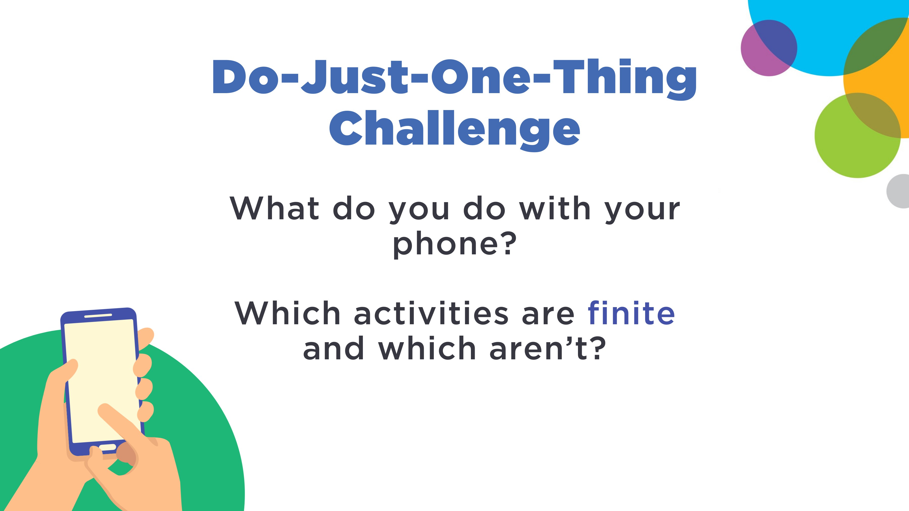
Do-Just-One-Thing Challenge
What do you do with your phone?
Which activities are finite and which aren’t?
Notes:
Think about all of the different things you do with your phone.
You can think of them either in terms of apps (email, each different social network app, and so on.) or why you’re using your phone (contact your parents, check the weather, check in with your friends, and so on.) Or you can use a mix of both!
Then you’ll think about which ones have are finite, with a clear end (like checking the weather) and which aren’t (like watching videos.)

Slide 18
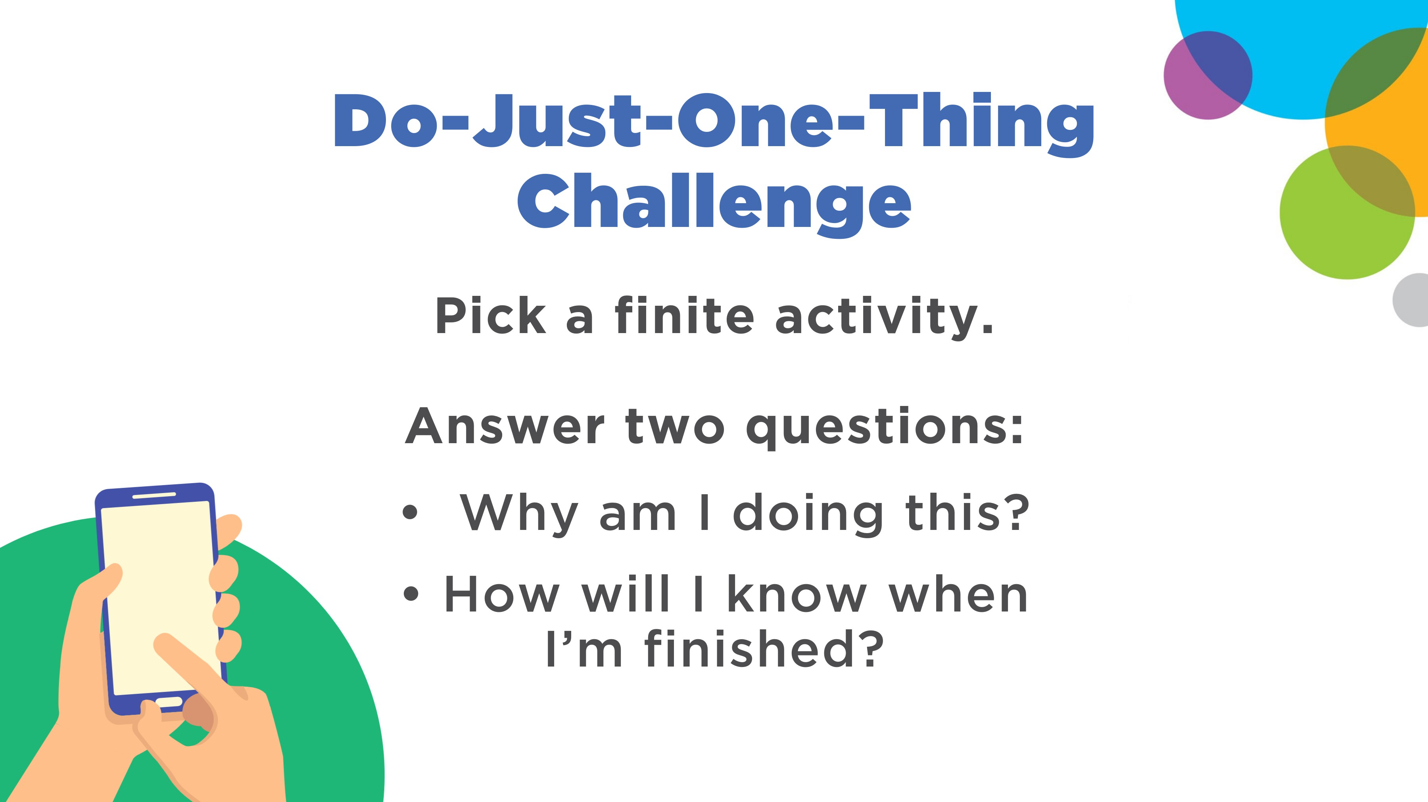
Do-Just-One-Thing Challenge-1
Pick a finite activity.
Answer two questions:
Why am I doing this?
How will I know when I’m finished?
Notes:
Now pick a finite activity. These could be one you do the most often, or one that is most likely to get you caught in the “phone loop.”
For each of those, answer two questions: What am I doing? and How will I know I’m finished?

Slide 19
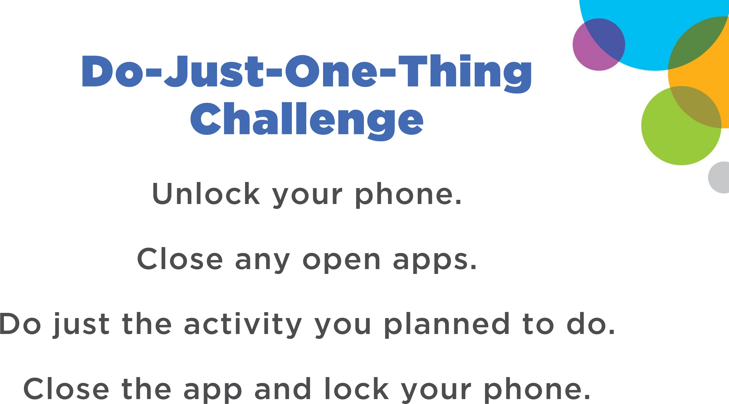
Do-Just-One-Thing Challenge-2
Unlock your phone.
Close any open apps.
Do just the activity you planned to do.
Close the app and lock your phone.
Notes:
Next, unlock your phone.
Close any apps that are open.
Then do just the activity you planned to do. Stop when you've reached the end point you identified (for example, when you know what the day's weather is going to be.
And lock your phone.
Like any exercise we need to do this more than once to get good at it. Try it now.

Slide 20
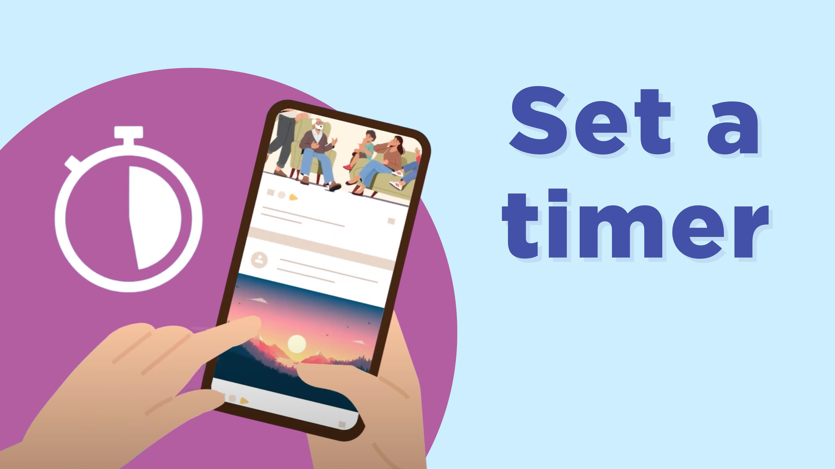
Set a timer
Notes:
For activities with no obvious end-point, like scrolling social media, set a timer.

Slide 21
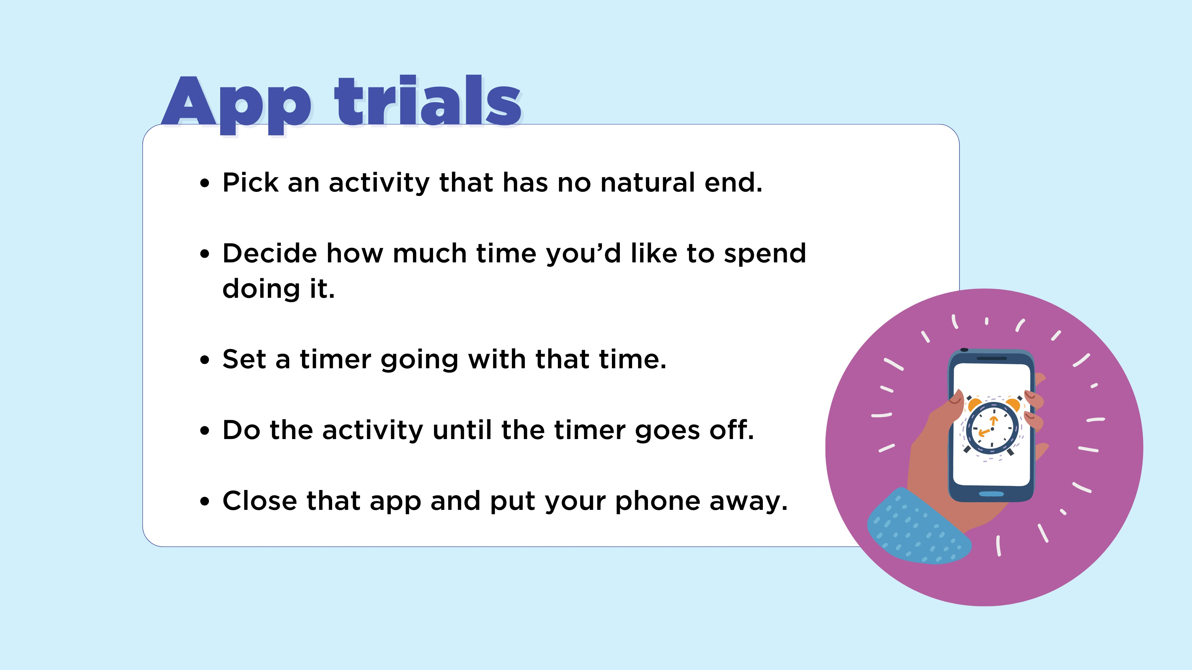
App trials
Pick an activity that has no natural end.
Decide how much time you’d like to spend doing it.
Set a timer going with that time.
Do the activity until the timer goes off.
Close that app and put your phone away.
Notes:
Here’s an activity for making your use more manageable, called “app trials.”
Pick an activity that has no natural end, like playing a game, or watching videos.
Decide how much time you’d like to spend doing it (for instance, five minutes watching videos.)
Set a timer going with that time.
Do the activity until the timer goes off, and then close that app and put your phone away.
Even if you don’t stop when the timer goes off, timing what you’re doing can be illuminating: I used to occasionally play a game that I thought took about five minutes per session – but actually took fifteen.
Take a moment to think of something you do online like that, that has no natural end – checking your favourite social media feed, for example. Take a guess how long each session usually is, and write it down. Next time you do it, time yourself, and compare that time to your guess.

Slide 22
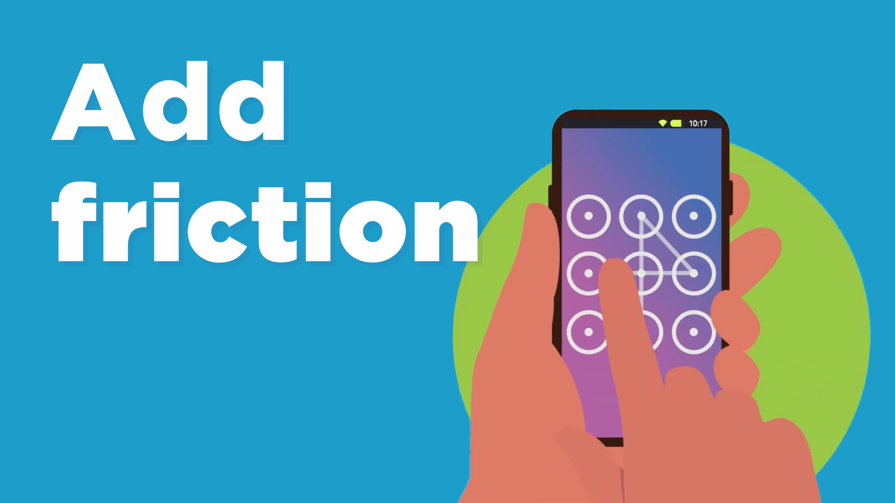
Add friction
Notes:
Another way of avoiding that is to add friction to your phone experience, by doing things like regularly changing your unlock method or moving the most tempting apps off your home screen. When you’re first getting started, changing your colour scheme to grayscale can also help.

Slide 23
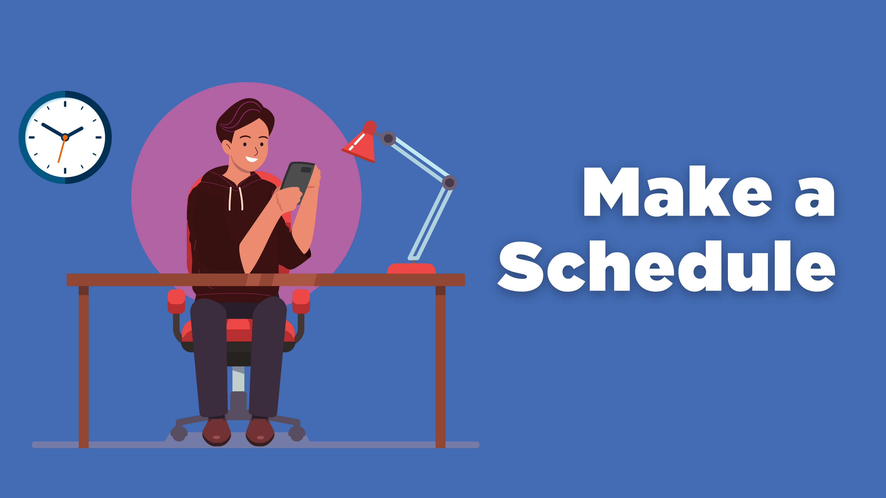
Make a Schedule
Notes:
Notifications make us feel more stressed, but also more connected with others. We also spend less time responding to them than we may think: just one in ten interactions with our phones are prompted by notifications.
You can also set a schedule for when devices, and specific activities, are and aren’t allowed. That can cover both times and places: for instance, we strongly recommend that you keep phones out of your kids’ bedrooms and establish times and places where screens aren’t allowed, such as at the dinner table.

Slide 24
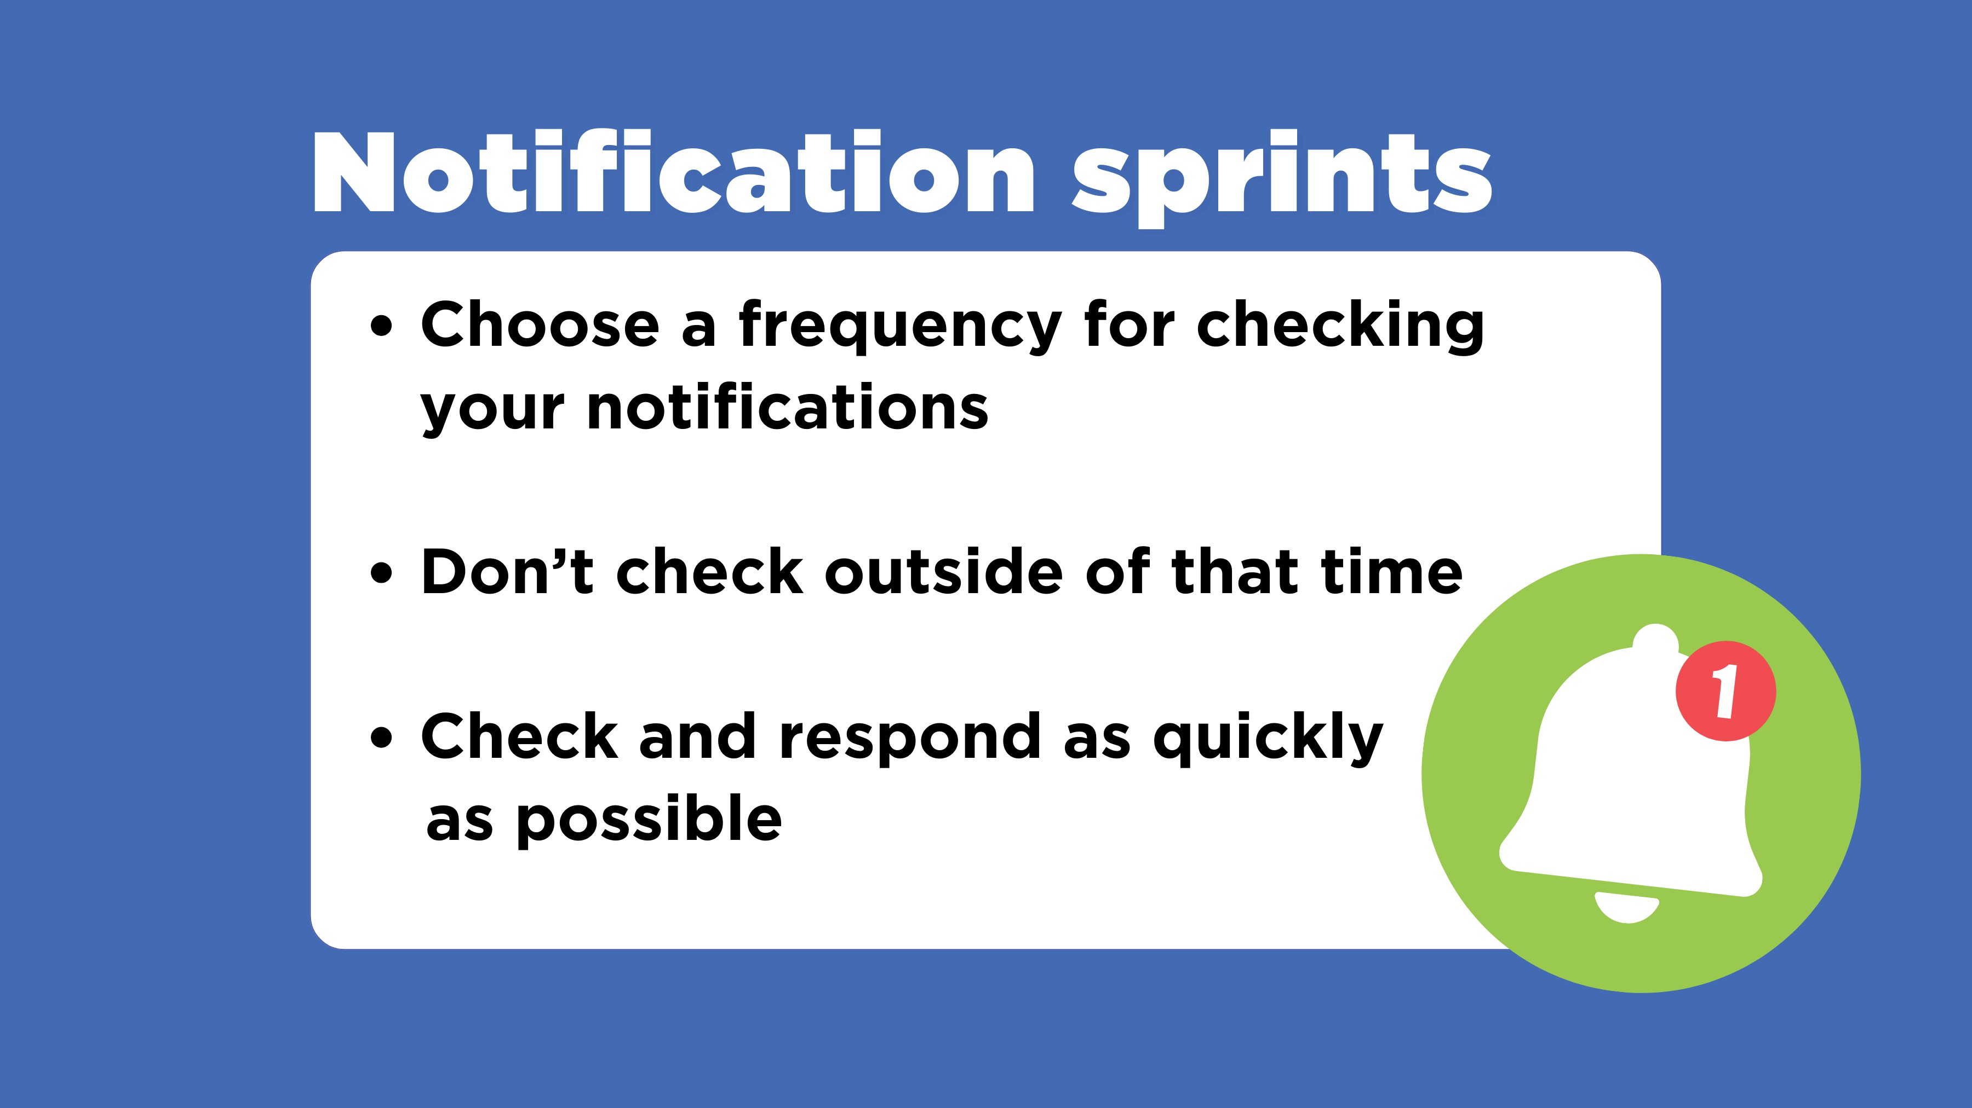
Notification sprints
Choose a frequency for checking your notifications
Don’t check outside of that time
Check and respond as quickly as possible
Notes:
Turning notifications off completely can actually be more stressful than leaving them on, because we are likely to worry that we’re missing something important.
Instead, try “notification sprints”:
Choose a frequency for checking your notifications (how often you will check them – for instance, once every hour, or once every half hour.)
Don’t check any notifications outside of that time (except for ones that are clearly emergencies.)
When the time comes, check all your notifications, respond to any that need responses as quickly as possible, then put away your phone.

Slide 25
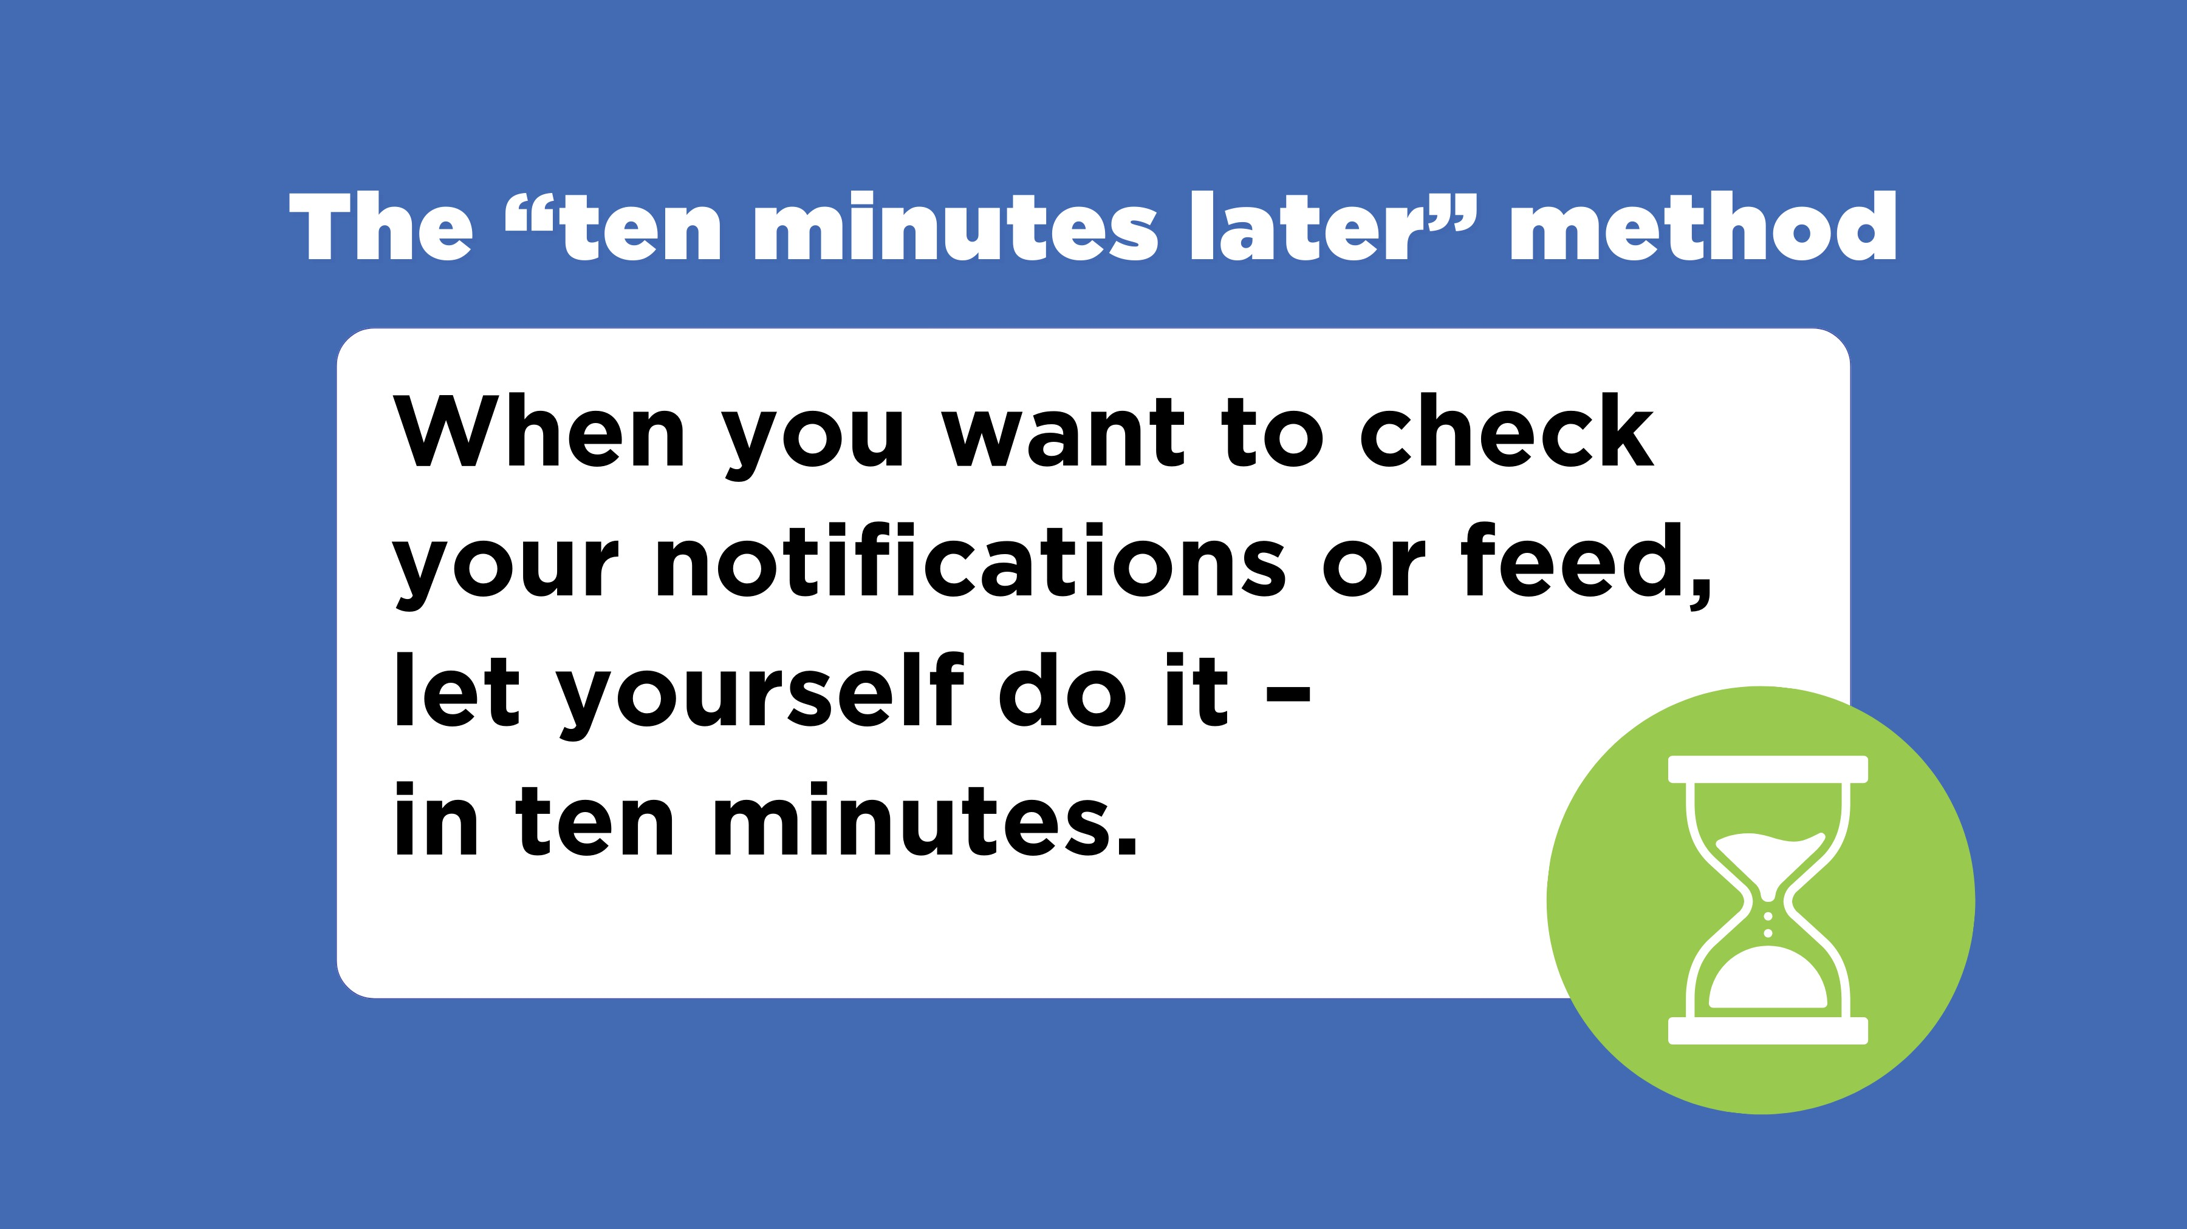
The “ten minutes later” method
When you want to check your notifications or feed, let yourself do it - in ten minutes.
Notes:
You can also teach kids the “ten minutes later” method: tell them that when they feel the desire to check their notifications, they can – in ten minutes. This delay reduces the number of times they check their phones, which may be more important than the total time you spend on it. It’s also likely that something else will happen in that ten minutes to distract them from checking their phone.

Slide 26
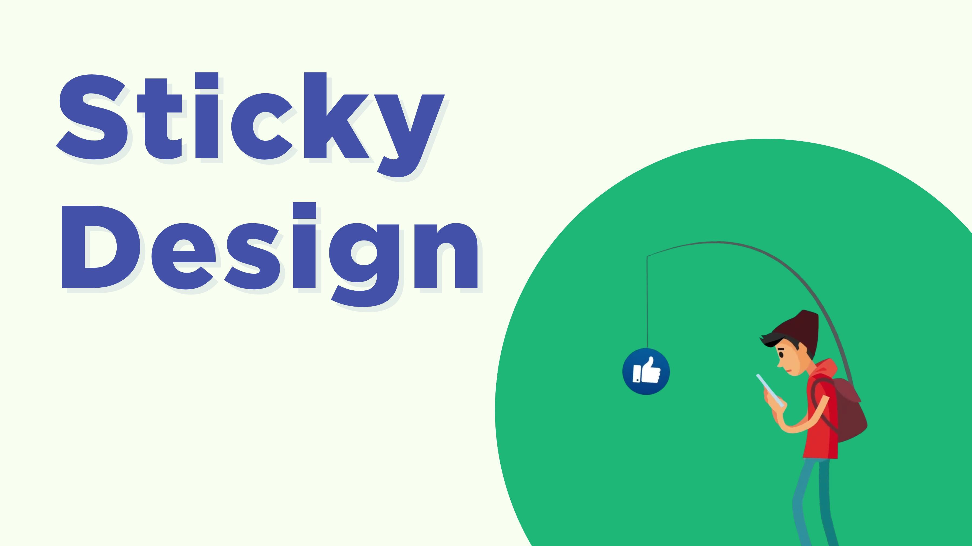
Sticky Design
Notes:
Social media aren’t neutral, of course. They have been carefully designed to make us spend more time on them and to come back often – what app makers call sticky design.

Slide 27
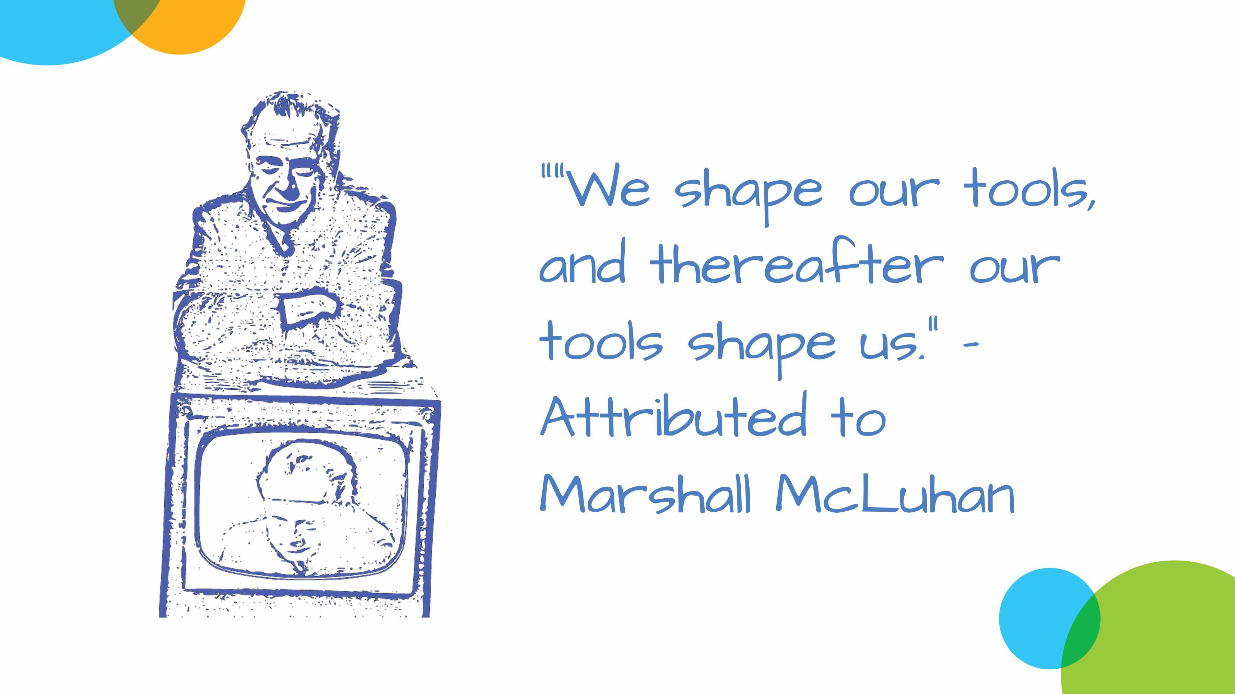
“We shape our tools, and thereafter our tools shape us.” – Attributed to Marshall McLuhan
Notes:
Those apps and devices don’t control us, but they do influence us through their features - the things we can do – and the defaults, which are the things that are easy to use.
Autoplay, for instance, is a feature that encourages us to keep watching longer than we otherwise might. If autoplay is turned on unless you turn it off – as it is in most video sites and many social networks, like YouTube and TikTok – it’s an even more powerful default.

Slide 28
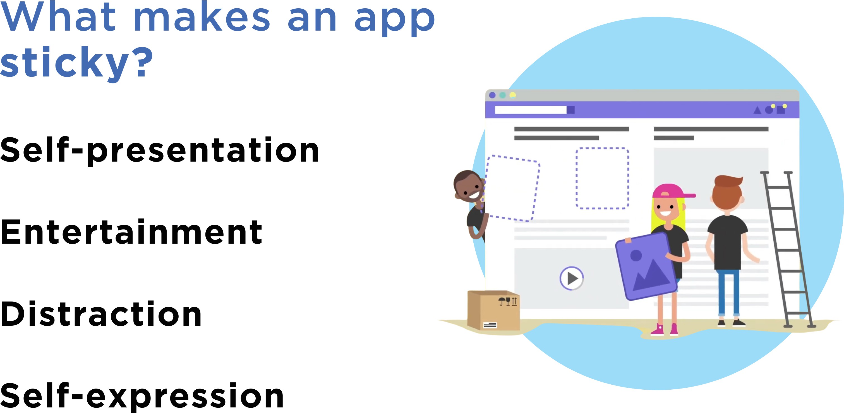
What makes an app sticky?
Self-presentation
Entertainment Distraction
Self-expression
Notes:
Unfortunately, the things that make an app sticky are also some of the biggest benefits we get from them: exploring our identities, being entertained and distracted, and self-expression.
The good news is, research shows that teaching kids about the design tricks that apps use to get us to keep checking them – from Snapchat “streaks” to TikTok’s ForYou page – helps them take control of their online experience.
In fact. a lot of research shows that most kids don’t like the ways that apps manipulate them, so we can also teach them ways to advocate for more healthful design.

Slide 29
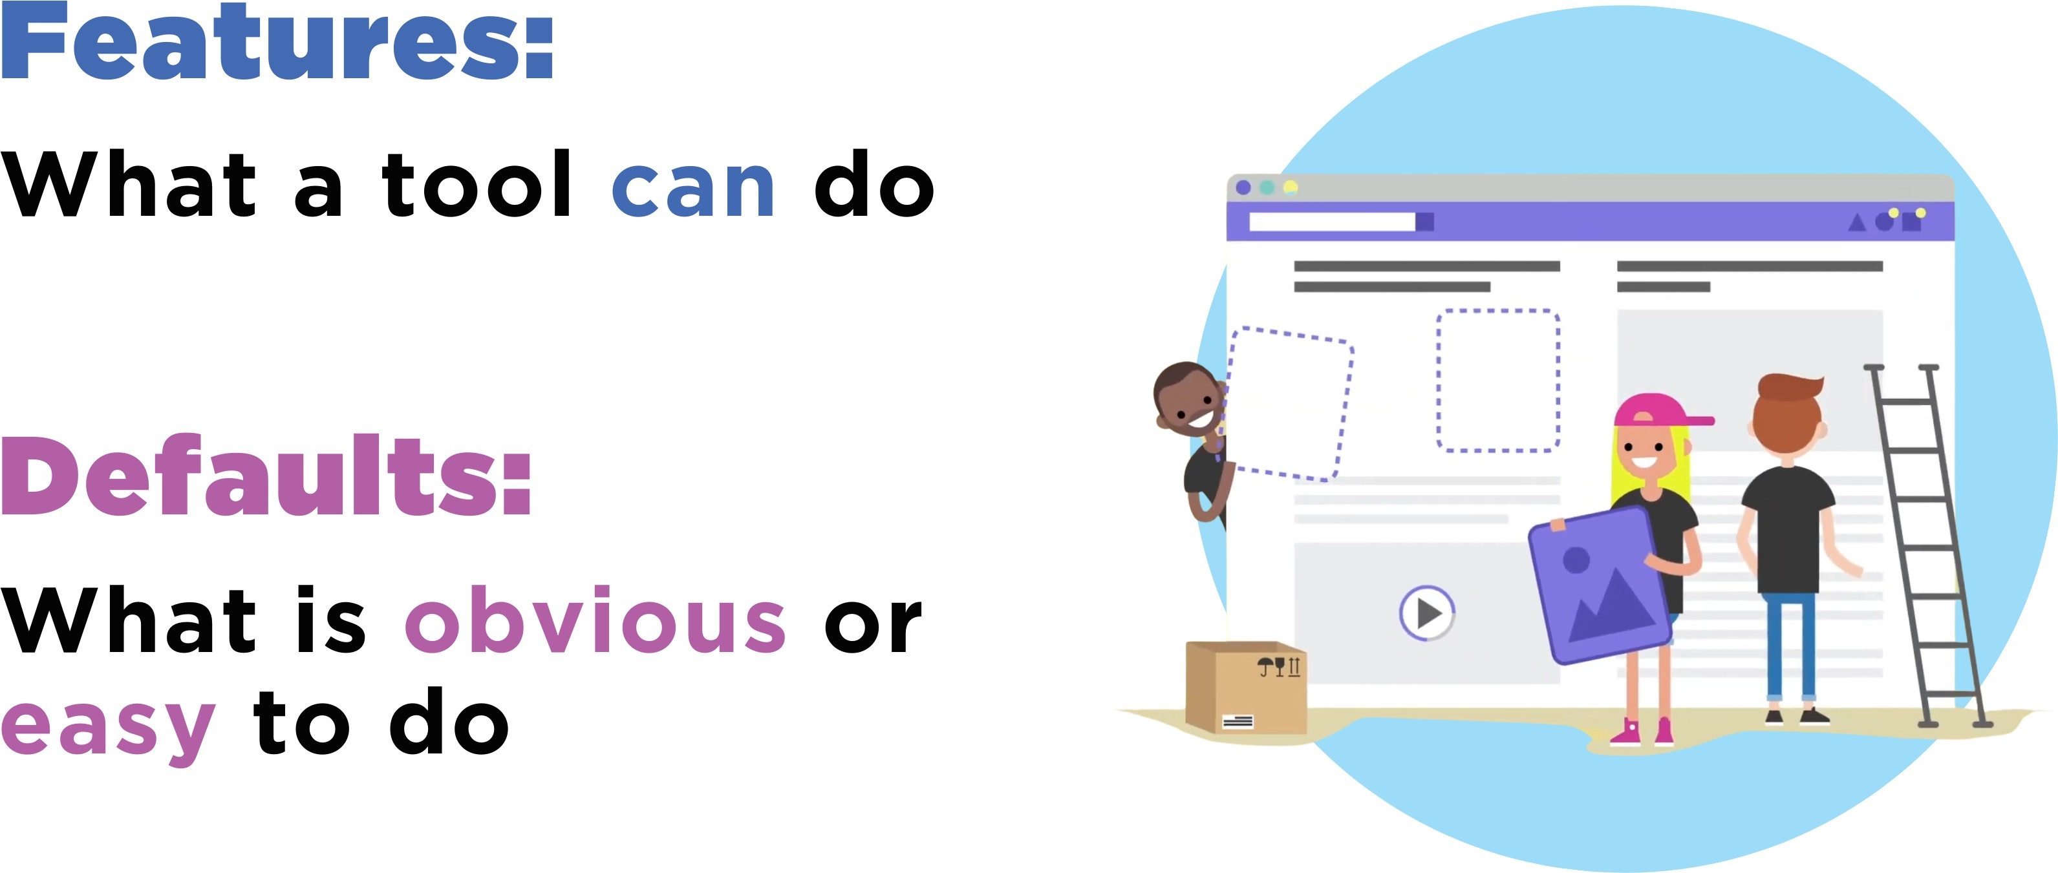
Features:
What a tool can do
Defaults:
What is obvious or easy to do
Notes:
Here’s an exercise that you can do, or do with kids, to explore how tools influence how we use them: Think about the features or defaults of your phone or your favourite apps that make it easy to lose track of time, that keep you coming back, or that make you stay longer.

Slide 30
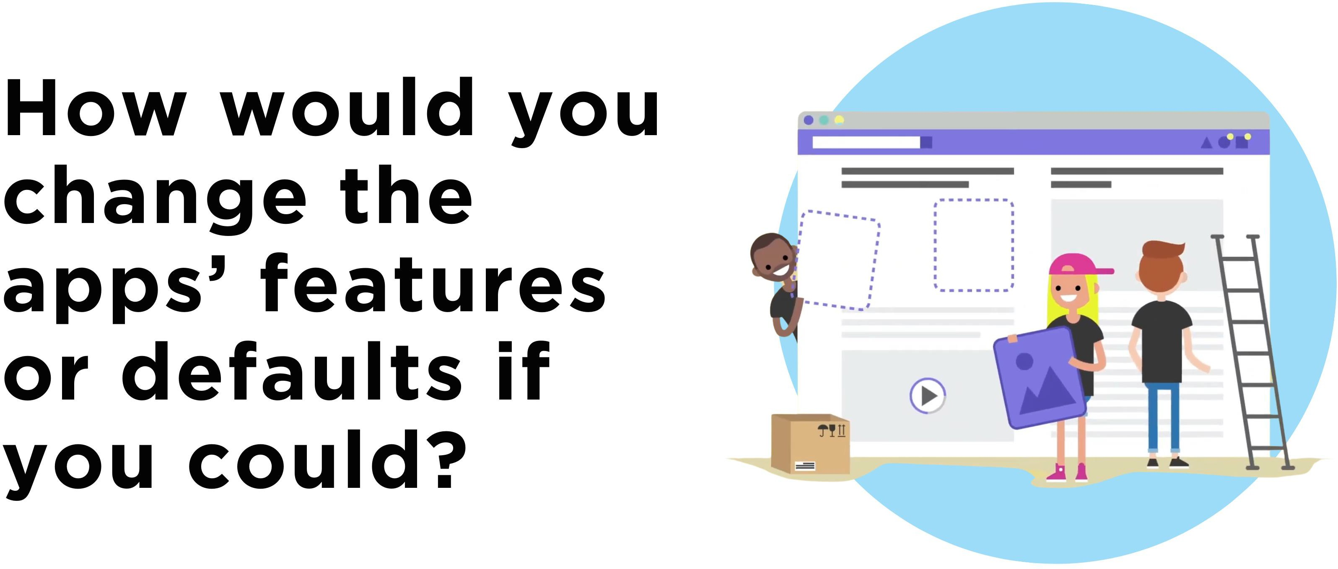
How would you change the apps’ features or defaults if you could?
Notes:
Imagine that you could make tech companies change their products in any way you wanted.
What would you change to promote more healthful use?

Slide 31
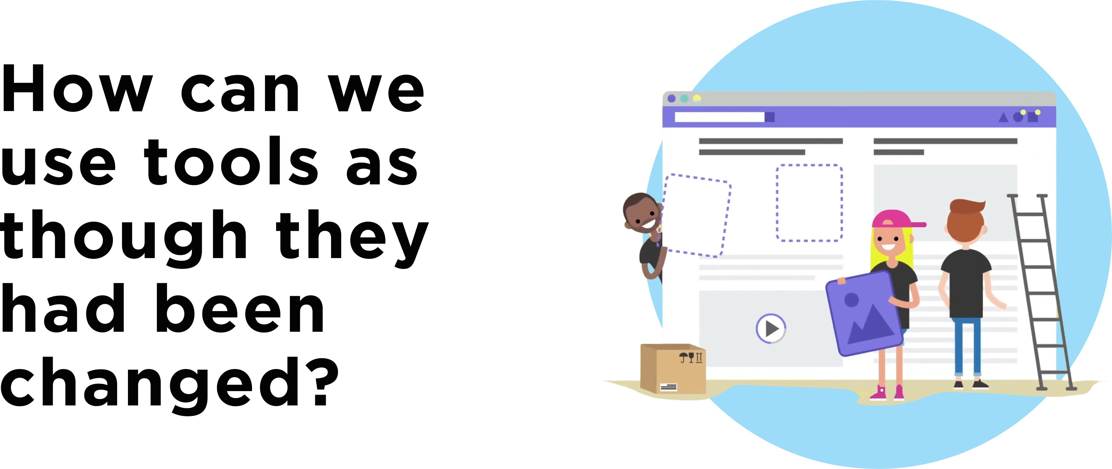
How can we use tools as though they had been changed?
Notes:
While we can influence how tech companies do business, reflecting on how their tools influence us also helps us see how we can use those tools as though they had been changed.

Slide 32
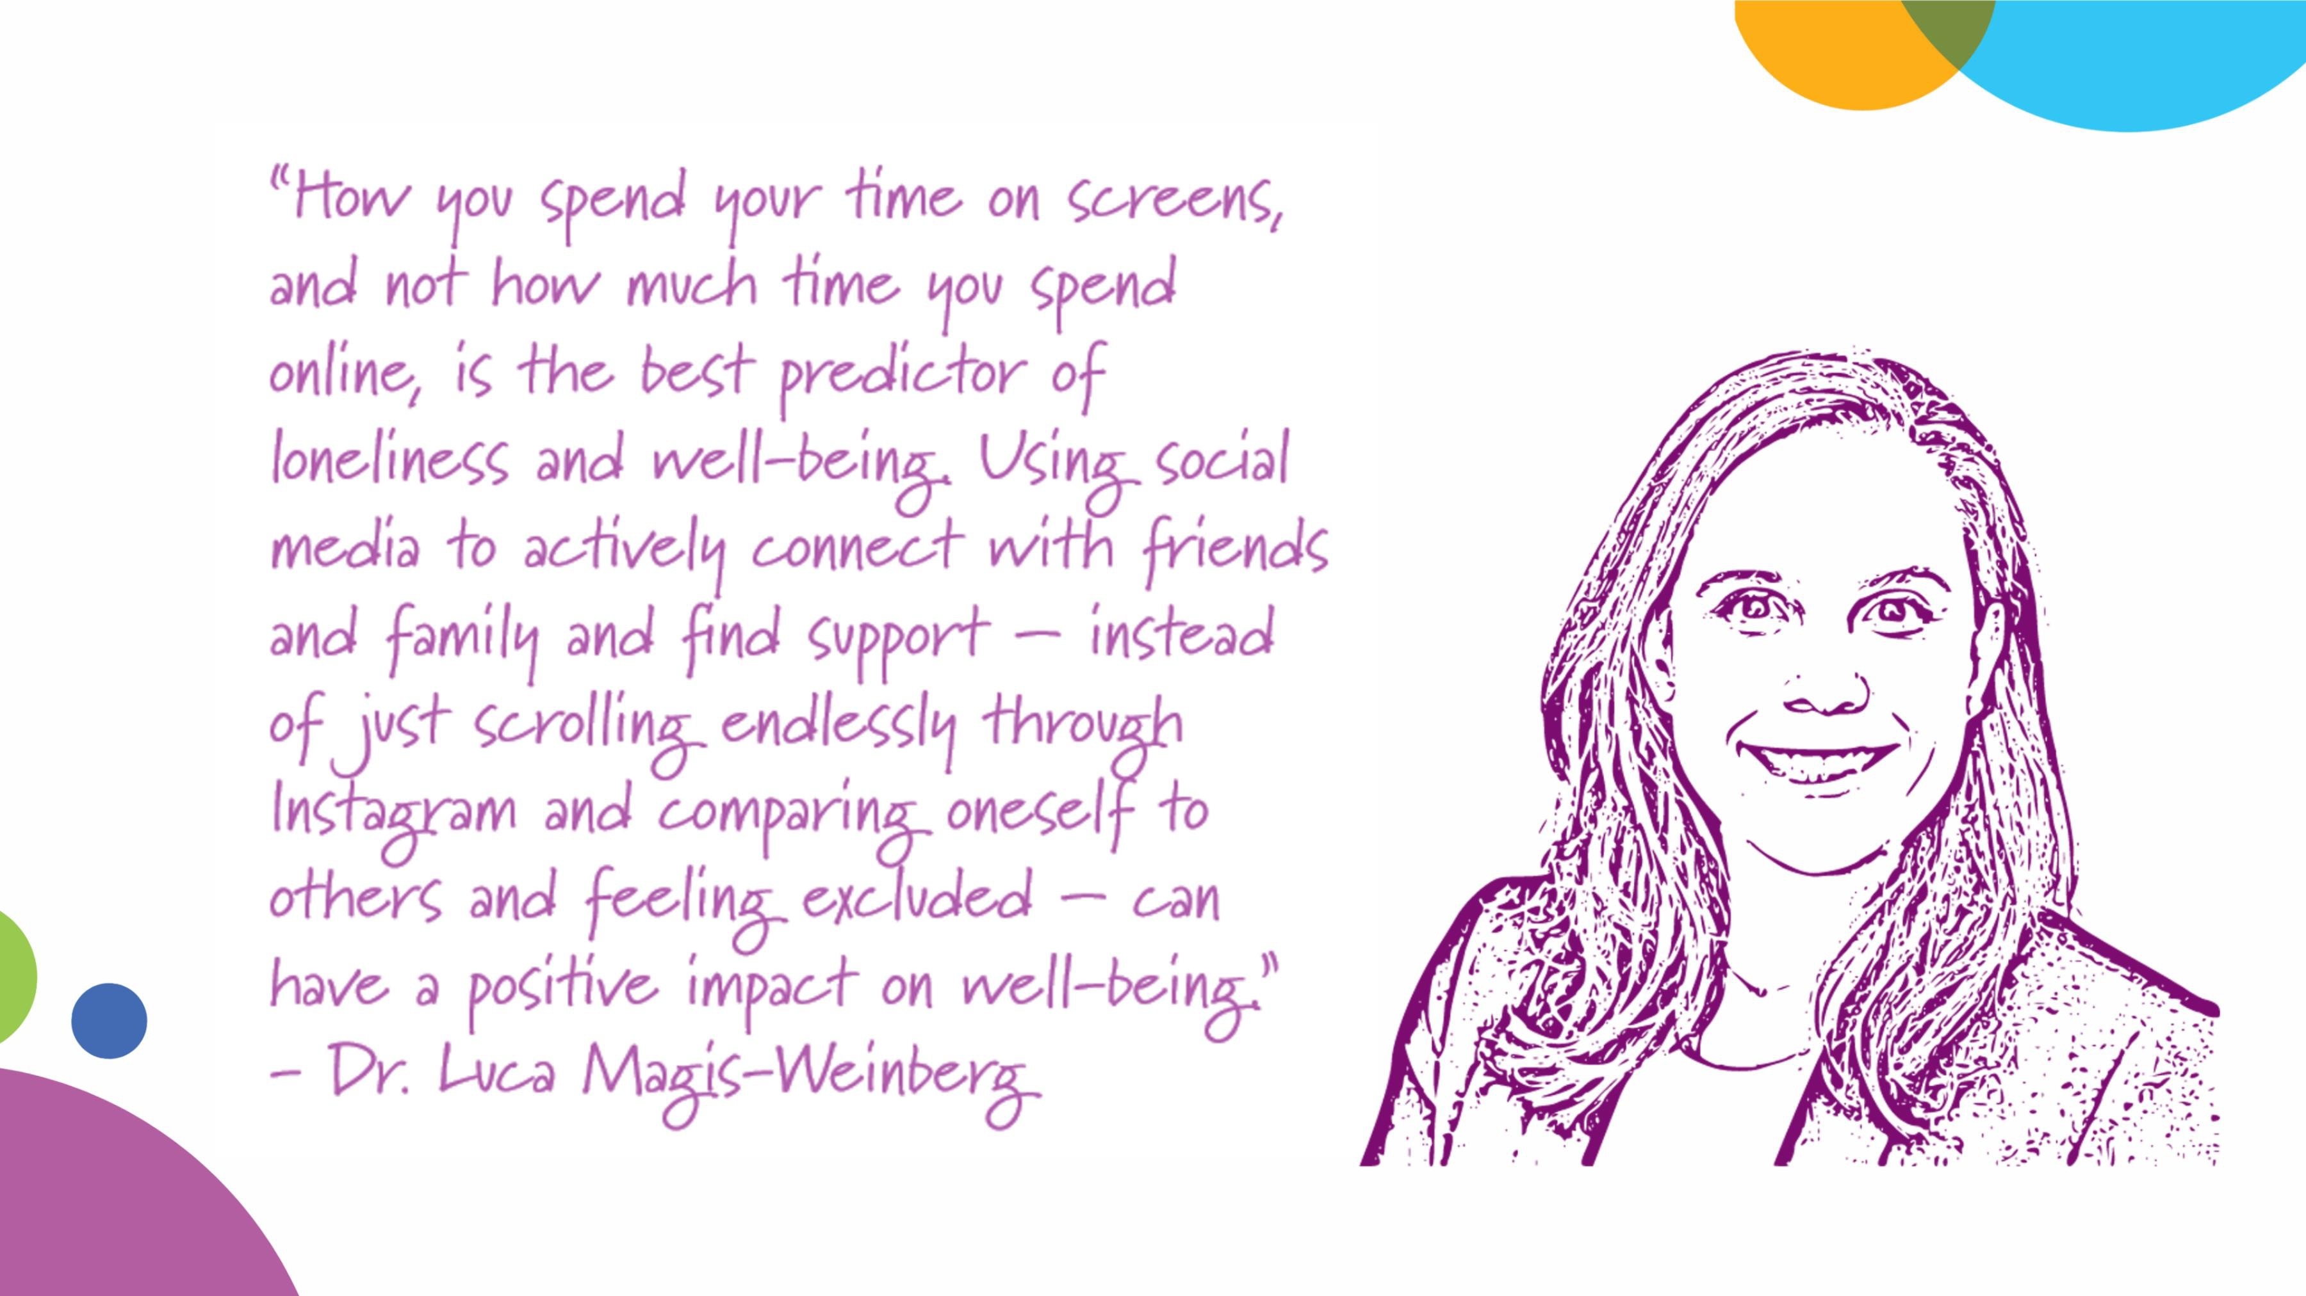
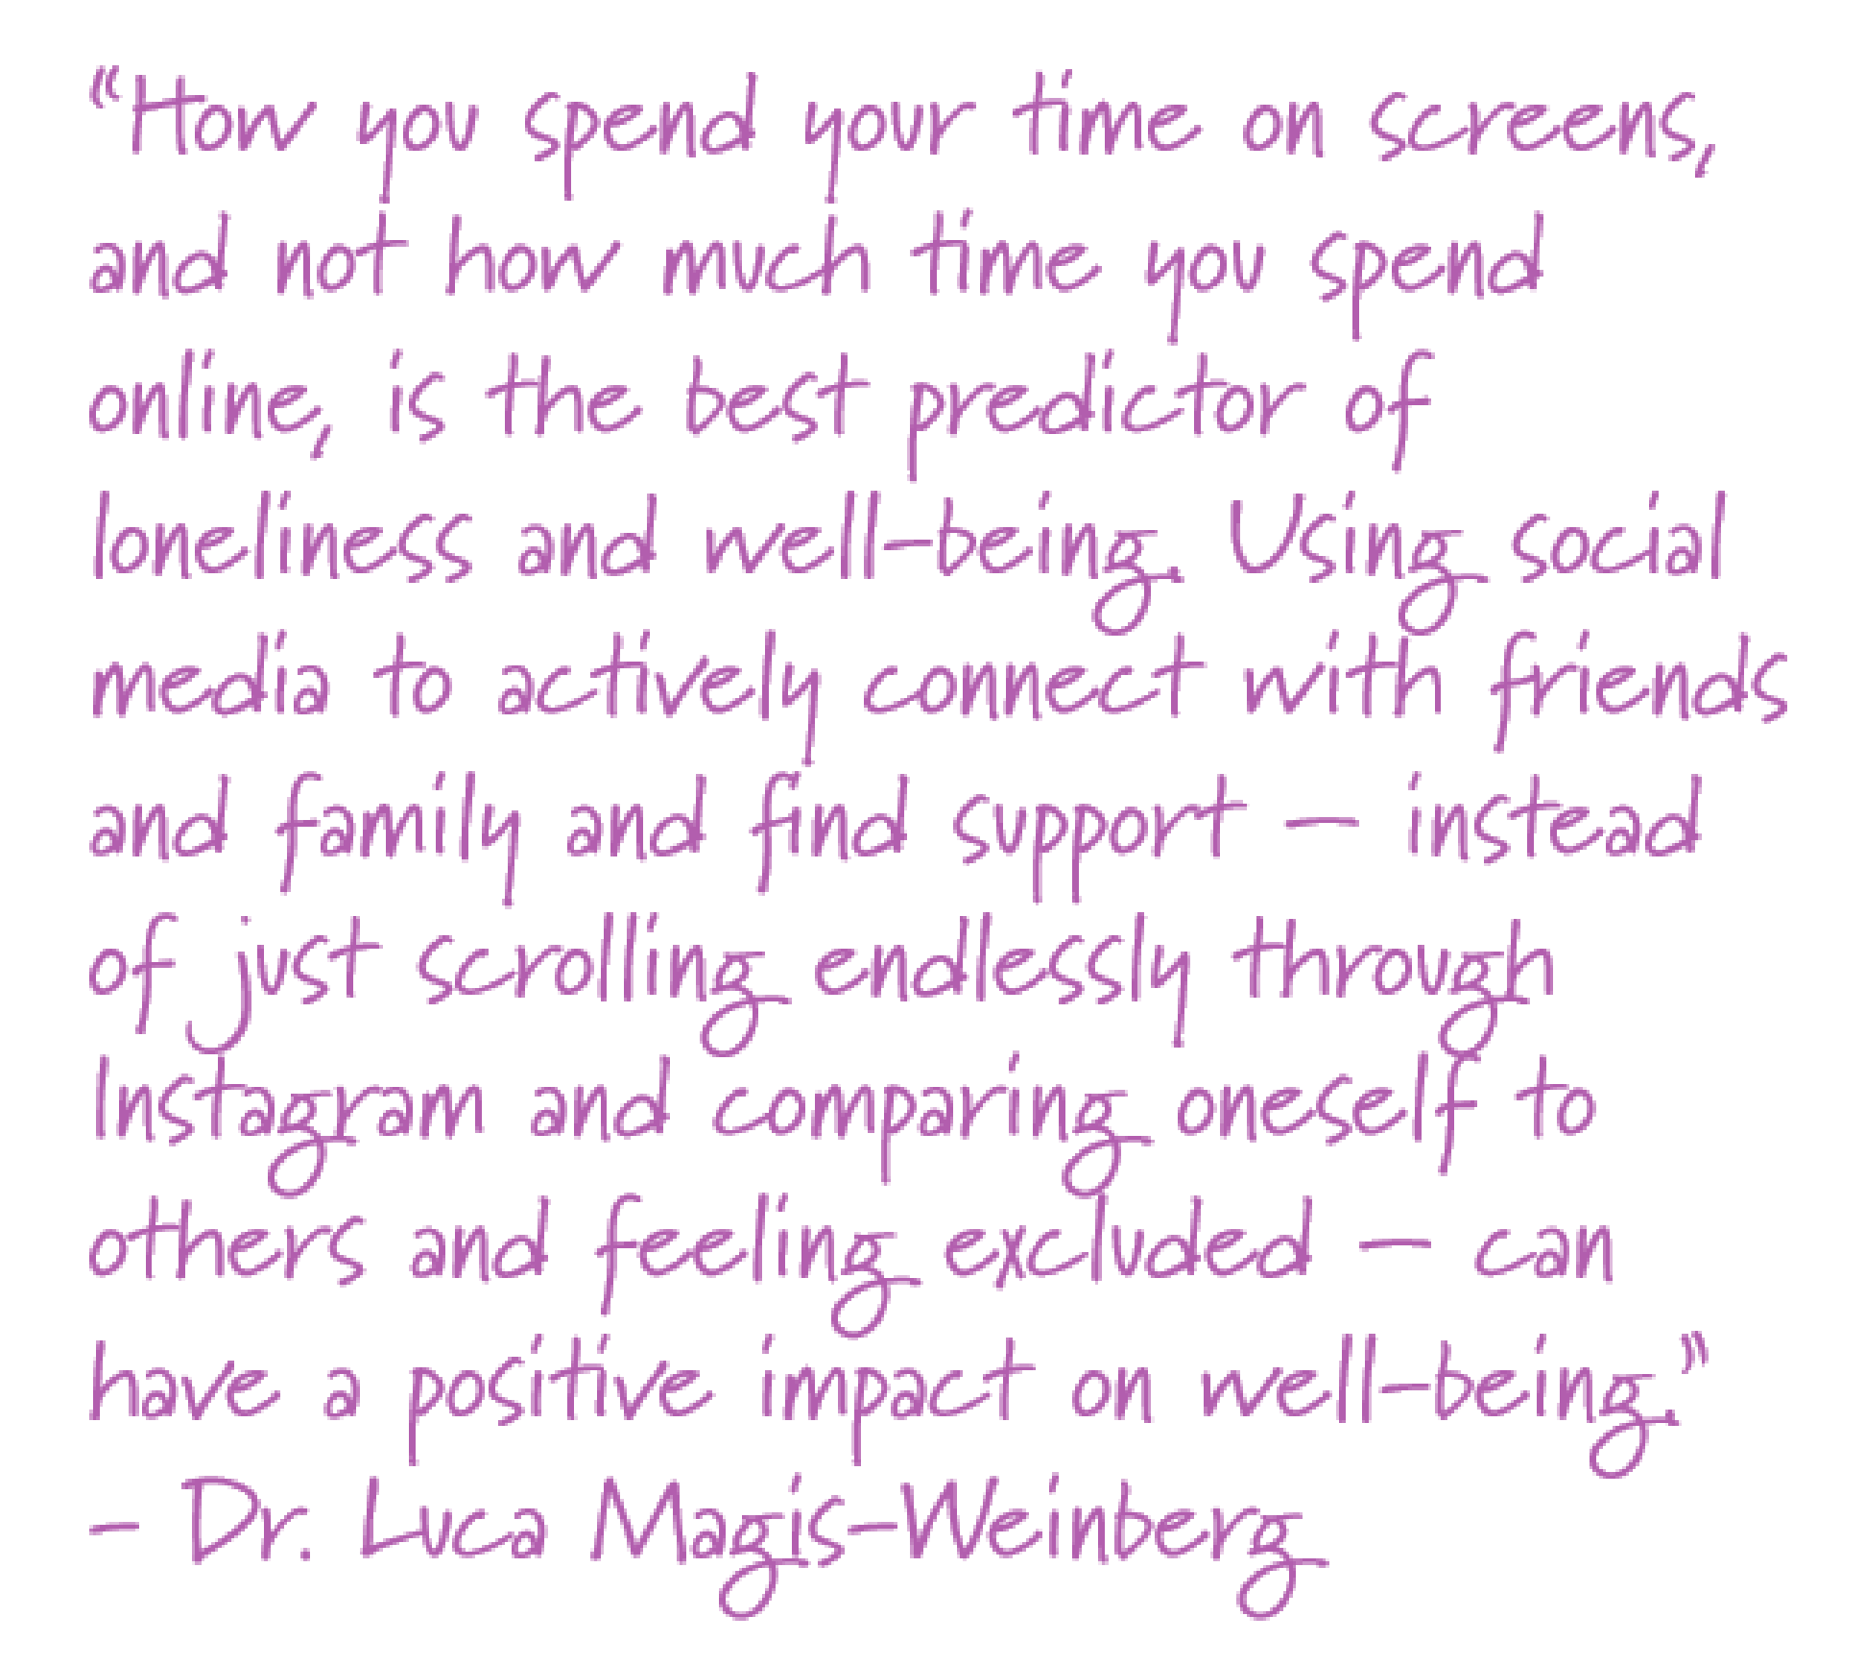
How can we use tools as though they had been changed?-1
Notes:
Of course, the time we spend using devices – and the ways that they may displace or interfere with other activities – are just part of how media can affect us.
Researchers like Dr. Luca Magic-Weinberg have found that overall, “how you spend your time on screens, and not how much time you spend online, is the best predictor of loneliness and well-being.”
Different activities may have different effects than others. One study found that young users of social media typically felt worse after browsing other people’s posts, but felt better after posting content themselves or after sending their own messages.

Slide 33
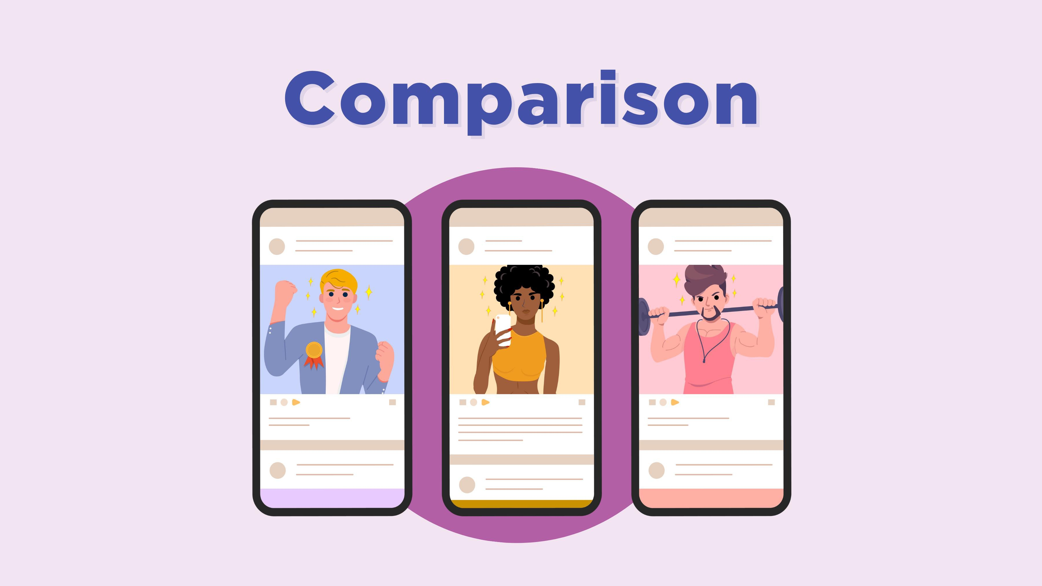
Comparison
Notes:
While social media can lead to experiences like cyberbullying and exposure to extreme content, what is much more common is comparing ourselves to other people. When we compare other people’s lives as we see them in social media – carefully filtered and chosen to make them look good – we may end up think they’re better looking and happier than we are. Some research suggests that it’s comparison, more than anything else, that makes the difference in whether social media has a positive or negative effect.

Slide 34
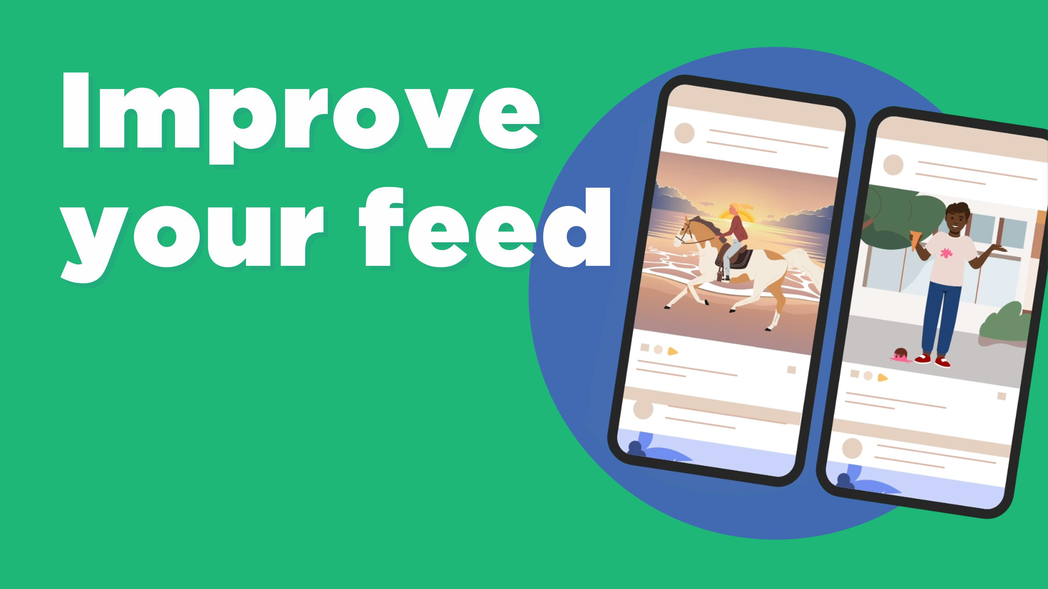
Improve your feed
Notes:
We can help our kids avoid the “comparison trap” by curating their social feeds.
These feeds come to us partly as a result of people we’ve chosen to follow, so we can curate them by muting or unfollowing people who make us feel bad about ourselves.
But a lot of what we see online is also determined by recommendation algorithms.

Slide 35
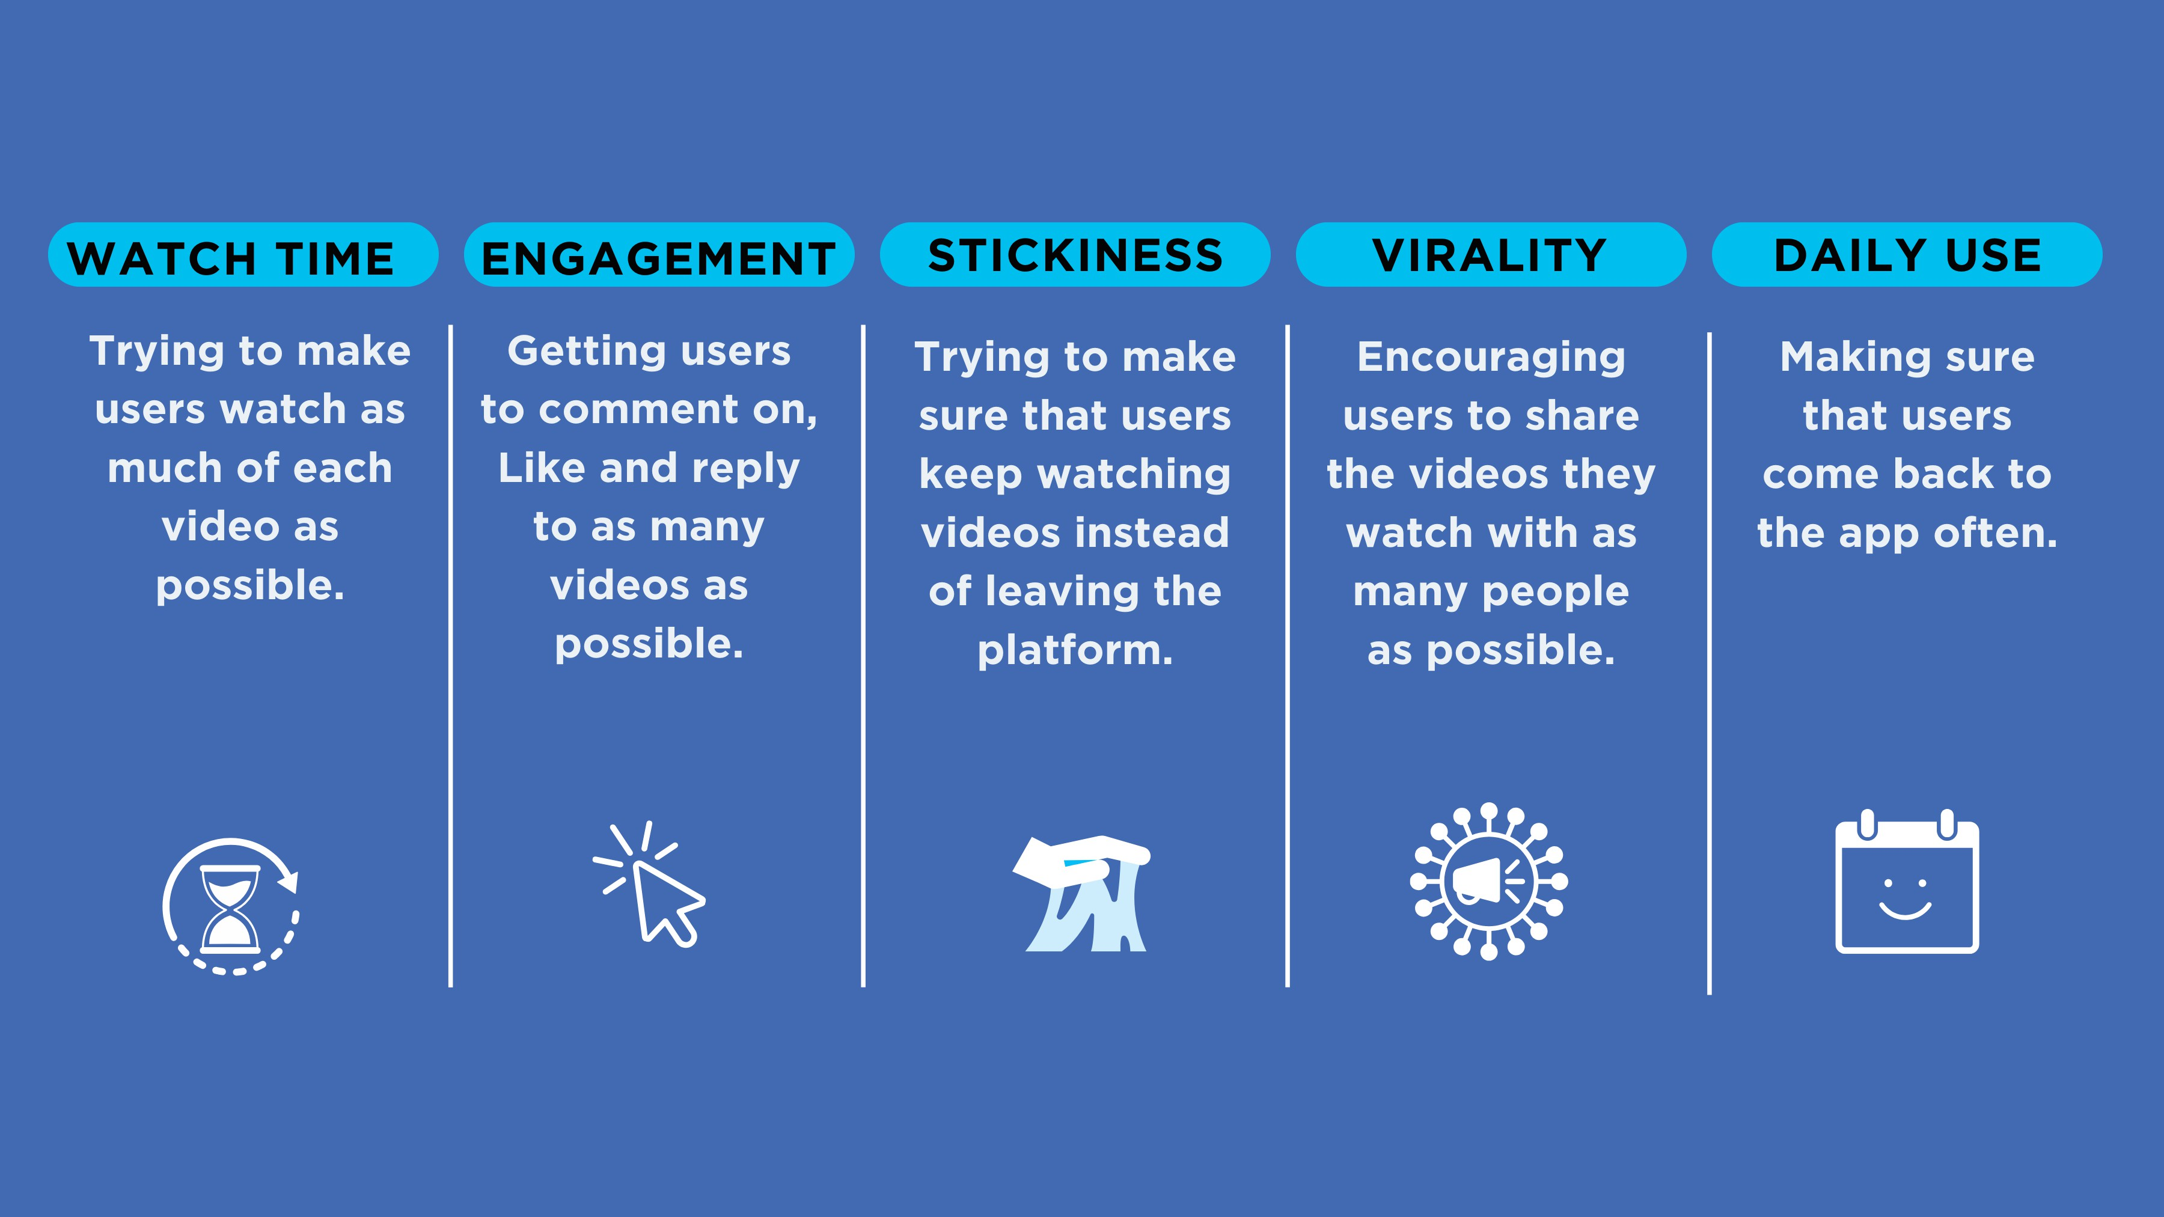
Improve your feed-1
_{WATCH TIME}
_{ENGAGEMENT}
_{STICKINESS}
_{VIRALITY}
_{DAILY USE}
Trying to make users watch as much of each video as possible.
Getting users to comment on, Like and reply to as many videos as possible.
Trying to make sure that users keep watching videos instead of leaving the platform.
Encouraging users to share the videos they watch with as many people as possible.
Making sure that users come back to the app often.
Notes:
Different algorithms are optimized for different things, but in general they’re aimed at trying either to get you to spend more time on the app, or to come back more often. Here, for example are some of the different things a video app might be optimized for:
Total watch time;
Getting users to engage with the content through commenting or replying;
Keeping users on the platform;
Encouraging users to share what they watch with others;
And making sure that users come back at least once a day.
Any particular app may be optimized for several of these things, with some having more “weight” than others, and they change over time as video makers and advertisers learn how to “game” the algorithm.
Unfortunately, the content that makes us watch longer, be engaged, share with our friends or come back often isn’t necessarily what’s good for us or our mental wellness.
Think about any app you use that shows videos – whether that’s a social network or a streaming site like Netflix. What do you think their recommendation algorithm is optimized to do?

Slide 36
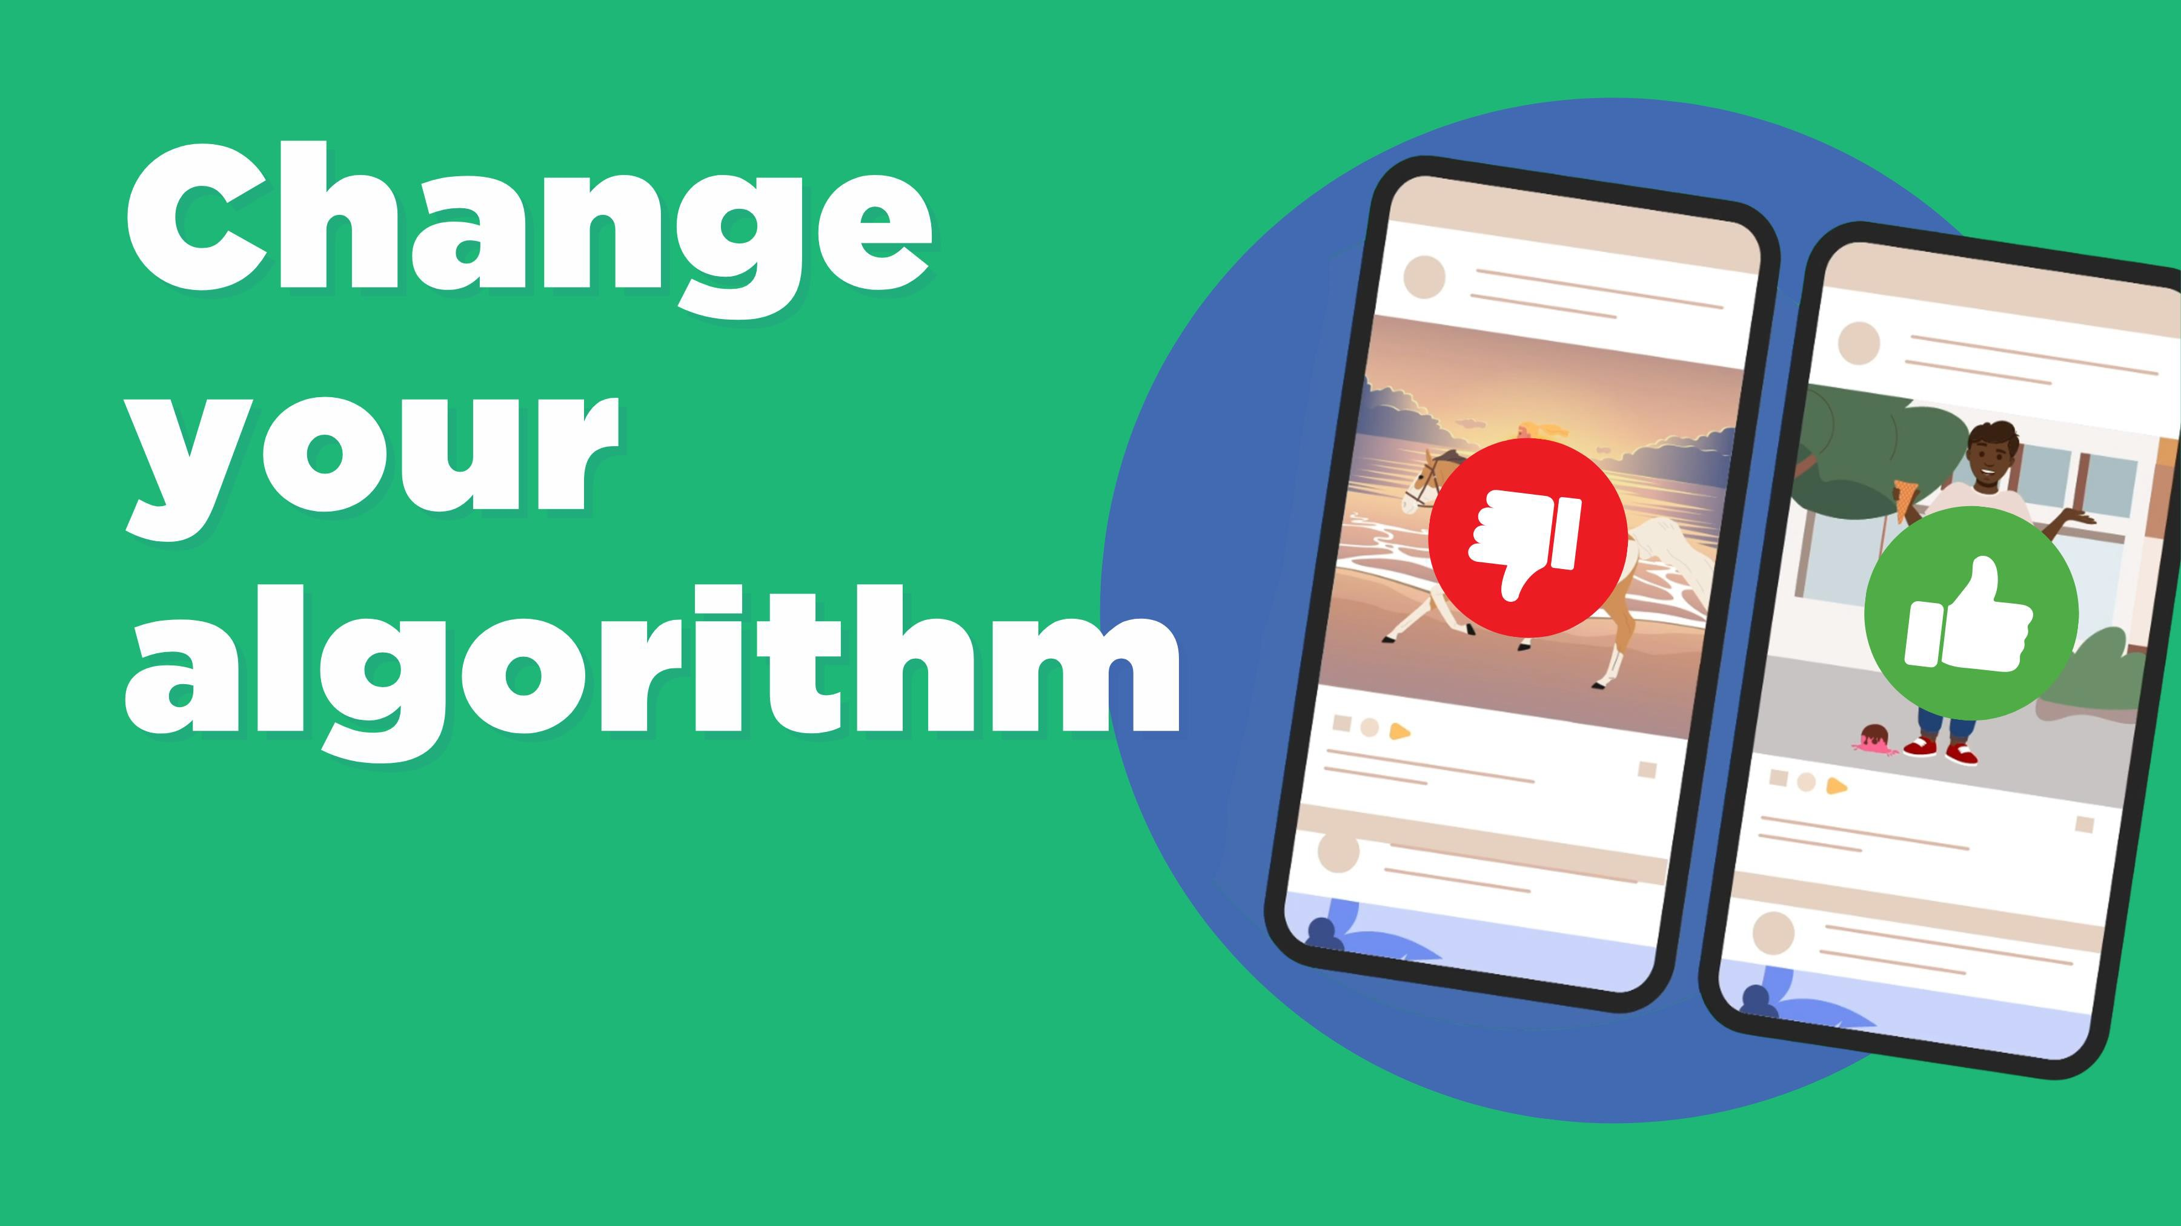
Change your algorithm
Notes:
Fortunately, we can also take steps to change our algorithms and make apps show us more of the content that make us feel good, and less of what doesn’t.

Slide 37
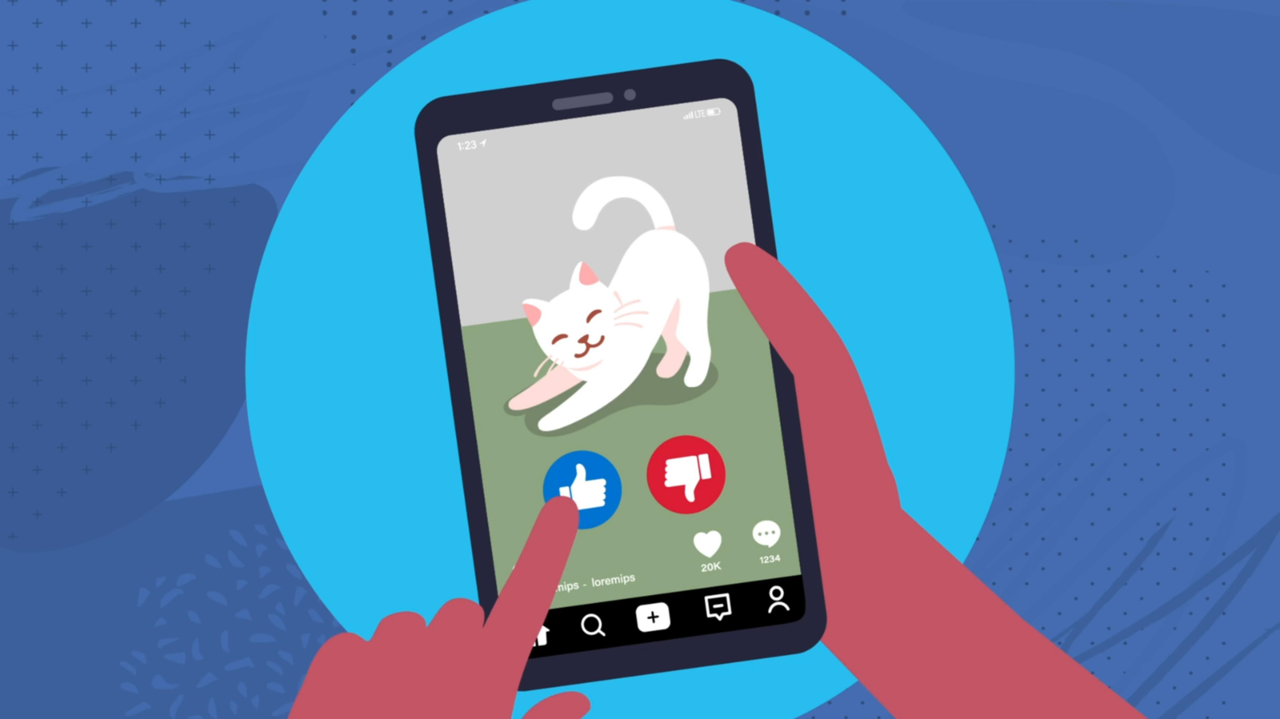
Change your algorithm-1
Notes:
Different apps let you do this in different ways, but in general “Liking” something or watching it all the way to the end will show that you want more of something. Swiping away or giving a thumbs-down does the opposite.
Some apps, like TikTok, let you clear what they know about you and start fresh. Starting from there, it took me only about fifteen minutes to train it to show me nothing but cat videos.

Slide 38
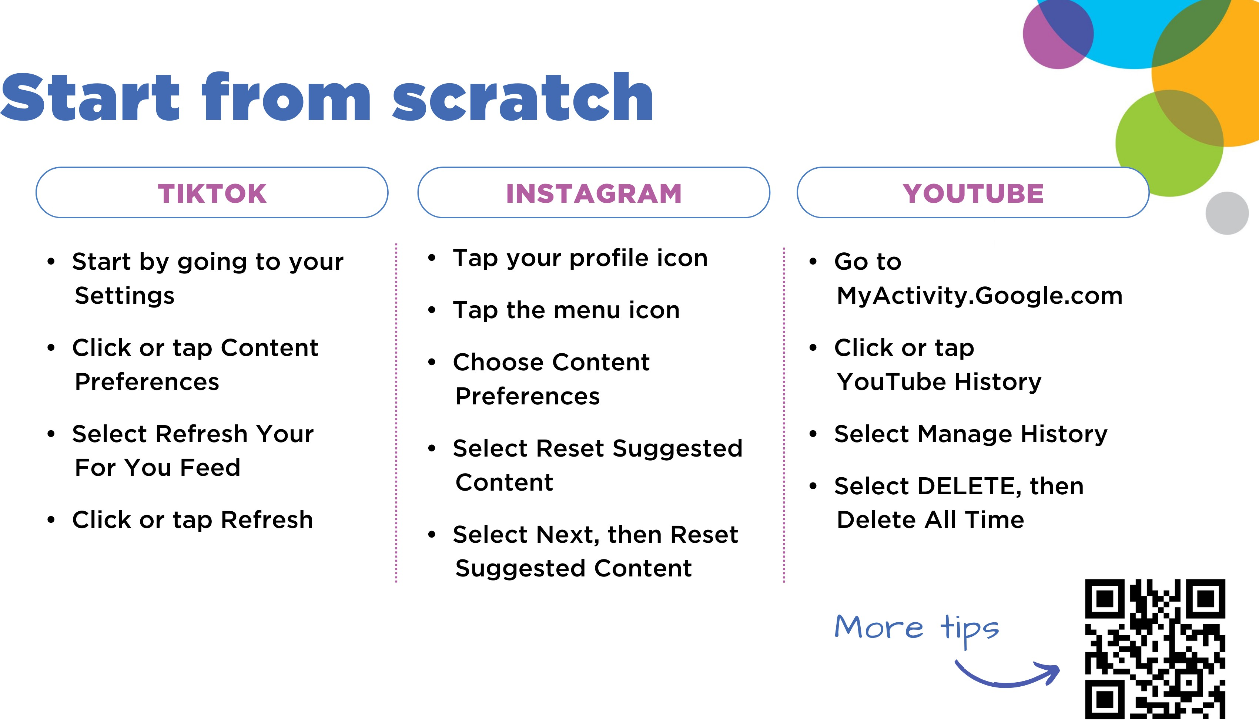
_{Start from scratch}
_{TIKTOK}
_{INSTAGRAM}
_{YOUTUBE}
Start by going to your Settings
Click or tap Content Preferences
Select Refresh Your For You Feed
_{Click or tap Refresh}
_{Tap your profile icon}
_{Tap the menu icon}
_{Choose Content Preferences}
_{Select Reset Suggested Content}
Select Next, then Reset Suggested Content
_{Go to}
_{MyActivity.Google.com}
_{Click or tap YouTube History}
_{Select Manage History}
Select DELETE, then Delete All Time
More tips
Notes:
Here’s how you do that on three popular apps:
TikTok
Start by going to your Settings
Click or tap Content Preferences
Select Refresh Your For You Feed
Click or tap Refresh.
Instagram
Tap your profile icon (bottom right of the screen)
Tap the menu icon (the three lines at the top right)
Choose Content Preferences
Select Reset Suggested Content
Select Next, then Reset Suggested Content.
YouTube
Go to Myactivity.google.com (you don’t need to include the capital letters, they’re just there for clarity)
Click or tap Manage Your Watch History
Select Delete Activity
Choose All Time.

Slide 39
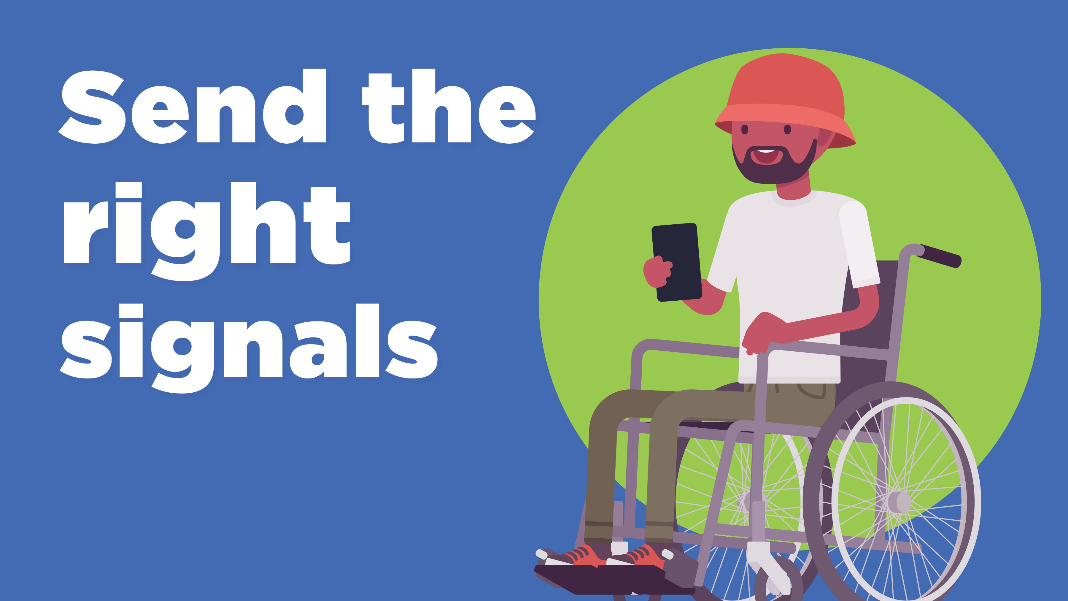
Send the right signals
Notes:
Now you can start to consciously retrain your algorithm by sending the right signals.

Slide 40
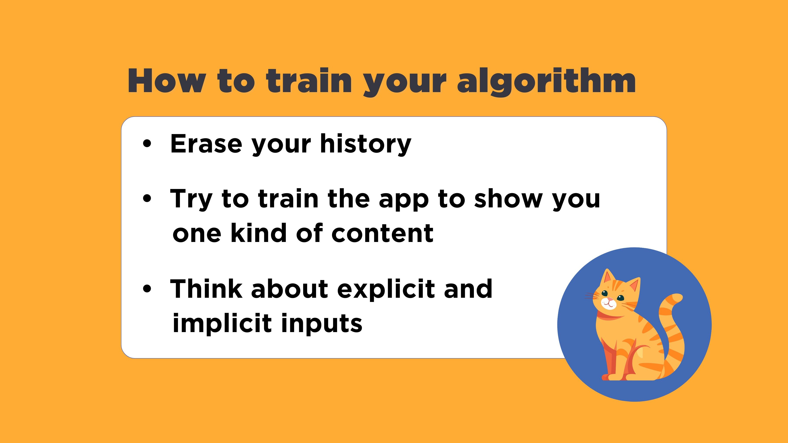
_{How to train your algorithm}
_{Erase your history}
Try to train the app to show you one kind of content
Think about explicit and implicit inputs
Notes:
Here’s an experiment you can try after resetting your algorithm: try to get the app to only show you one kind of content – all cat videos, for example. How long does it take?
What works better – liking videos, watching them all to the end, or something else?
If it gives you options for negative feedback, like “Not interested” or “Don’t recommend” buttons, test how well those work at weeding out the content you don’t want to see.
Remember that building a positive digital experience is an ongoing process. By understanding how algorithms work and taking steps to train them effectively, you can curate a more positive online environment.

Slide 41
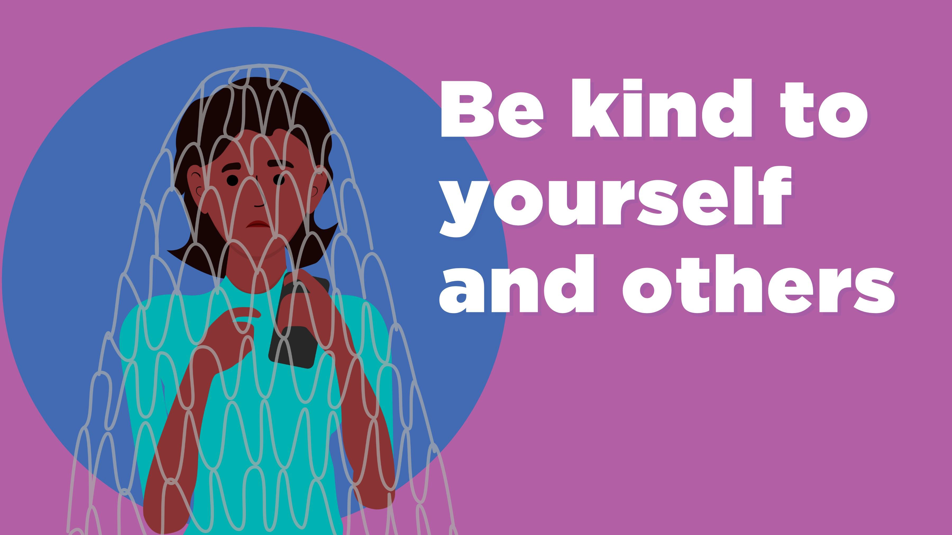
_{Be kind to your and others}
Notes:
We also want kids to understand that everyone is under the same pressures that they are to always be available and to present an ideal picture of themselves.

Slide 42
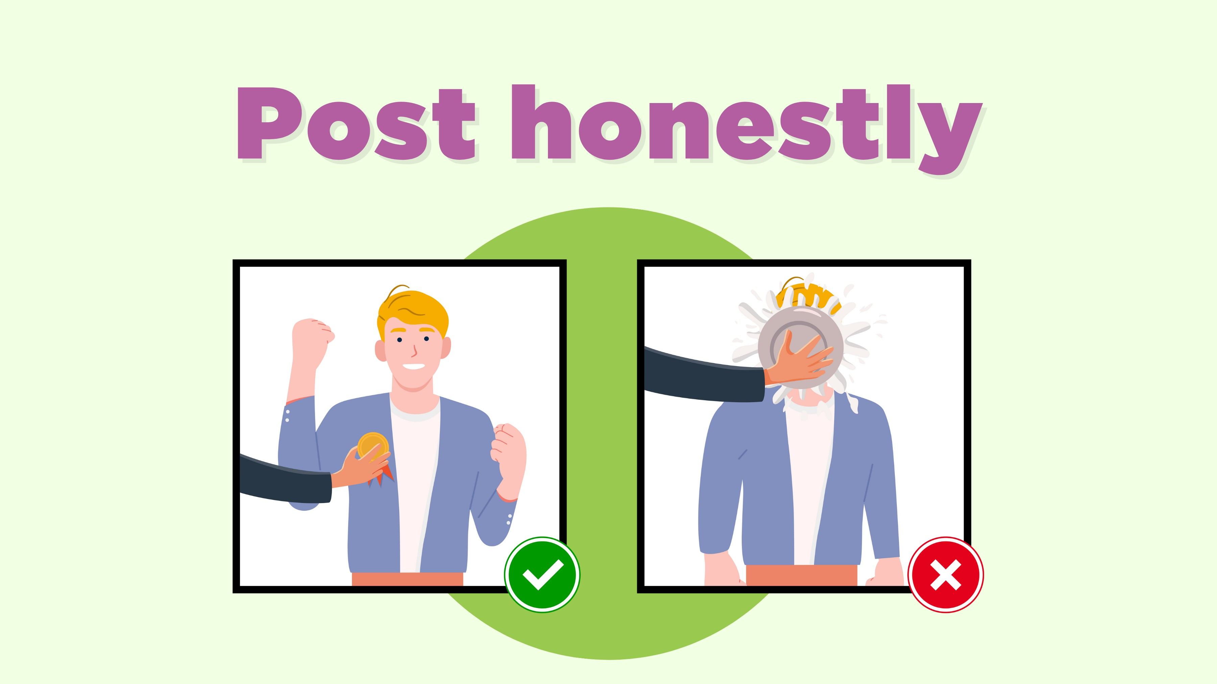
Post honestly

Slide 43
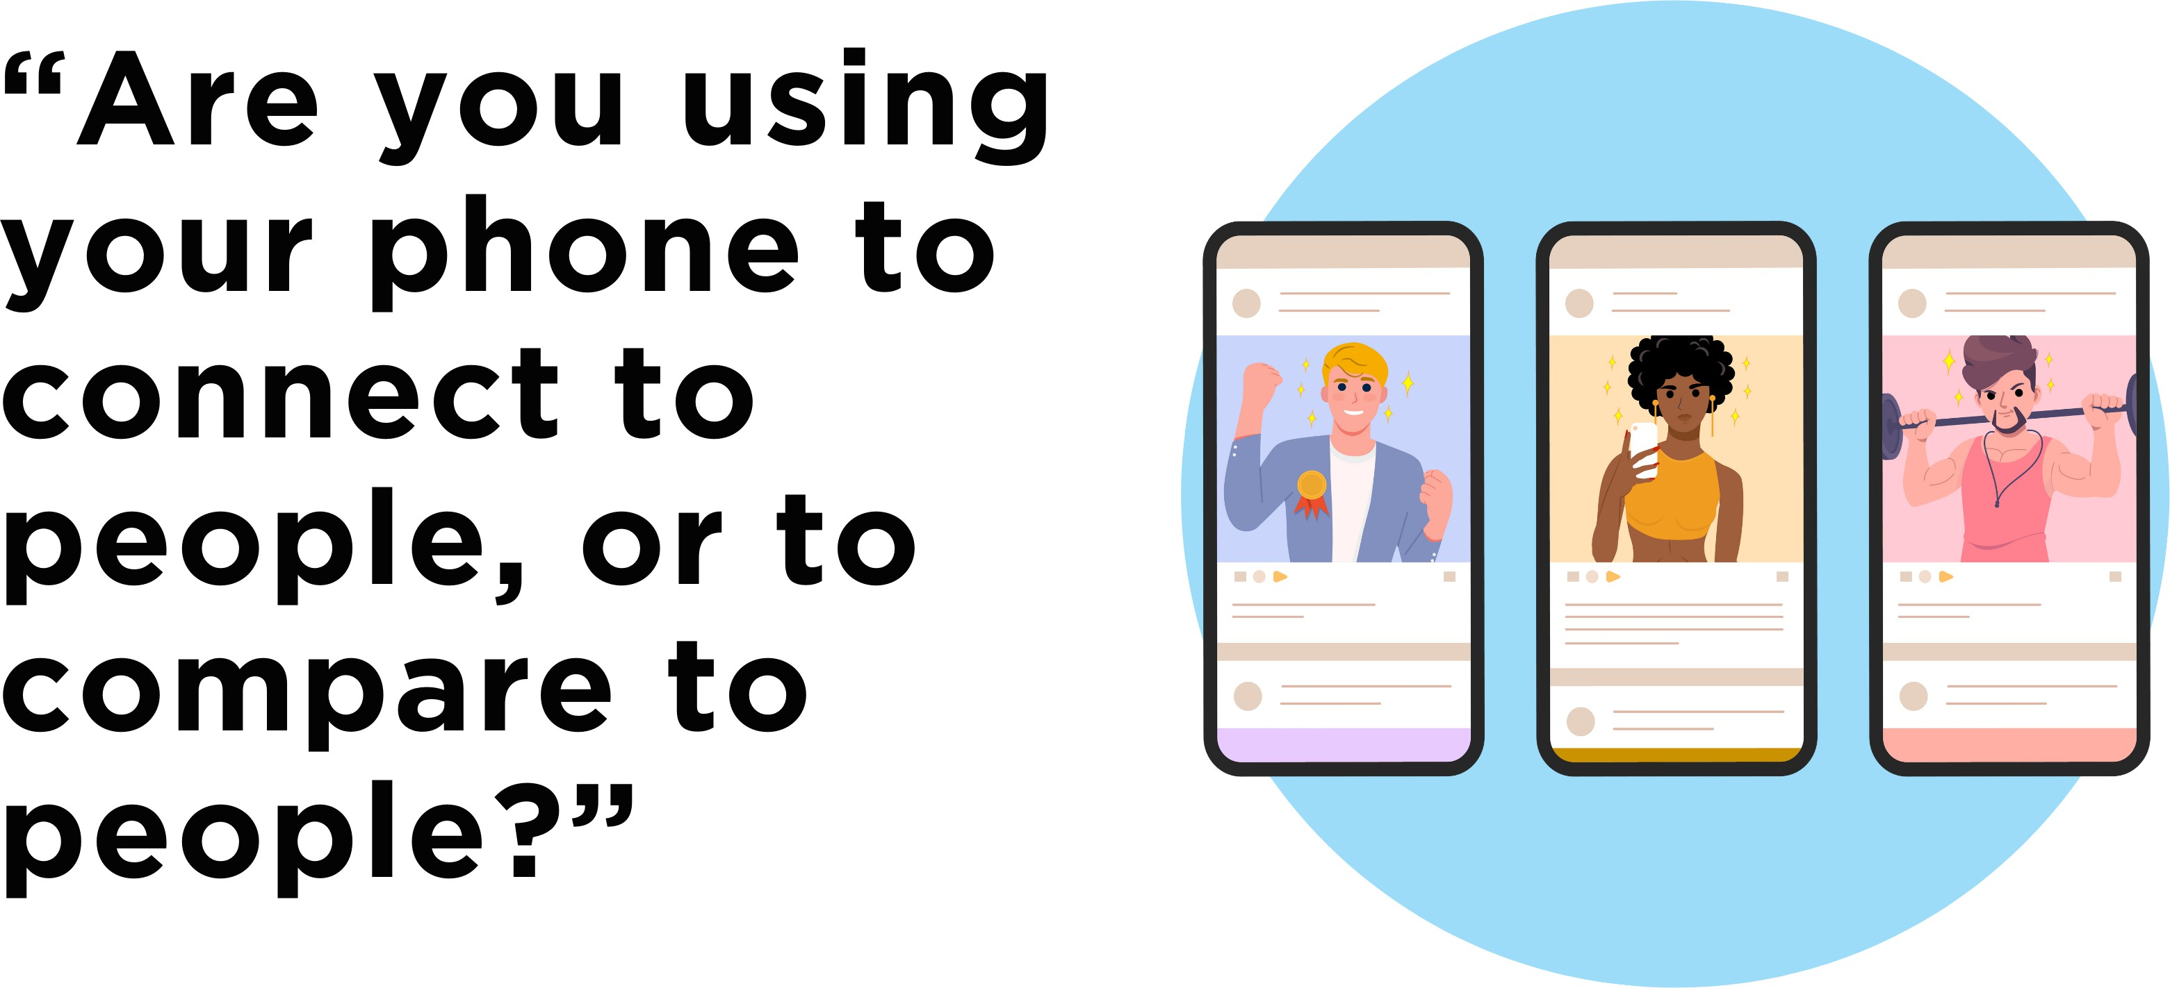
“Are you using your phone to connect to people, or to compare to people?”
Notes:
Because social media is an important part of how teens stay in touch with friends and family, and can be a valuable way of socializing, psychologist Dr. Tara Porter suggests having kids reflect on this question: “Are you using your phone to connect to people, or to compare to people?”
Recent research has shown that one reason kids find it hard to unplug – especially overnight – is that they worry about not being there when their friends need them, so make sure they’ve told their friends that their mean old parents won’t let them check their apps or notifications at night. (They may not thank you, but odds are good they’ll be secretly grateful for it.)

Slide 44
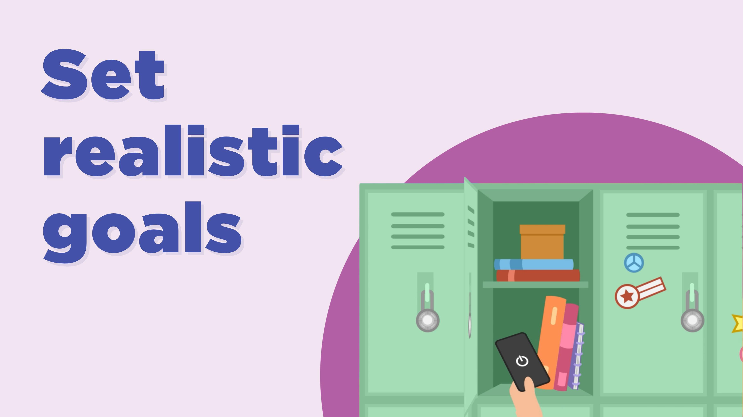
Set realistic goals
Notes:
Both good and bad habits are like muscles: they get stronger the more you practice them. The stronger they are, the harder they are to change.
But just like building muscles, you can’t do too much all at once. Small, consistent changes work better than big ones, so it’s important to set realistic goals for ourselves, especially when we’re just getting started.
It may also be better to put devices away completely in situations where we really don’t want to be distracted.

Slide 45
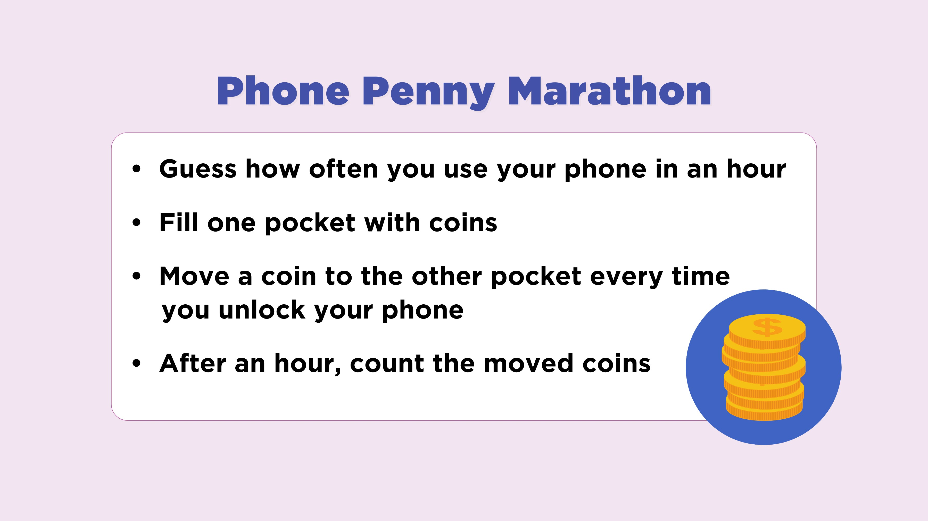
_{Phone Penny Marathon}
Guess how often you use your phone in an hour
_{Fill one pocket with coins}
Move a coin to the other pocket every time you unlock your phone
After an hour, count the moved coins
Notes:
This exercise, the “phone penny marathon,” is a good way of gauging your current habits.
Guess how often you check your phone every hour.
Fill one pocket with pennies or other small coins or objects.
Pick an hour of the day when you usually use your phone at least once, or set a timer for an hour.
Each time you unlock your phone, move one of the pennies to another pocket.
At the end of the hour, count the pennies in the second pocket to see how many times you unlocked your phone.
If you don't have any pennies or other small items you can use (or you don't have pockets), use this variation:
Set your phone face-down in front of you.
Each time you unlock your phone, put it down a bit further away when you're done.
How far away from you is the phone at the end of the hour?

Slide 46
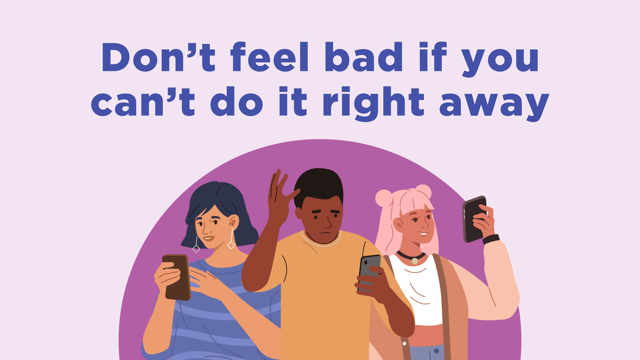
Don’t feel bad if you can’t do it right away
Notes:
All of us, adults and kids, are dealing with these issues, and we often underestimate how our tech habits affect the other people in our lives.
We need to commit and take steps to develop better habits, but we also need to have compassion for ourselves if we don’t get things right immediately. Habits take time to build, especially when we’re trying to reverse bad habits, and feeling guilty actually reduces self-control in the future.

Slide 47
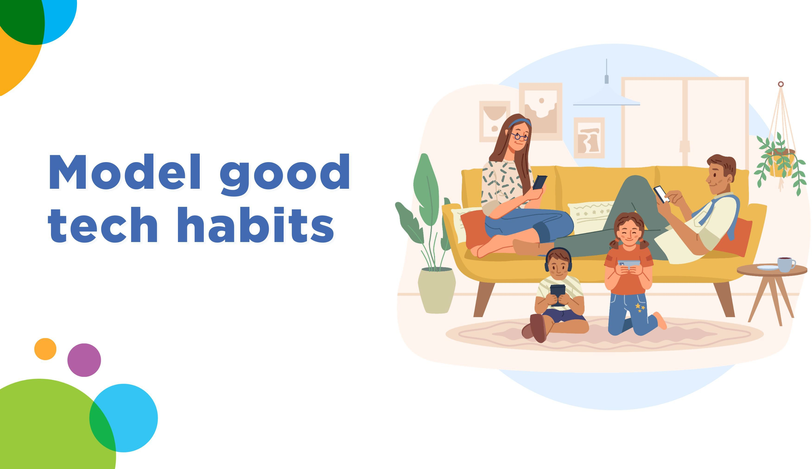
_{Model good tech habits}
Notes:
Finally, as adults in kids’ lives, we also need to make sure we're modeling good tech habits for our kids. What we do with devices sends a louder signal than anything we can say, so you can think about how these might help you manage your own phone use, too.​

Slide 48
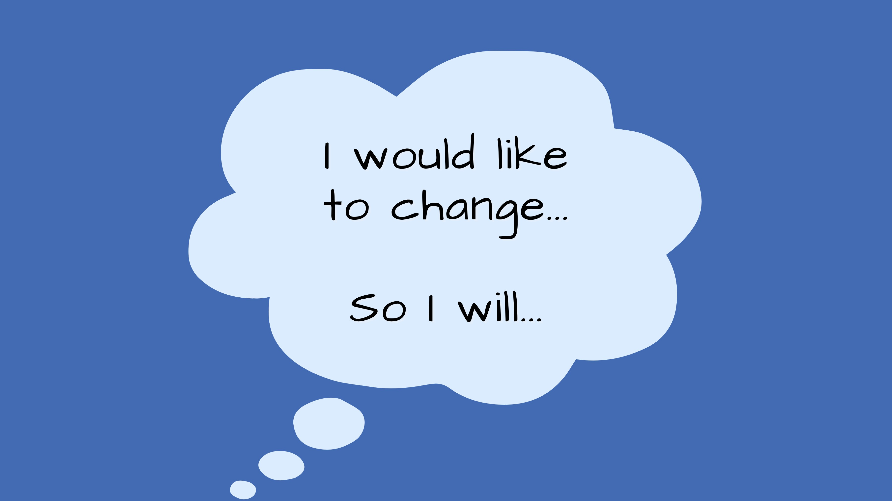
I would like to change…
So I will…
Notes:
You can start by choosing just one habit related to device use that you want to change.
It can be a habit that you don’t want, and want to interrupt, or it can be one that you want to build and make stronger.
Be as specific as possible about the habit and how you want to change it – instead of saying “I want to spend less time on Instagram,” for example, you might say “I want to spend a half an hour or less per day on Instagram.”
Think about what triggers or “cues” the habit, and what you can do to make it harder or easier.
Finally, ask how you’ll know if your habit is changing the way you want it to.
What habit did you choose? How can you start to change it? How will you know if it’s working?
(If delivering remotely): You can put those into the chat if you like.
Now you can do the same exercise with your kids. Remember to pick a habit that they want to change – but as we’ve seen, half of kids feel they spend too much time on their phones.

Slide 49

Thank you!
_{info@mediasmarts.ca}
_{MediaSmarts.ca}
Disclaimer: Bell provides financial support to MediaSmarts.
MediaSmarts does not endorse any commercial entity product or service, and not endorsement is implied.

