Slide 1


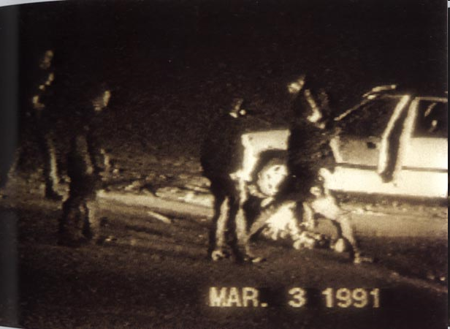
A History of Citizen Journalism
March 3, 1991: The beating of Rodney King by Los Angeles Police Department officers is videotaped by a bystander. The footage leads to the arrest and trial of four of the officers. Their acquittal sparks the Los Angeles riots of 1992.
Notes:
www.mediasmarts.ca
© 2016 MediaSmarts A History of Citizen Journalism ● Page 1 of 8
The Citizen Journalist ● Overhead

Slide 2
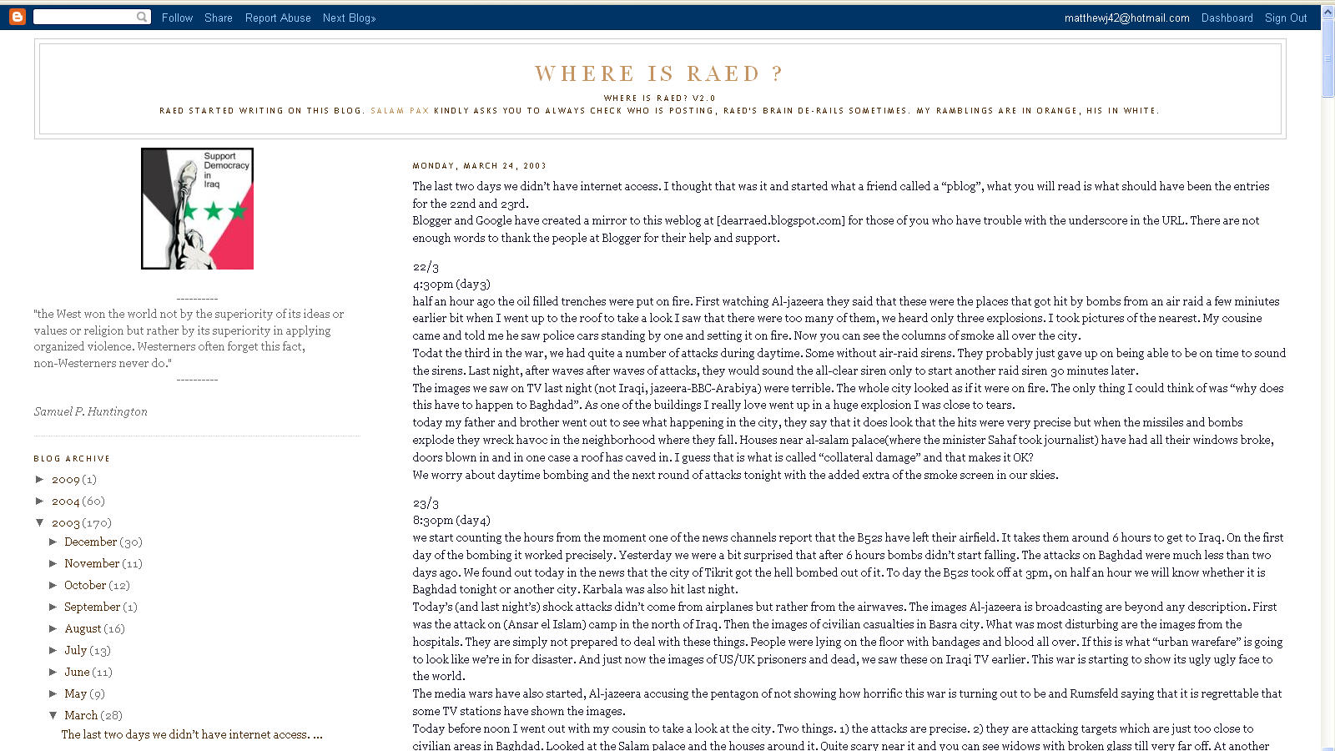
A History of Citizen Journalism
… half an hour ago the oil filled trenches were put on fire. First watching Al-jazeera they said that these were the places that got hit by bombs from an air raid a few minutes earlier bit when I went up to the roof to take a look I saw that there were too many of them, we heard only three explosions. I took pictures of the nearest…
2003: Iraqi blogger “Salam Pax” provides coverage of the war in Iraq from the perspective of his home in Baghdad. His blog describes the bombing of the city and the chaos that followed the fall of Saddam Hussein.

Slide 3
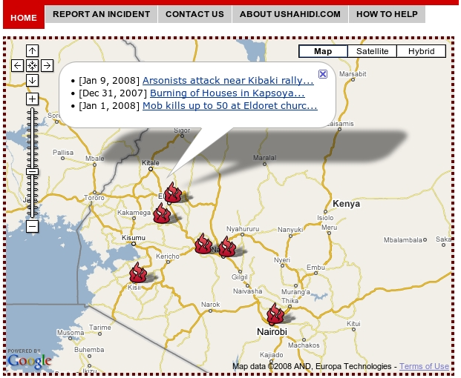
A History of Citizen Journalism
2008: Website Ushahidi (“testimony” in Swahili) is created to collect and map eyewitness reports of violence following the 2007 elections in Kenya. It has since been used to track political violence in South Africa and Congo, to monitor elections in India and Mexico, and to aid humanitarian efforts in places such as Haiti and Chile.

Slide 4
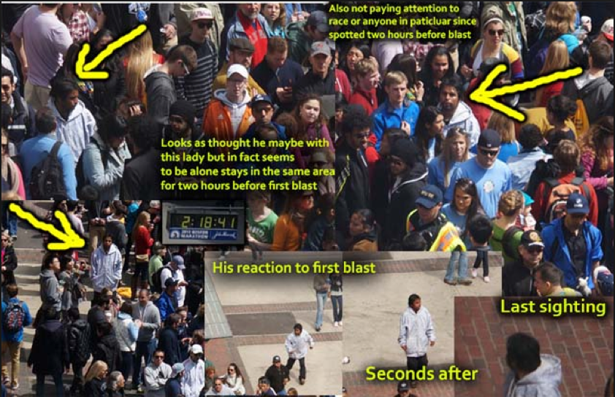
A History of Citizen Journalism
2013: Following the Boston Marathon bombings, users of the online forum Reddit misidentify several people in photos as suspects. This mistaken information spreads onto other online sources and eventually to mainstream media, including the New York Post, before being corrected.

Slide 5
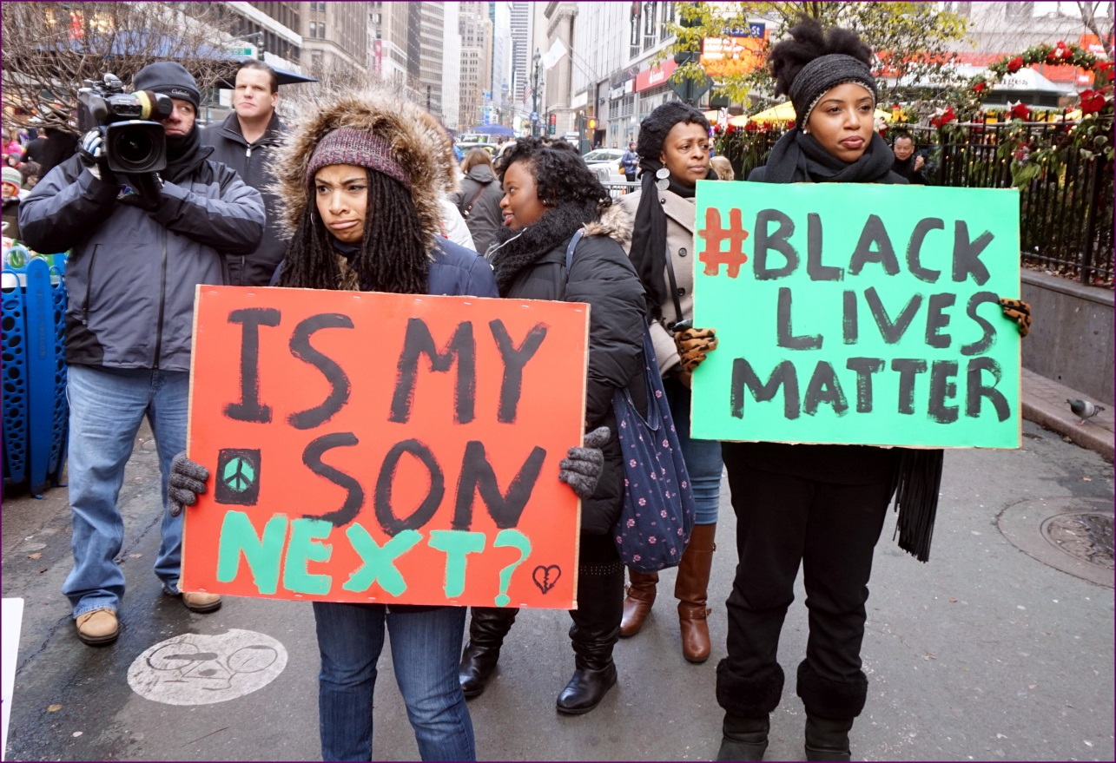
A History of Citizen Journalism
2013: The shooting of African-American youth Trayvon Martin inspires the Twitter hashtag #blacklivesmatter, which gives its name to a political movement in the wake of other deaths of African-American youth – especially at the hands of police officers – in 2014 and 2015.

Slide 6
A History of Citizen Journalism
2018: CBC opens the first of its “pop-up” news bureaus, where reporters use citizen journalism tools such as smartphones and laptops to cover news in places with few or no news outlets.

Slide 7
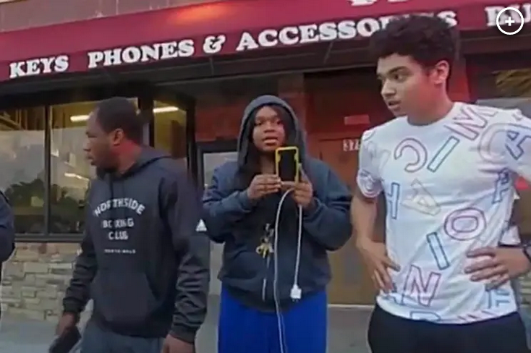
A History of Citizen Journalism
2020: 17-year-old Darnella Frazer films Minneapolis police officer Derek Chauvin killing George Floyd. The video goes viral, inspiring protests against police racism and brutality throughout the summer and providing evidence that contributes to Chauvin’s conviction for murder.

Slide 8
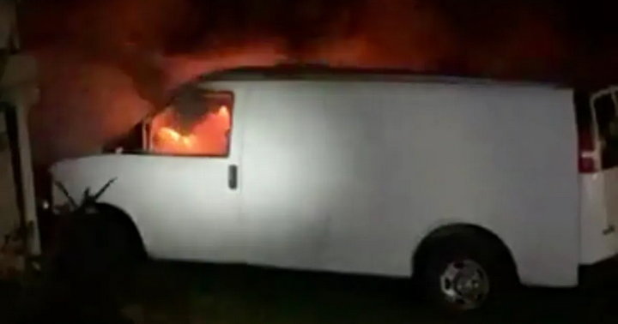
A History of Citizen Journalism
2020: Mi’kmaw fishers use Facebook Live and TikTok to document acts of racism and violence against them, including a van and a lobster pound being destroyed by fire.

Slide 9
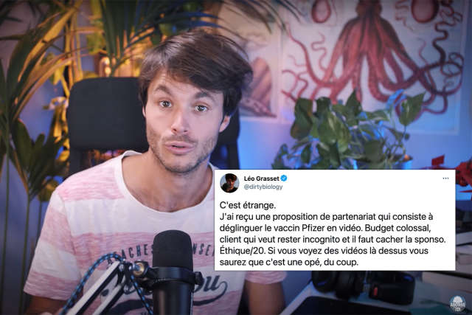
A History of Citizen Journalism
2021: YouTubers in France and Germany are approached by a marketing company to spread disinformation about COVID vaccines. Both pretended to go along with it and then used their YouTube channels to report on the story.

Slide 10
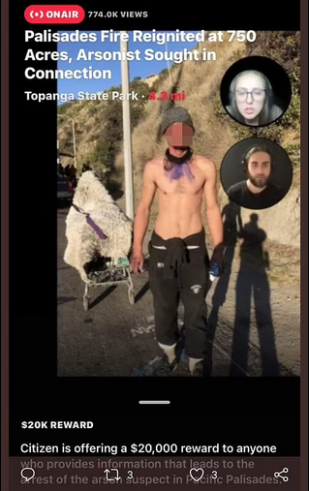
A History of Citizen Journalism
2021: Citizen, a neighbourhood watch app, offers a $30,000 reward for footage of a person suspected of starting a wildfire in California. The suspect’s name and photo are displayed for hours on the app before it becomes clear he is innocent.

