Slide 1
IMAGES OF MEDIA STEREOTPYES

Slide 2
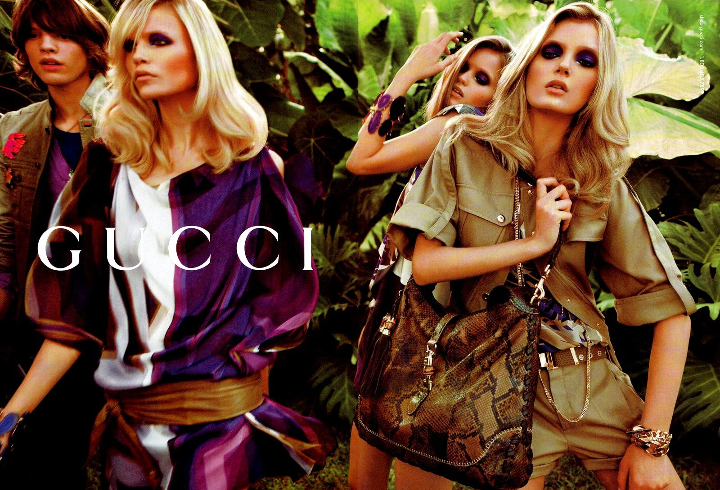
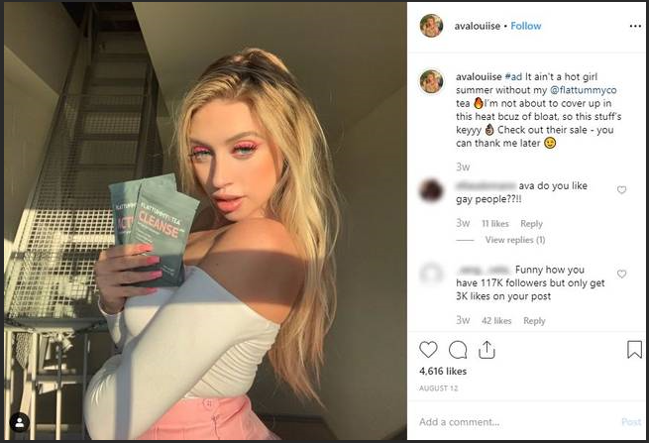

Slide 3
